Slide 1

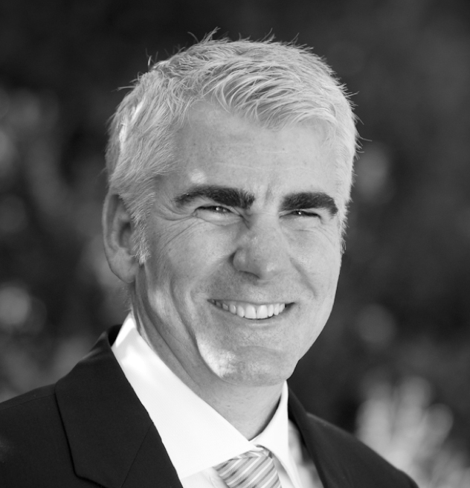

Michael Ahearn
VP Customer Development & Strategy, Sinch for Marketing
Mobile messaging strategist for dozens of Fortune 500 companies
Co-founder one of the first US mobile marketing firms in 2004
Mobile Marketing Association Individual Impact Award Winner 2019
Multiple MMA Campaign Awards & Nominations
Former NA MMA Board Member
About Sinch
Including SAP Digital Interconnect & Wavy (Brazil)
$1.3b
8 of 10
145+ bn
Annual revenue
and profitable
Serving 8 of the 10 largest U.S. tech companies
Transactions
per year
1,000+
370
80+
Enterprise customers
Direct operator connections
Operator customers
NASDAQ
2,100+
In 47+
Publicly listed on
NASDAQ in Stockholm
Employees
Countries
Notes:
Engagement through messaging is our foundation, and today we are 1600+ people strong, with a local presence in over 40 markets.
We are consistently profitable and enjoyed a 26% YoY growth 2018-2019
We are trusted to deliver 40 billion engagements a year
We serve 1000+ enterprise customers globally, including 8/10 of the largest US tech companies
We serve 80+ operator customers around the globe
We have 370 direct operator connections, offering a way to reach customers in trusted and secure channels every time
We have 1600+ employees in 30+ countries
We are publicly listed on NASDAQ in Stockholm

Slide 2

Products for enriched customer experience
Engagement
Campaigns, Conversations, AI/NLP, Personalized Video, Rich Content, Landing pages, Platform integrations, Strategic/Agency Services, Creative & Content Production, Analytics
Create meaningful 1:1 experiences at scale
Communication APIs
SMS, MMS, RCS, Numbers, Conversation API, WhatsApp, Chat Apps, Voice, PSTN, Video, Verification, 2FA
Immediate reach on any mobile channel
Super network
350+ direct operator connections, Chat integrations, Telco infrastructure, Geo-redundant, Elastic Capacity, Smart Routing, Instant Provisioning, ISO 27001, GDPR
Scalable, secure communication without middlemen

Slide 3
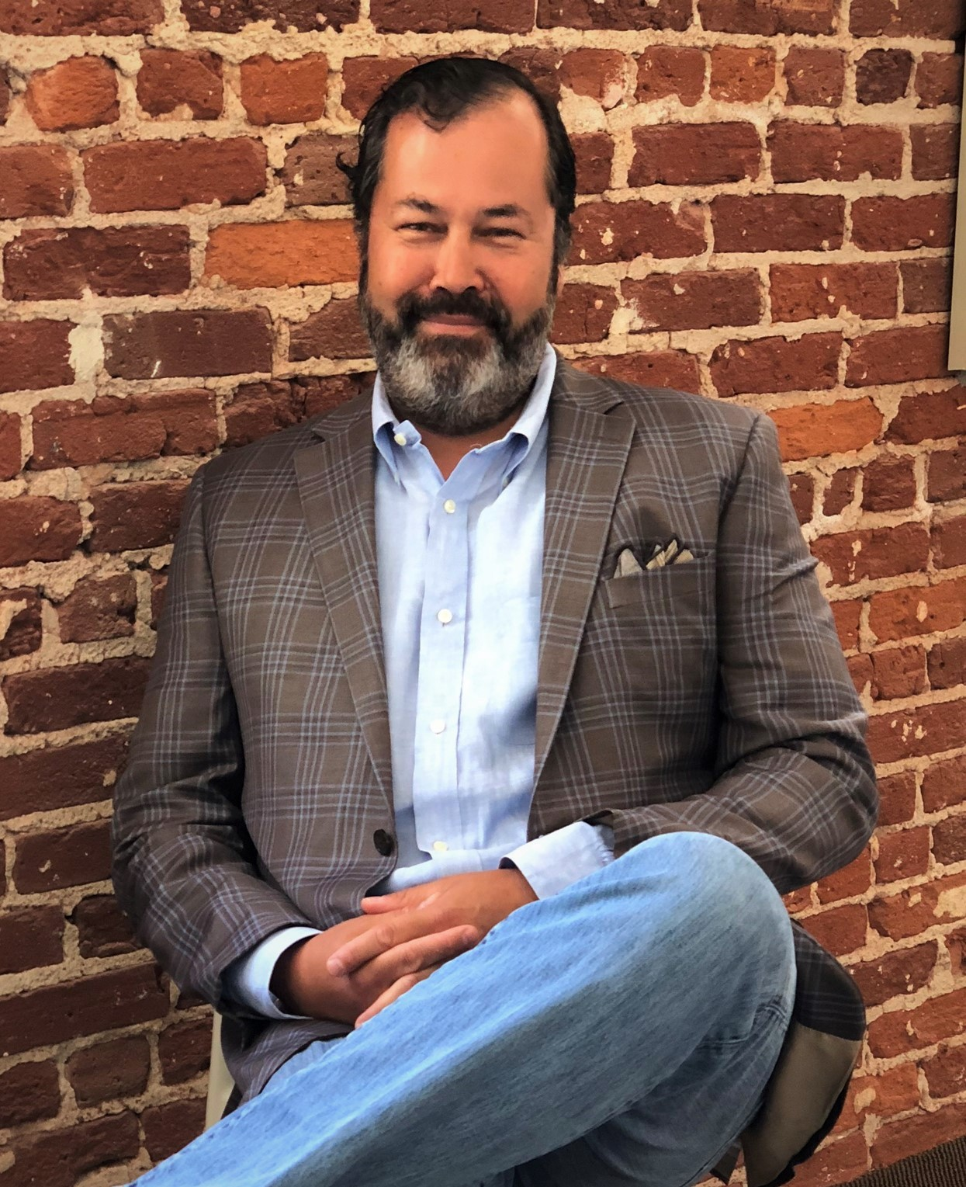


IMPACT AT SCALE
Over the course of his career, Tom’s work has directly or indirectly influenced millions of businesses and billions of people on a global basis.
GLOBAL RECOGNITION
2 appearances on AdWeek’s Top 10 List of “Most Influential People”
“Top 50 Most important people in Mobile Content”
OMMA “Interactive Marketing All-Star”
Mobile Marketing Association “Mobile Marketer of the Year”
AdAge “Digital Media Master”
Business Insider “Top 30 Most Creative People in Mobile Advertising”
Mobile Marketer/Mobile Commerce 2014 “Mobile Marketer of the Year” & “Mobile Evangelist of the Year”
2015 inductee into the “Mobile Marketing Hall of Fame

Slide 4
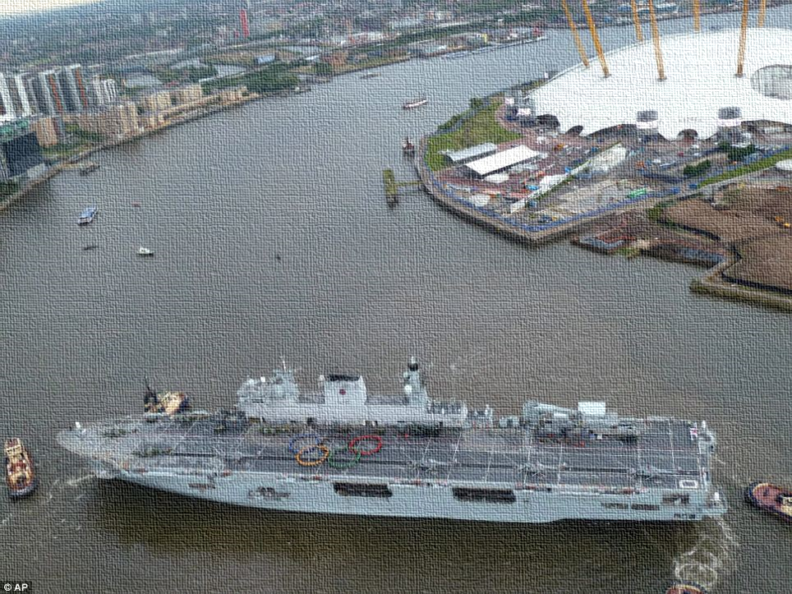
I turn big ships in small spaces toward a digital future.
Comfortable on the bridge and in the boiler room.

Slide 5
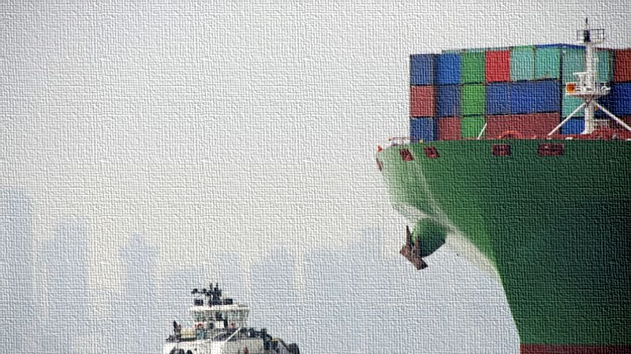
It’s somebody
else’s ship.
I’m the tiny tug.

Slide 6
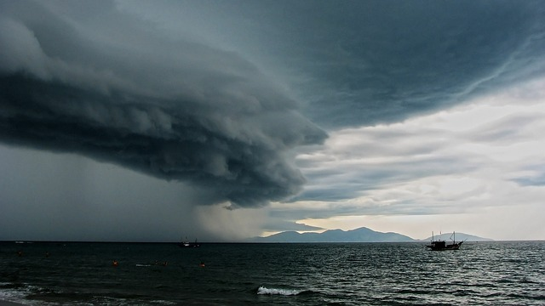
After +25 years of developing
“digital” plans, a moment of clarity:

Slide 7
After +25 years of developing
“digital” plans, a moment of clarity:
There are only two resources to manage:
Human
Resources
Financial
Resources

Slide 8
After +25 years of developing
“digital” plans, a moment of clarity:
There are only two ways to engage with human resources:
Internally
Externally

Slide 9
After +25 years of developing
“digital” plans, a moment of clarity:
Similarly, all financial resources fall into 1 of 2 buckets:
Knowable ROI
Unknowable ROI

Slide 10

Mutually Exclusive; Collectively Exhaustive.
How many “strongly agree”?
We are the one to beat in today’s world.
~25%

Slide 11
Mutually Exclusive; Collectively Exhaustive.
How many “strongly agree”?
We are the one to beat in today’s world.
~25%
Partners are delivering maximizing impact.
~11%

Slide 12
Mutually Exclusive; Collectively Exhaustive.
How many “strongly agree”?
We are the one to beat in today’s world.
~25%
Partners are delivering maximizing impact.
~11%
We get the best result from our investments.
~10%

Slide 13
Mutually Exclusive; Collectively Exhaustive.
How many “strongly agree”?
We are the one to beat in today’s world.
~25%
Partners are delivering maximizing impact.
~11%
We get the best result from our investments.
~10%
We’re positioned for the world to come.
~15%

Slide 14
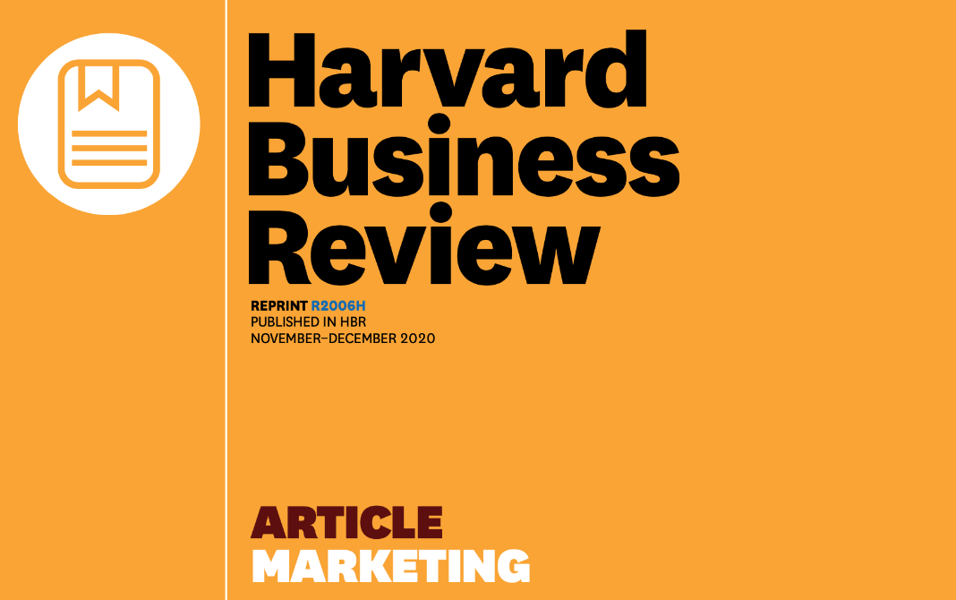
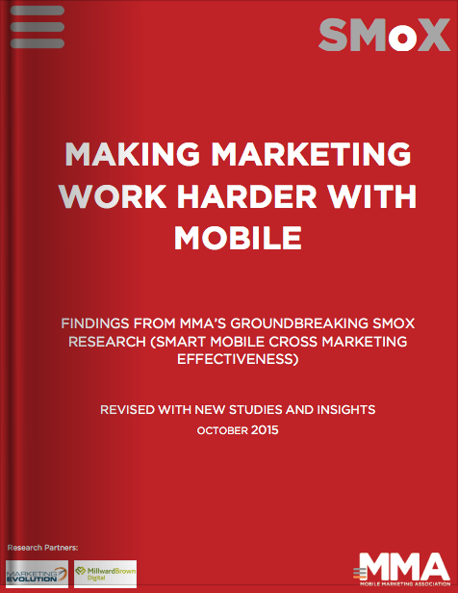
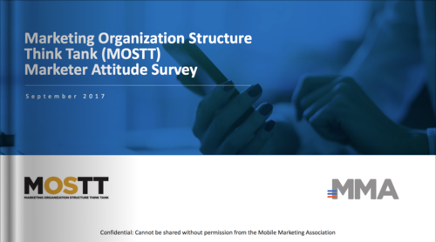
These four themes are interrelated.
2
THE ONE TO BEAT
Deeper insights into understanding how marketing creates value.
1
THE BEST RESULT
Proved the ROI, but the business didn’t change.
2
What was standing in the way?

Slide 15
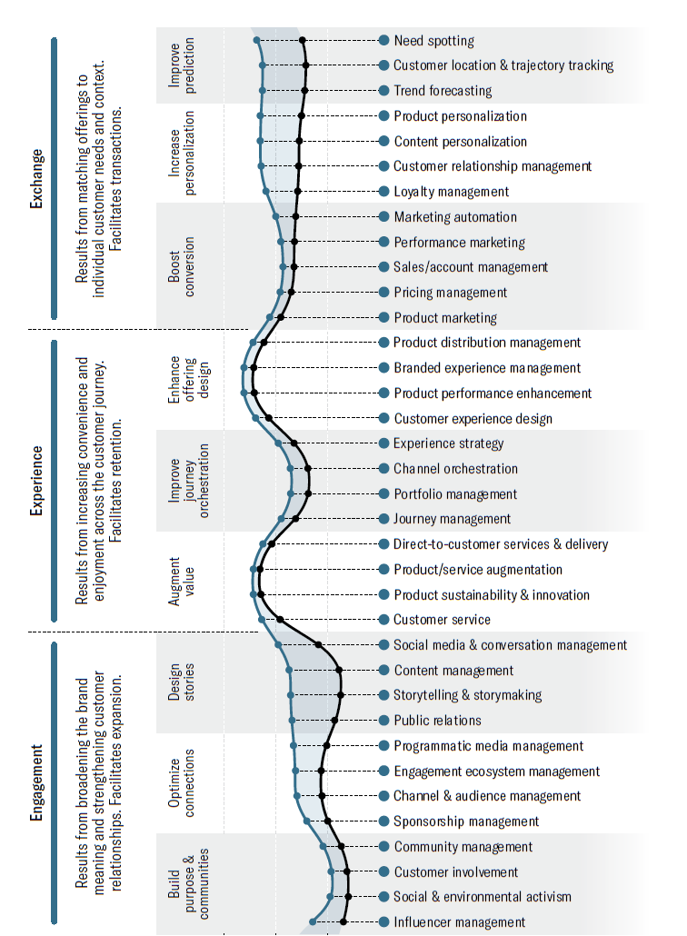
Today’s messaging plays a role in value creation.
A marketing team can
create value in three ways:

Slide 16

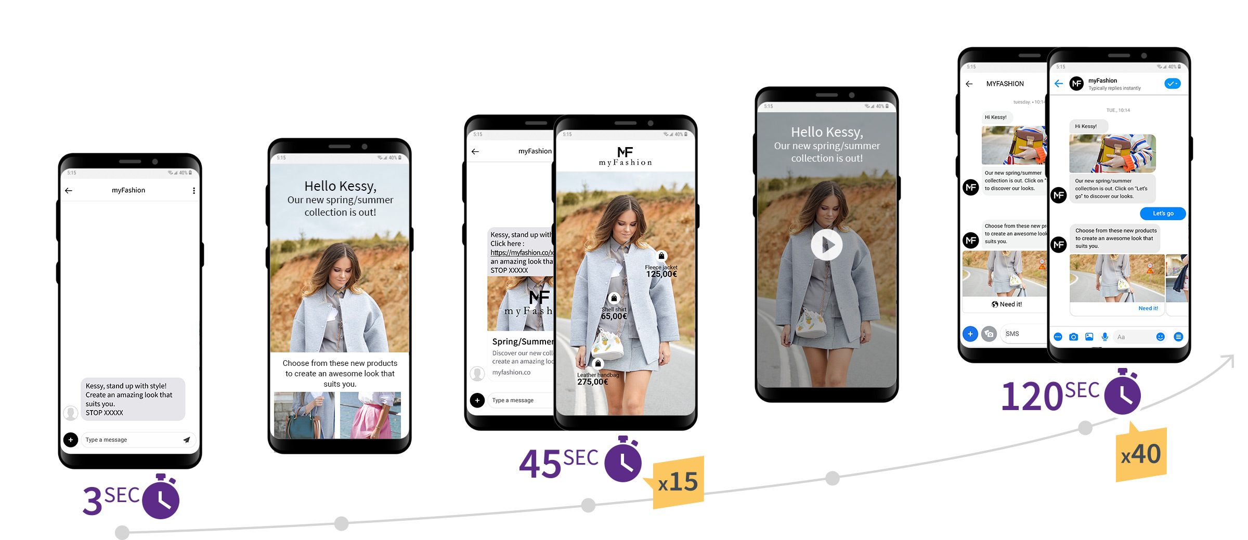
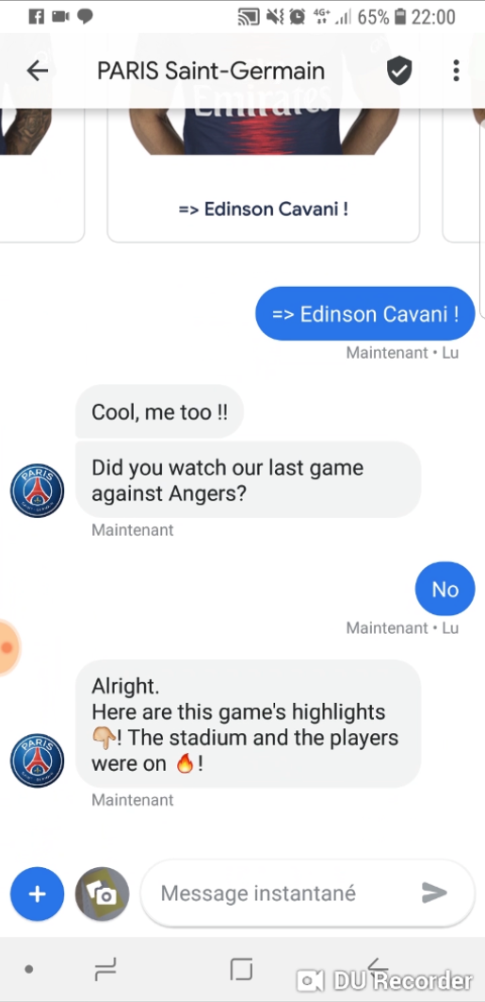
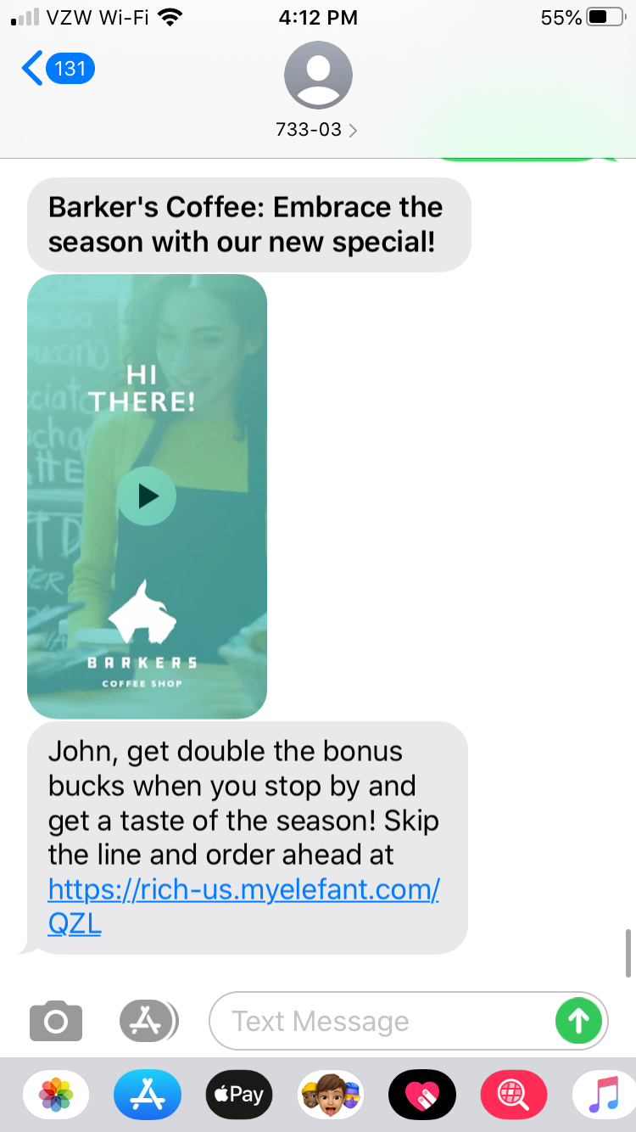
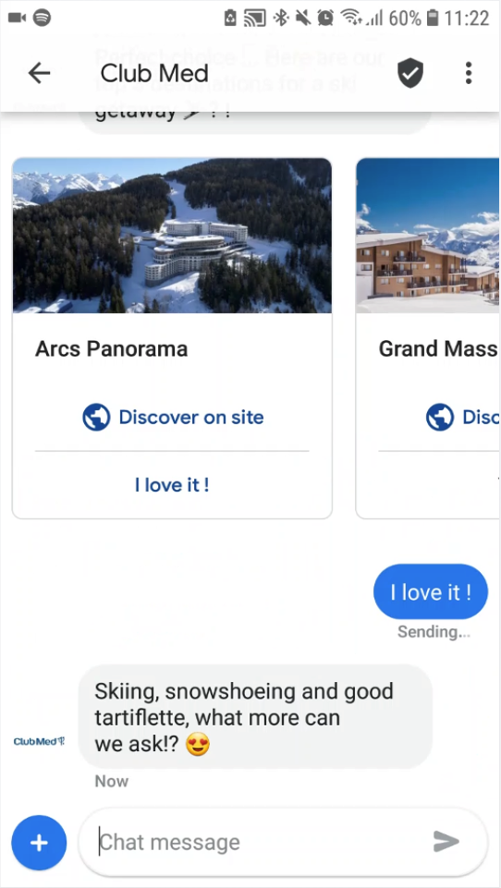
Sinch Examples
Exchange
Experience
Engagement

Slide 17

Goods
Funds
Producer
RTM
Consumer
Remove friction across
the entire experience.

Slide 18
Goods
Funds
Producer
RTM
Consumer
Back
Office
Front
Office
Brand
1
2
3
Consumer Experience:
The sum of three
different experiences.

Slide 19
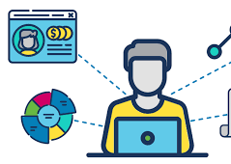



Difficult & time consuming to change.
Back Office
Front Office
Brand

Slide 20

Back Office
Front Office
Brand
Messaging between the links drives alignment and shapes the experience.

Slide 21
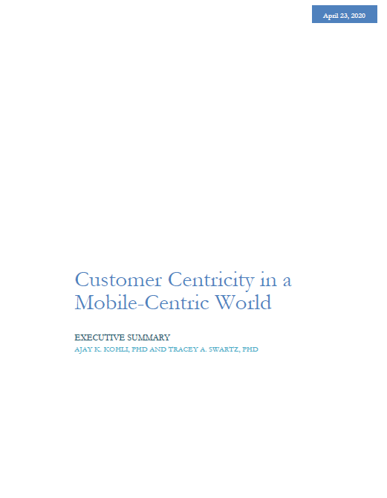

Today’s messaging stitches
together the customer experience.

Slide 22
We can overcome the challenges & create truly customer centric experiences
Research revealed:
The value to brands:
The two dimensions comprise 22 component themes
Basis for developing a comprehensive diagnostic for assessing the two dimensions of customer centricity using perceptions of:
  Internal team members
  Customers
Comprehensively & objectively assess the mobile experiences
Identify gaps between customer experiences and internal beliefs about those experiences
Use customer insights to align teams:
  IT
  Marketing
  Other (e.g. supply chain partners)
Identify & prioritize specific back-end processes for development/integration focus

Slide 23
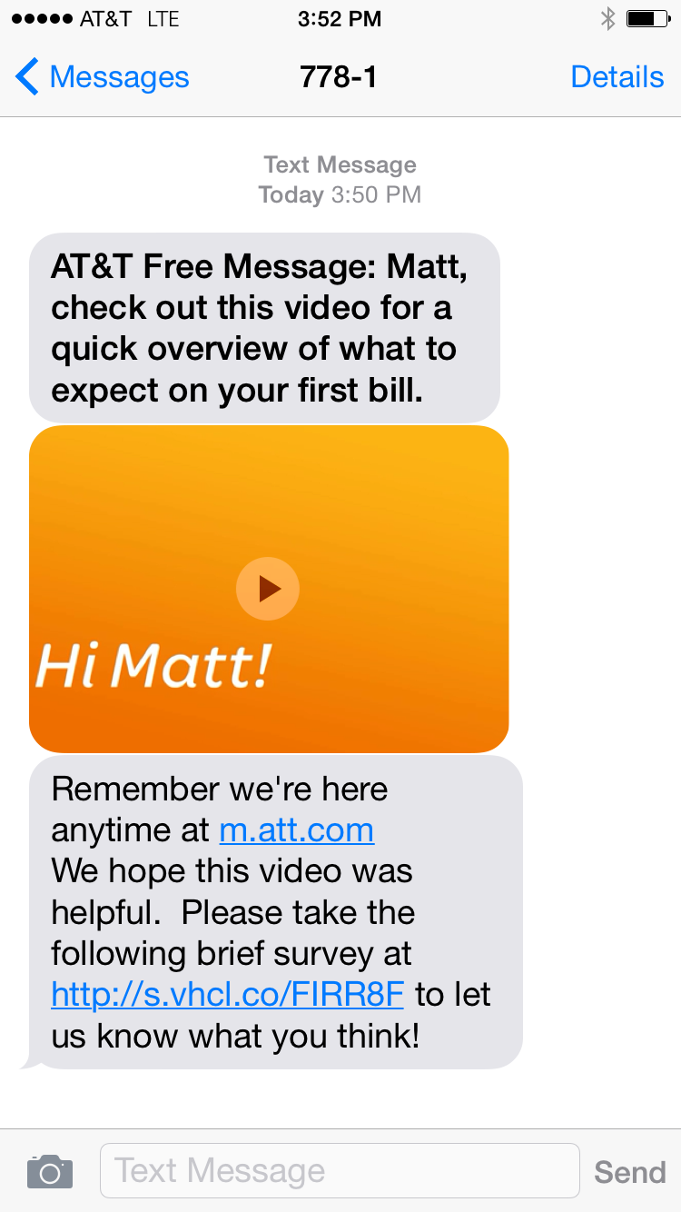
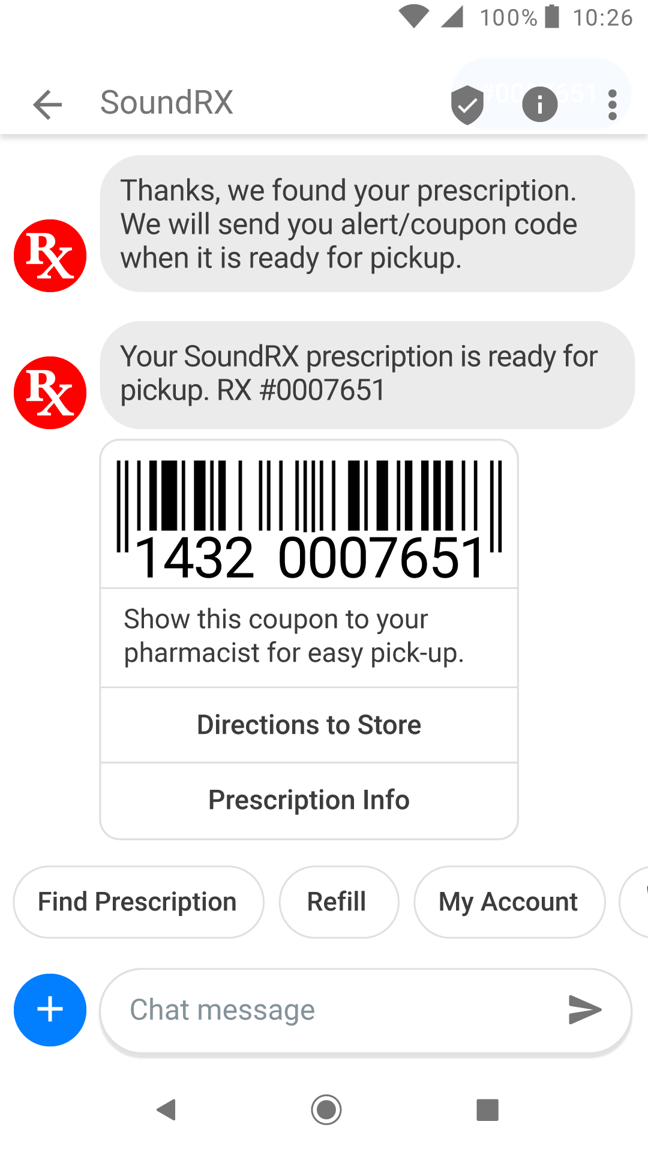
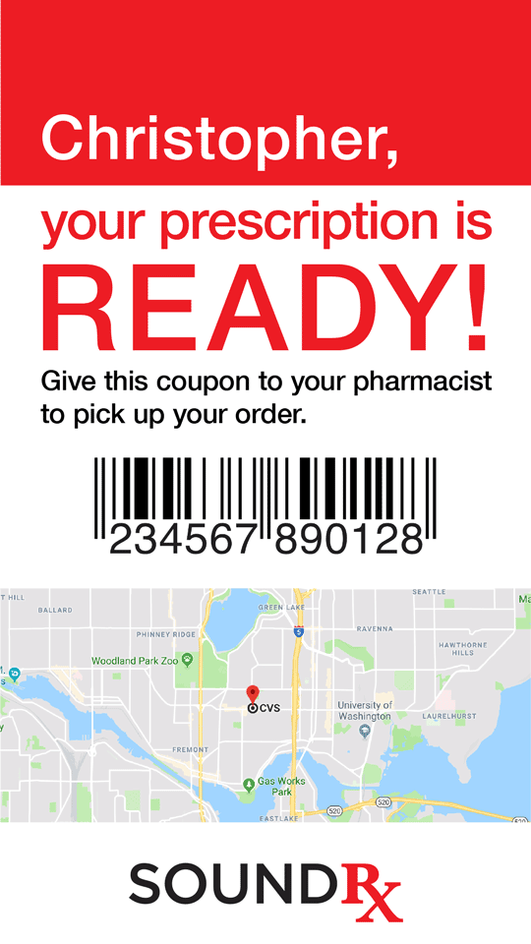



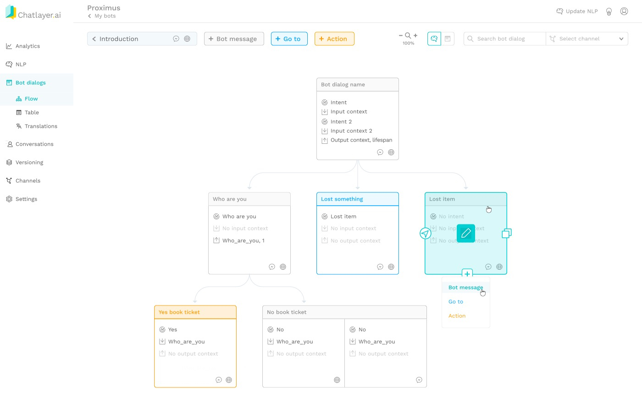

Sinch Example: Retail Pharmacy
Personalized MMS
Messaging App
Back Office
Front Office
Sound RX: Click here for turn-by-tun directions soundrx.com/45stseattle. Call (206) 213-4567 for more information.
Optimized Brand Experiences

Slide 24
2021: (R)Evolutionary Mobile Messaging for Marketing & Operations

Slide 25
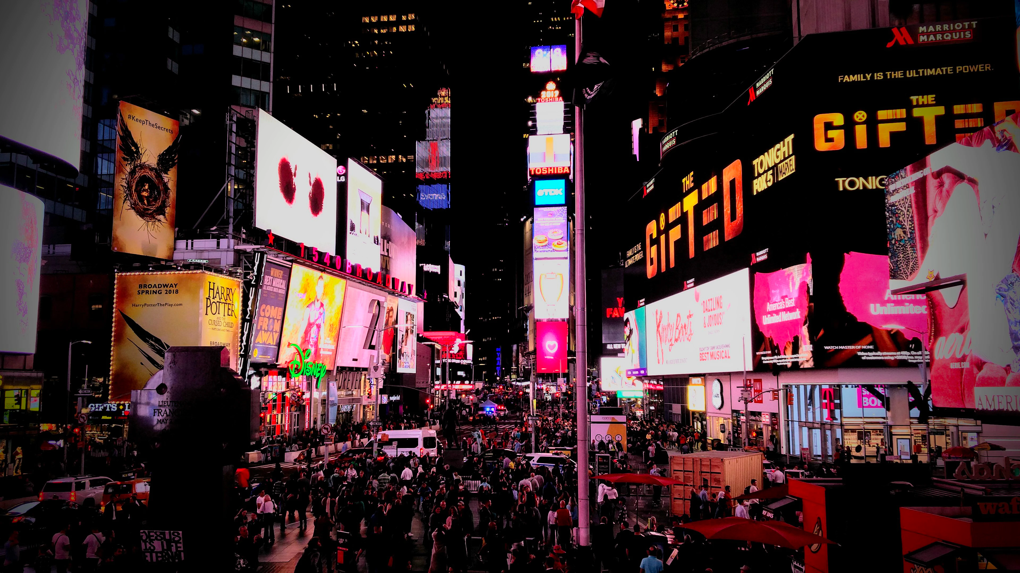

Turn your audience of a million into a million audiences of one
TM
Copyright © 20121Sinch. All rights reserved.

Slide 26
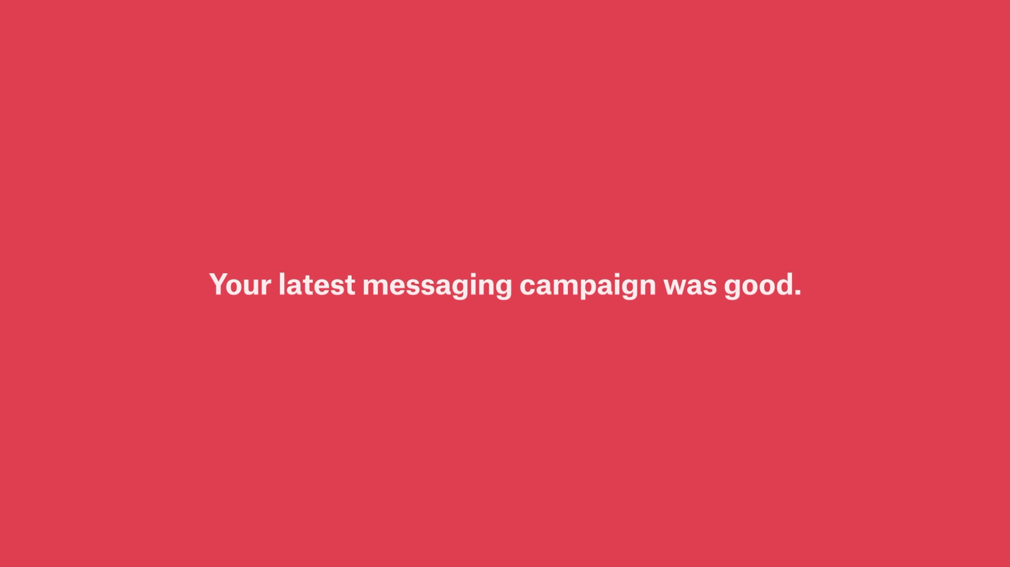
Notes:
Video: 54 seconds

Slide 27

The new intersection of
Personalized Message Content
Personalized Rich Media Experiences (video, web, images)
Conversational Interaction & AI Chat
Multi-channel Delivery

Slide 28

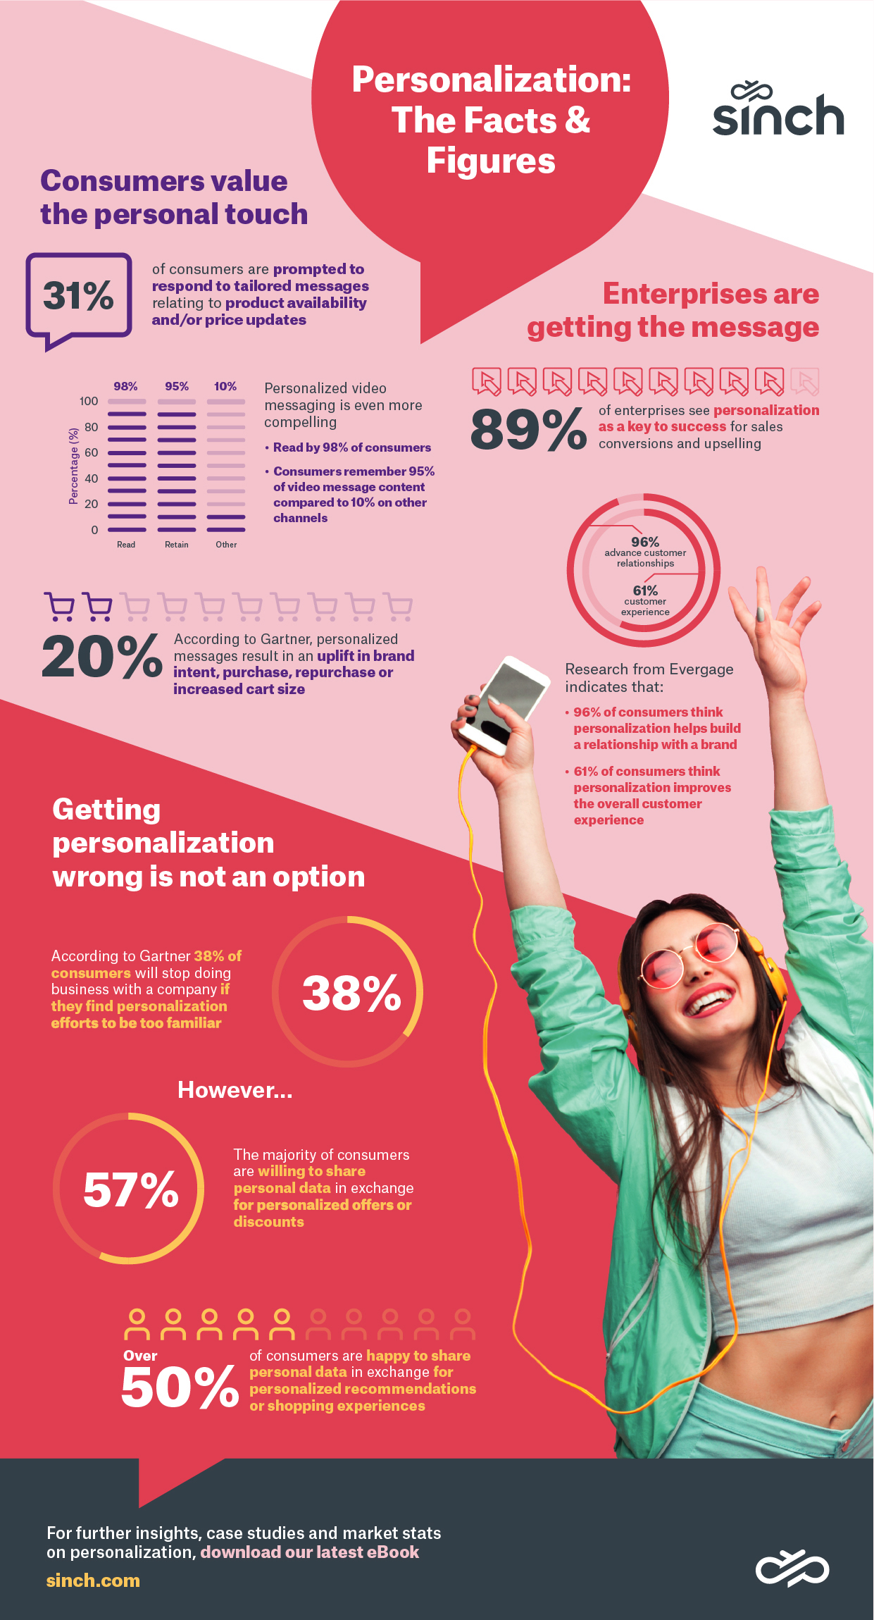


The Power of Personalization
of consumers are prompted to respond to tailored messages relating to their interests, especially product availability and/or price updates
Personalized Video Messaging
31%
98%
are read
95%
is remembered
personalized messages result in an uplift in brand intent, purchase, repurchase or increased cart size
10%
only 10% for other channels
20%
Sources:
¹Periscope by McKinsey: “The Art of Personalization—Keeping It Relevant, Timely and Contextual 2019
²Gartner: Research finding released during Gartner Marketing Symposium/Xpo 2019
³Sinch internal data 2020

Slide 29
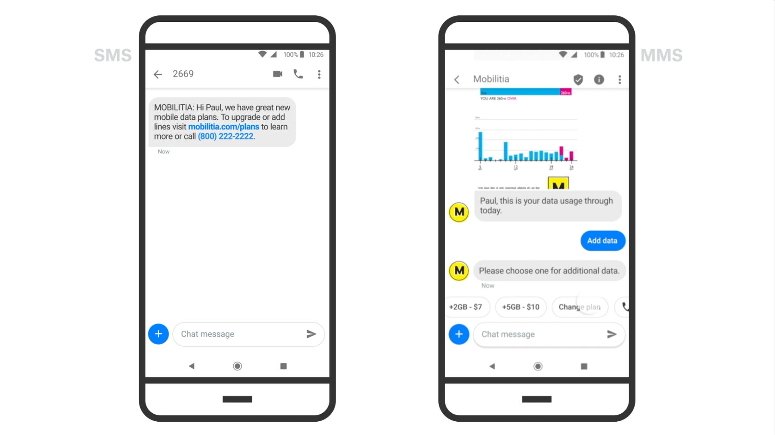
Conversational Personalized Rich Media
Notes:
Video: 1:36

Slide 30





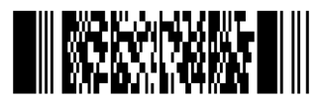
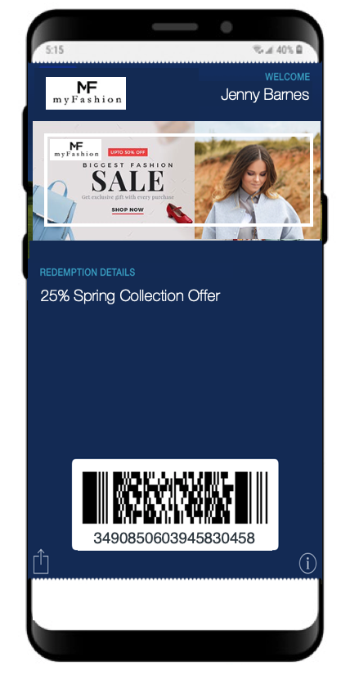
Compelling Personalized Rich Media Customer Experiences
Conversational Real-time AI
Personalized
Video
Personalized Web Pages
Mobile Wallet
Simple
Message
Personalized
Image

Slide 31
The ROI of Personalization
80%
say they’re more likely to make a purchase when offered a personalized experience
90%
72%
say they only engage with personalized messaging
Consumers find personalization appealing
Source: Epsilon “The Power of Me: The Impact of Personalization on Marketing Performance” 2018

Slide 32
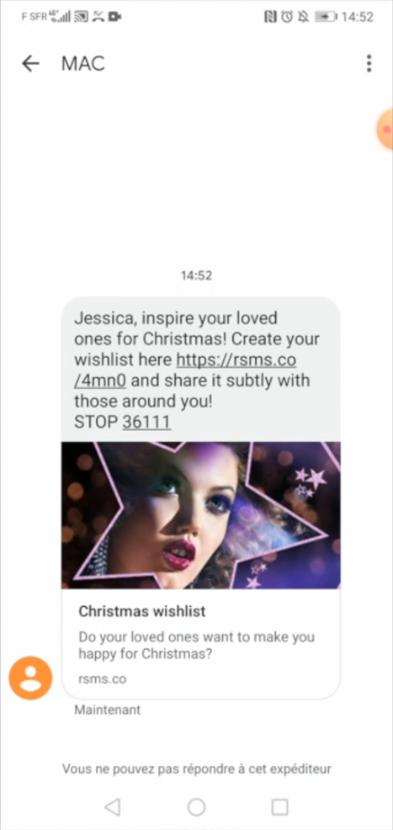
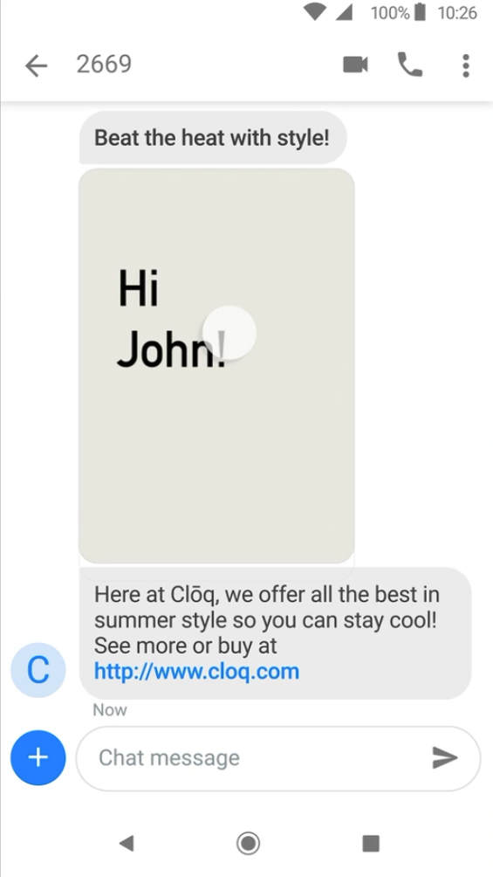
Evolved Customer Messaging Experiences
Rich SMS: Personalized Message & Web
Personalized Rich Media
Notes:
Adds personalized rich web content to standard SMS driving 25% increased conversion

Slide 33



Personalized Rich Media Real World Performance
Reduce Churn
Increase Revenue
Improve Brand Experience
100%
lift over control
25%
+NPS
Source:
Sinch internal data 2020

Slide 34
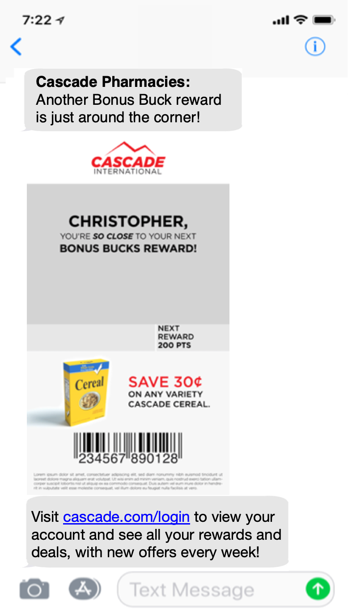
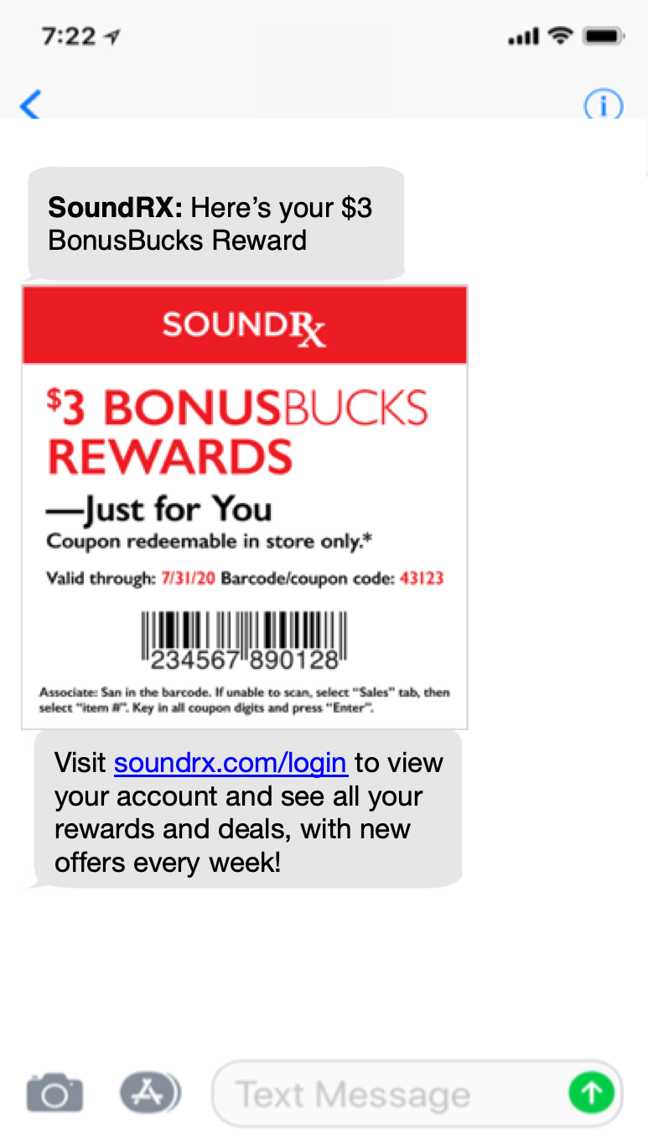

Loyalty Notifications & Rewards
Use rich media and creative text to increase visibility, comprehension, excitement and conversion
Deliver ancillary information, offers or marketing content from any source within the message
Proven performance increases

Slide 35
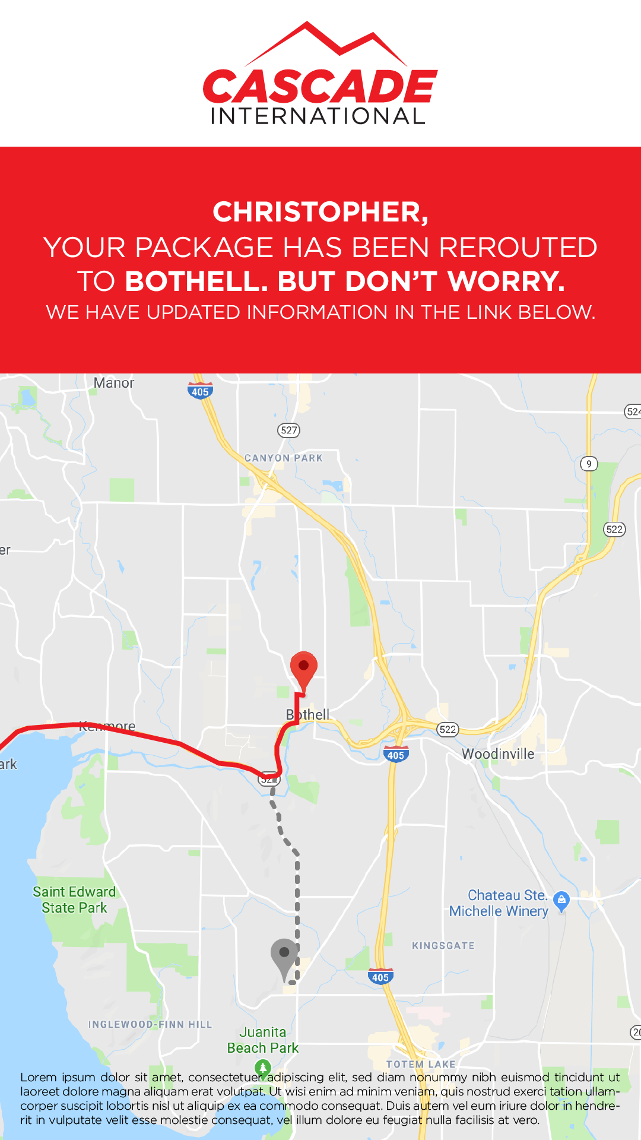

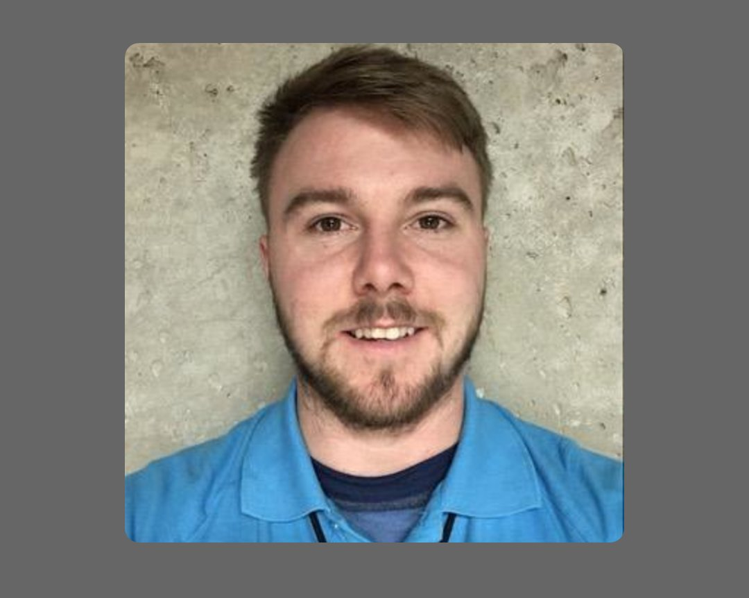
Give Logistics a Human Voice.
Cascade installation appointment 10/19
Cascade: Product delivery ticket
Hello,
My name is Matt M. I’m your service technician for your 11am appointment. I’m running a bit late I’ll be there in 30 min to install your Cascade services.
See you soon!
TV
Internet
Mobile
Cascade: There is a 30 min delay in your installation appointment. For help call (800) 344-2938
Cascade: We’re sorry there was an issue with the delivery of your equipment. Call (800) 344-2938 for help.
Notes:
Better visibility and comprehension
Fewer abandoned pickups & deliveries
Faster checkout
Security & validation
Exceptional customer experience and service

Slide 36
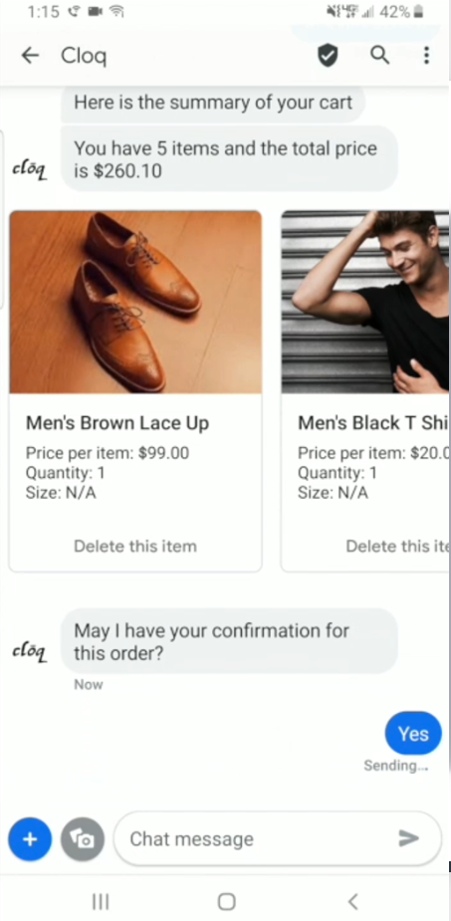





Conversation & AI Chat
Verified sender
Providing trust and assurance
Web and app-like interactive conversational messaging experience in the phone’s native SMS app.
SaaS solutions for AI/NLP interactive chat.
Branding
Name, logo, colors
Interactive conversations
Automate dialogs with customers
Richer media with Rich Cards
Text, audio, images, videos, links
Carousels
Swipe to view multiple Rich Cards
SMS
Rich SMS
MMS
Suggested actions and replies
Call to actions & quick replies with “chip” scrollable buttons
RCS
WhatsApp
Facebook
Apple
Other media
Maps, Click to Call, Web, Calendar
Viber
Line
WeChat
KakaoTalk
BYO Channel

Slide 37
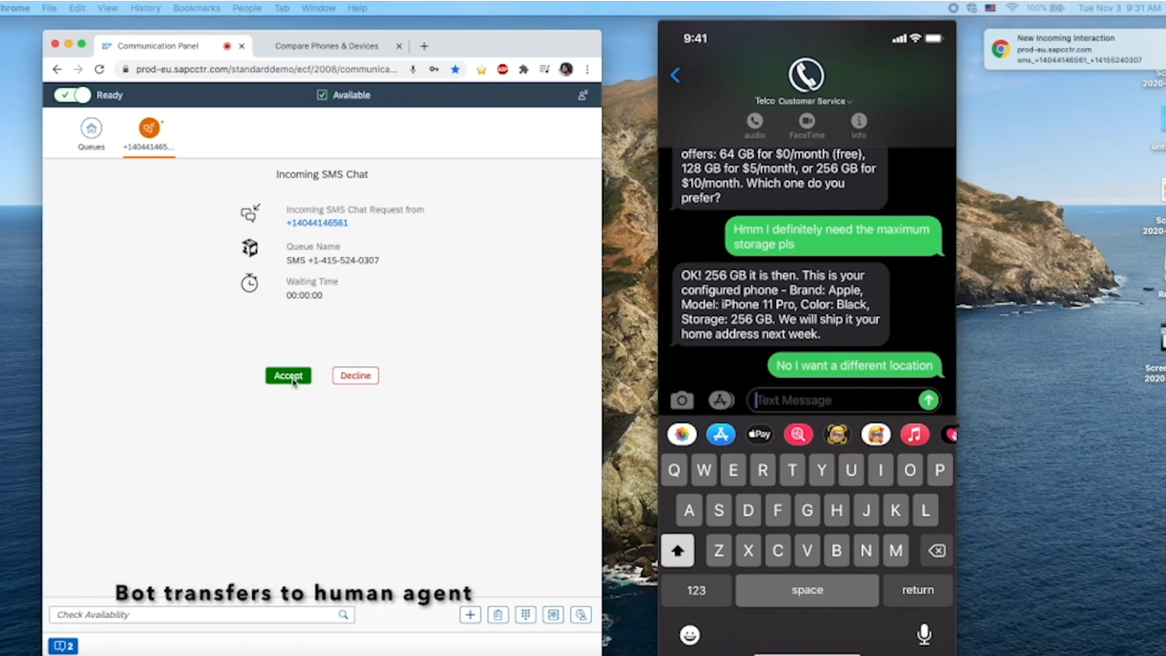
Conversational AI Message + Live Human Transfer
Notes:
Chatlayer vs Flows
Flows more sophisticated and advanced campaign programming and trigger logic, Chatlayer is a bot builder
Chatlayer mostly inbound, Flows is 2 way to initiate a conversation…it’s a publisher for outbound
Flows can integrate with nodes for integration into third party systems….it’s a stronger platform for third party integration
Flows with Conversation API is a more integrated channel optimization platform….better platform match
Data needs to reside inside Chatlayer for AI, Flows can keep data off platform if desired

Slide 38
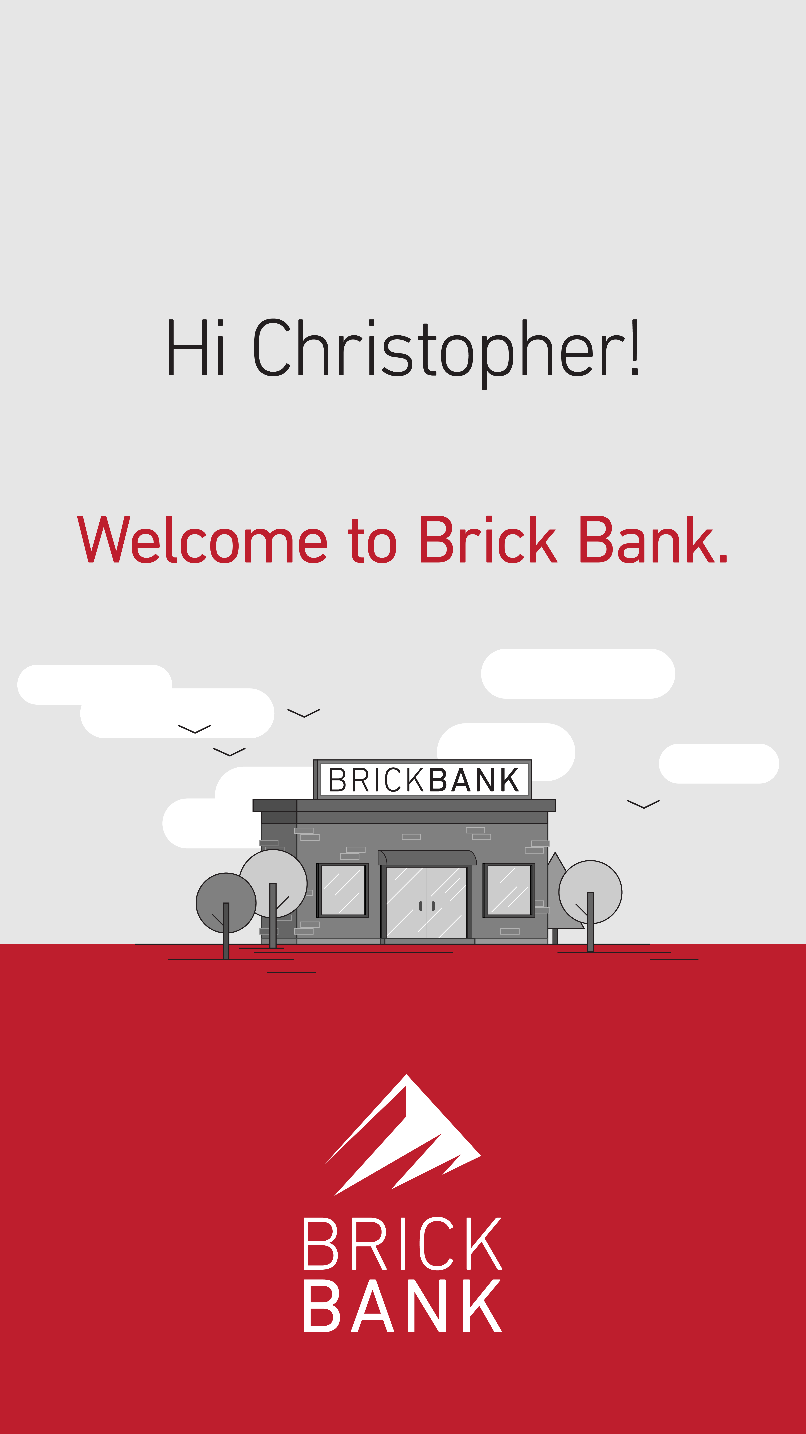
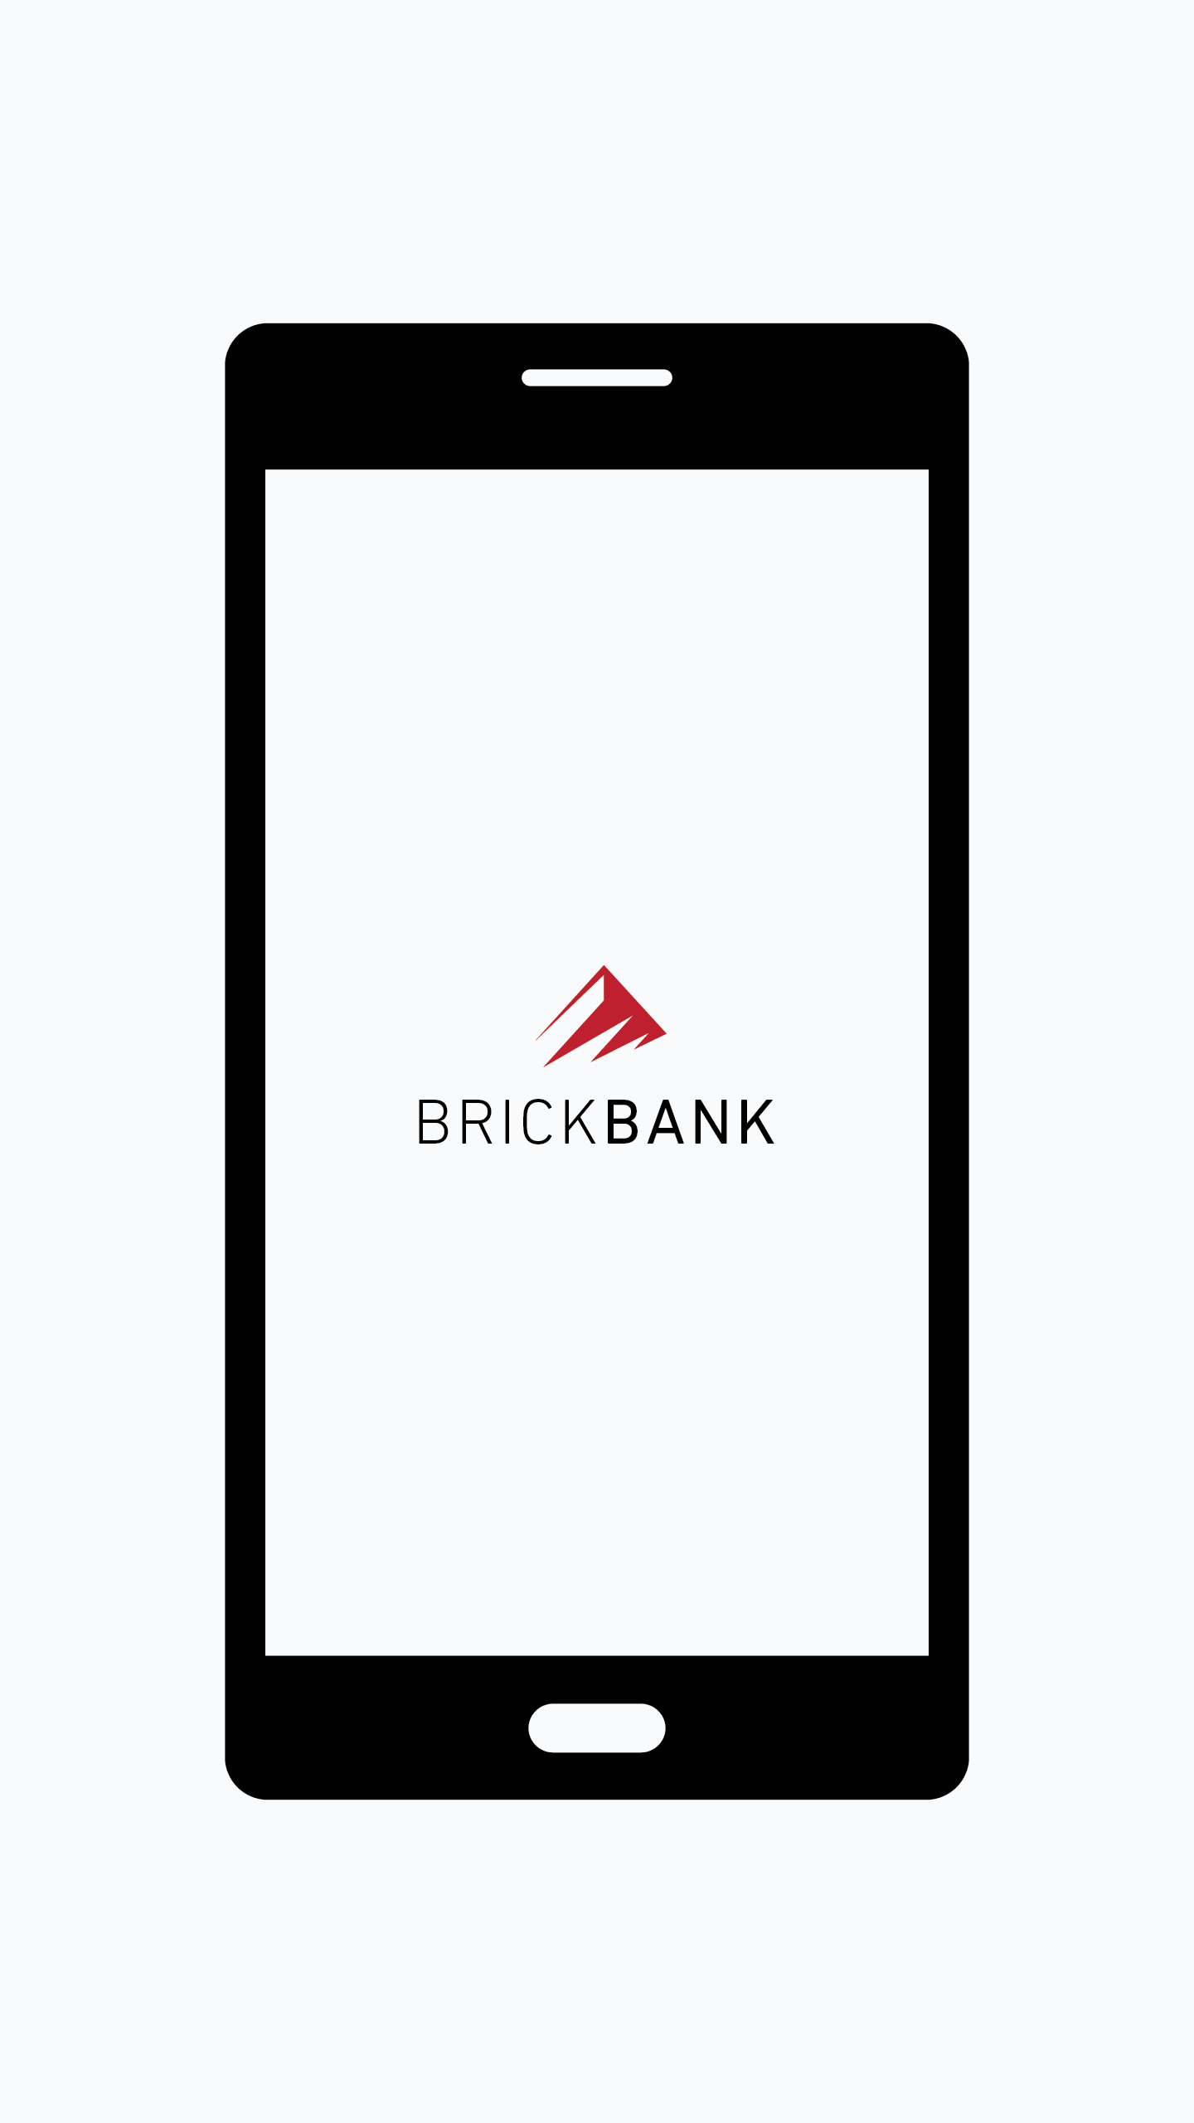

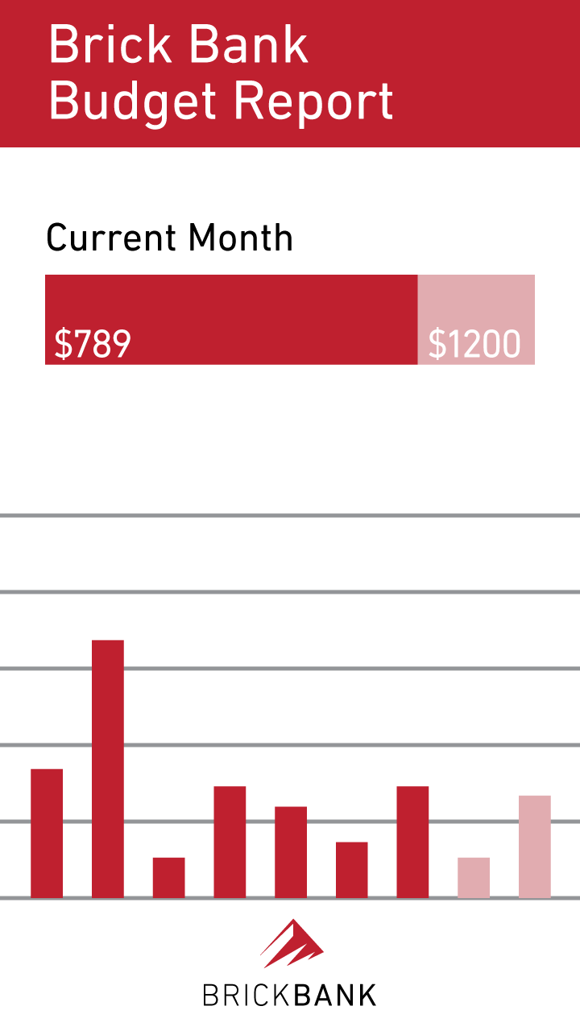
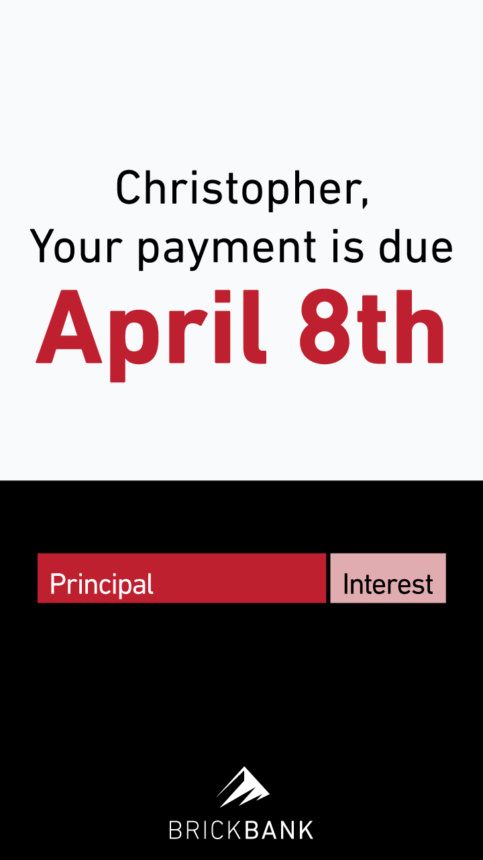





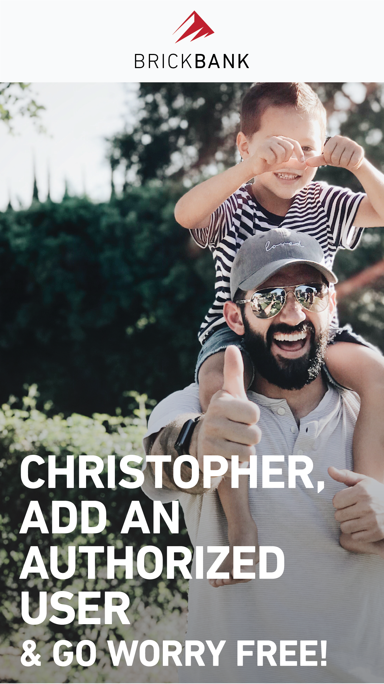

Customer Touchpoint & Lifecycle Strategy
Acquisition & On-Boarding
Mid Tenure
Mature, Dormant or Threatened
Welcome Video
Account Overview Video
2-Factor
Auth.
Online Account
Center
Overview
Payment
Paperless Statements Flyer
Customer Appreciation
New Services (Credit Monitoring)
Loan or Banking Product Offer
1 Yr Anniv. Video/Offer Featuring CB Offer
Add Authorized User
Refer a Friend
Delinquent
Strategically identify each enterprise’s key customer touchpoints and create the best message type and personalized content to achieve each touchpoint’s established, measurable objective.

Slide 39
Thank You

