Slide 1


Messaging Webinar Series:
The Future Of Messaging - How Companies Should Prepare For The Next-Generation Of Messaging

Slide 2





















MMA is the Global Industry Association for Marketing
Started in 2003; turned around in 2013
Operations in 15 countries
Marketer led; plus media sellers, tech and agencies
55+ team worldwide
25+ conferences in 15 countries
CHRIS BABAYODE
chris@mmaglobal.com
EMEA
LATAM
EMEA
Mexico
France
mdellapenna@inmarket.com
Brazil
Germany
Colombia
Middle East
HQ
Argentina
South Africa
APAC
Spain
China
Turkey
Vietnam
India
United Kingdom
ROHIT DADWAL
rohit.dadwal@mmaglobal.com
APAC
FABIANO LOBO
fabiano.lobo@mmaglobal.com
LATAM

Slide 3








































MMA Is 800+ Members Strong
MARKETERS, AGENCIES, MEDIA SELLERS, TECHNOLOGY & SOLUTION PROVIDERS
Notes:
x

Slide 4
MMA Mission: Architecting the Future of Marketing While Relentlessly Delivering Growth Today!
At the MMA, we believe the best way to thrive —and the only way to
survive — is to capture this zeitgeist NOW by aggressively adopting proven, peer-driven and scientific best practices, without compromise.
In all that we do, we are committed to bringing the right people together to challenge the status quo and provide a path forward.
We invest millions of dollars in rigorous research to arm marketers with unassailable truths and actionable tools.

Slide 5



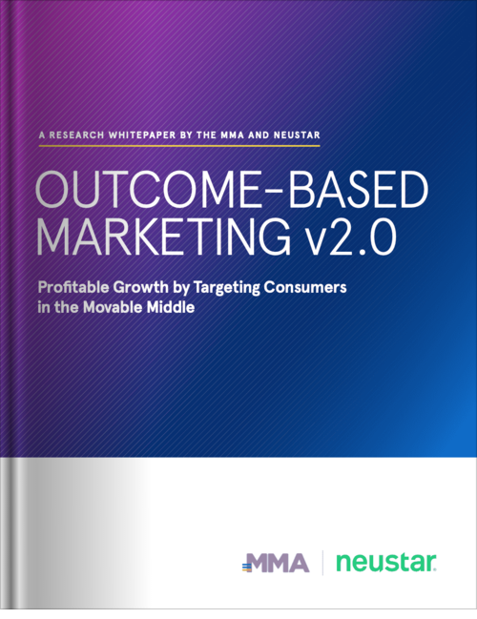









Outcome-Based Marketing 2.0 (OBM2)
Profitable Growth by Targeting The Movable Middle
  A new marketing growth framework that has been scientifically validated to outperform reach-based planning by more than 50%
  A practical approach to identify, quantify and target the most responsive audience for any brand
  A profitable strategy to win over non-buyers who are more likely to respond and build for the future of the brand
  Learn More & Download Whitepaper*
  mmaglobal.com/OBM
  Get Involved & Join the OBM2 Community
  OBM@mmaglobal.com
Academic Advisors
Marketer Advisors
Data Partner

Slide 6






A Year’s Worth of Insights & Education
Events designed to #ShapeTheFuture of marketing:
mmaglobal.com/events
Deep dive into the future of attribution.
Connected TV is at a tipping point –
discover how to add it into
your next campaign.
An invitation-only intimate gathering of industry thought leaders.
Event for data geeks or wannabe marketing data geeks.
Deep dive into marketing organization insights and knowledge.
Deep dive into the future of innovation & creative effectiveness.

Slide 8






TURNING THE CUSTOMER EXPERIENCE (CX) INTO A COMPETITIVE ADVANTAGE
JOIN THE FINAL SESSION!
MAY 18
The Future Of Messaging: How Companies Should Prepare for the Next Generation of Messaging
Rich messaging will become a more critical part of the customer journey in the future….
REGISTER NOW

Slide 9
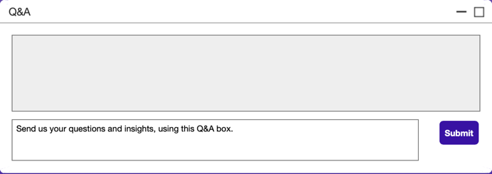

Asking Questions, Sharing Insights
#
#MMA #WeAreInItTogether #ShapeTheFuture

Slide 10

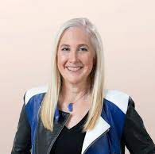

Messaging Webinar Series:
The Future Of Messaging - How Companies Should Prepare For The Next-Generation Of Messaging
Brenda Fackler
Global VP, Client Services
Sinch for Marketing
Julie Ask
Vice President & Principal Analyst
Forrester Research
Bruno Henriques
VP of Innovation and Growth and AI
iFood

Slide 11

Messaging apps include your SMS inbox and OTT apps like What’s App, Facebook Messenger, Apple business chat, Viber, Line among others.
3 billion monthly users accessing OTT messaging apps (eMarketer)
100 billion daily messages sent via Facebook’s What’s App, Messenger and Instagram (Facebook)
Consumers are using messaging apps for customer service and marketing
There has been a pandemic-inspired increase in mobile messaging usage with 68% of consumers using mobile messaging for the first time to interact with brands
Chat penetration predicted to reach almost 40% by 2024 capturing142 billion in retail dollars (eMarketer)
Notes:
3 billion monthly users – May eMarketer survey
January assessment by Statista to assess the worlds most popular mobile messaging apps.
https://www.statista.com/statistics/258749/most-popular-global-mobile-messenger-apps/
According to Facebook there are about 100bn daily messaging sent
2020 survey conducted by Statista, indicates that 32% of adults living in the U.S. are using Facebook Messenger, with another 20% using Instagram.
As of fall 2020 What’s App was the world’s most-used messaging app. It and it’s corporate sibling, Facebook Messenger are growing by 30% year over year. There are only 10 countries in the world where a FB app isn’t leading the market.
https://www.businessofapps.com/data/whatsapp-statistics/
Mobile marketing magazine tells us that mobile messaging uses increased during the pandemic
https://mobilemarketingmagazine.com/mobile-messaging-in-2021
Conversocial says that 68% of consumers communicated with brands via messaging.

Slide 12
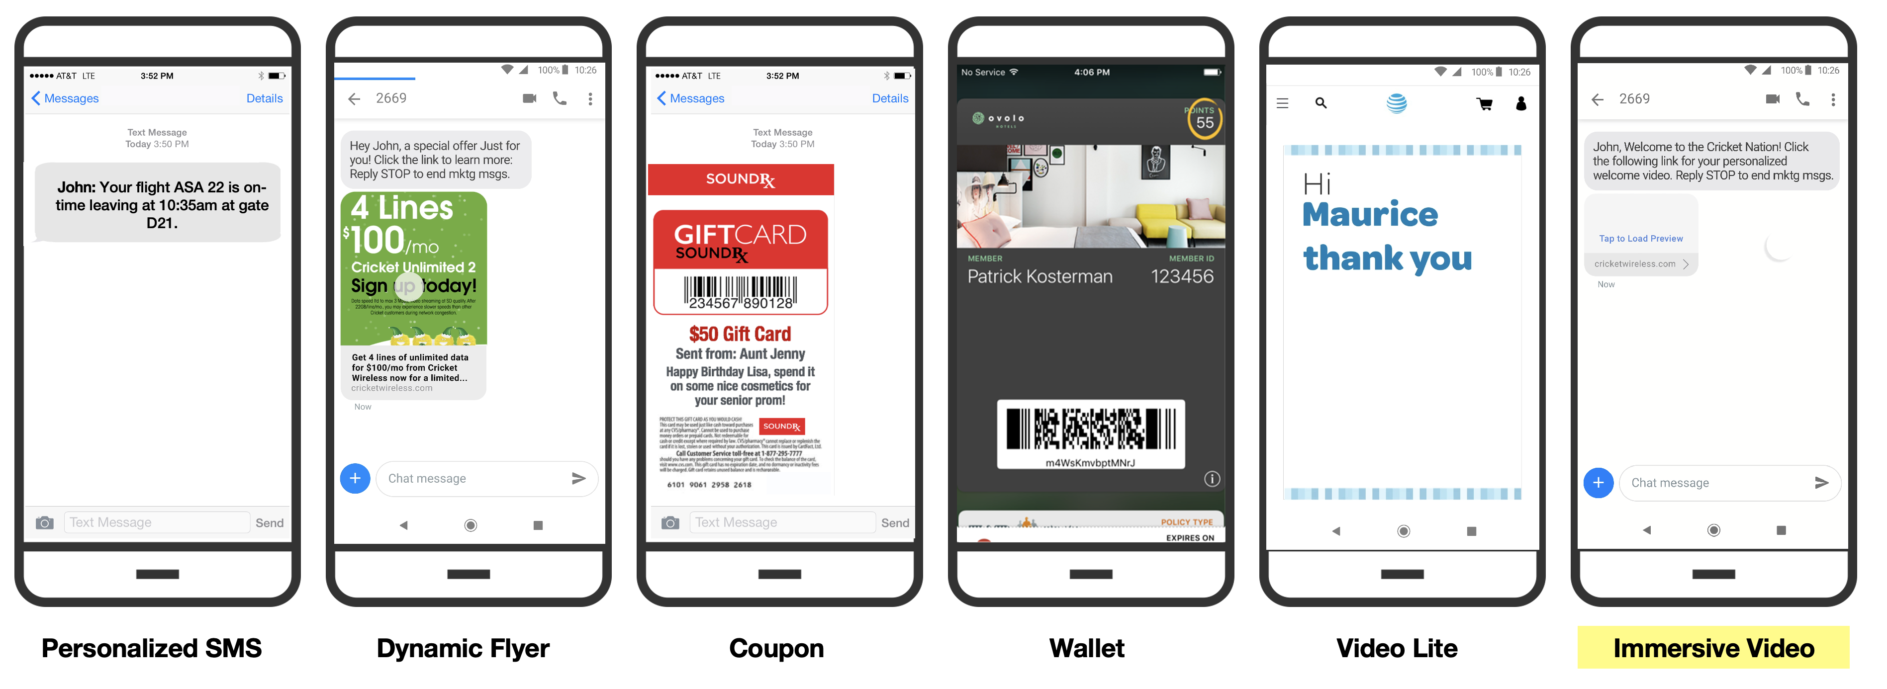
Sinch creates compelling customer experiences across formats

Slide 13
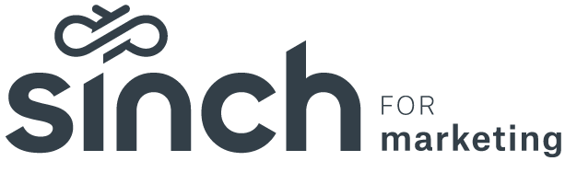
Creating frictionless customer experiences
Conversation API
Conversational Messaging
A single API for all channels
Rich media enabled and next-generation ready
Unified conversation history even when users switch channels
2-way messaging
Natural language understanding & AI
Rich source of customer data & feedback
Increase customer satisfaction
Automate repetitive inquiries
Notes:
Consistent messaging across your users' preferred channels
Continuous conversational flows from channel-to-channel
No need for repeated chat configurations after you define the message flow
Streamline customer service with one API
Design interactive chats for customer-driven questions
Automate FAQs and simplify Q&A, saving time and overhead
Build the message once. Hand over access across tools, agents and bots
Pass conversation histories to your support team
Reduce the amount of manual handoffs by assigning handover rules in your contact center
Cut cost
Increase efficiencies
Increase customer satisfaction
24/7 availability
Handling capacity
Automate repetitive inquiries
Eliminate errors
Improve navigation and product accessibility
Personalization
A gold mine of customer data and feedback

Slide 14
Asking Questions, Sharing Insights
#
#MMA #WeAreInItTogether #ShapeTheFuture

Slide 15

Thank you!
Up Next:
Next-Gen Identity: LiveRamp Product Overview
21 May - 11am ET - Register @ https://www.mmaglobal.com/webinars

