Slide 1



THE GREAT IDENTIFIER DEBATES
Strategic Partner
Execution Partner

Slide 2







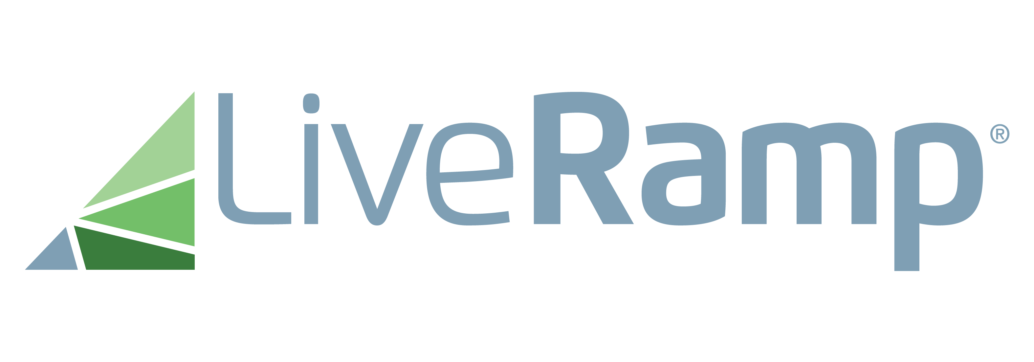









THE GREAT IDENTIFIER DEBATES
In partnership with:
30
9
5
ALL IDENTITY SOLUTIONS IN ONE PLACE
TO REGISTER & LEARN MORE:
mmaglobal.com/identifiers
Join the Discussion: #IdentifiersDebate
MARKETING EXPERTS
PRODUCT REVIEW SESSION
PANEL
DEBATES
Epsilon
CORE ID
Verizon
Media
ConnectID
Authenticated
Traffic
Solution (ATS)
Neustar
Fabrick
FLoC
ID5
Universal ID
16 April 2021
7 May 2021
21 May 2021
11 June 2021
1 July 2021
30 July 2021
13 Aug 2021
10 Sept 2021
1 Oct 2021
11:00 am ET
1:00 pm ET
11:00 am ET
11:00 am ET
11:00 am ET
11:00 am ET
11:00 am ET
11:00 am ET
11:00 am ET
FOLLOWED BY 5 PANEL DEBATES
MARKETER DEBATE
ANALYTICS DEBATE
CMO DEBATE
CHIEF DIGITAL OFFICER DEBATE
REGULATORY DEBATE

Slide 3









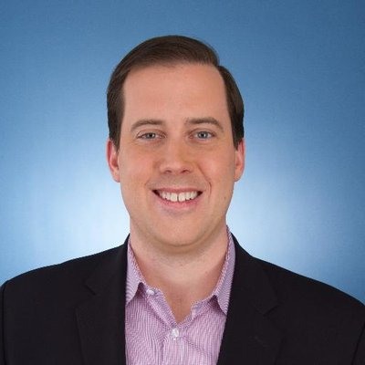

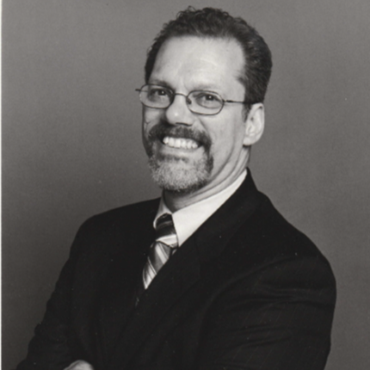
Today’s Agenda
Introduction to the Event by MMA CEO | :05 min
LiveRamp Identity Product Review | :25 min
BCG Moderation & Q&A All Q&A collected from the audience will be posted on MMA’s website after the event | :30 min
Panel Discussion | :15 min
Greg Stuart
MMA CEO
Travis Clinger
SVP of addressability
and ecosystem
Dennis Ellis
VP Product,
GM Identity Infrastructure
Alex Barocas
Partner & Associate Director
Adil Riaz
Expert Project Leader
Matt Prohaska
Jeremy Hlavacek
Vincent Rinaldi
Joel Rubinson

Slide 4





THE GREAT IDENTIFIER DEBATES
A Year’s Worth of Insights & Education
Events designed to #ShapeTheFuture of marketing:
mmaglobal.com/events
Connected TV is at a tipping point –
discover how to add it into
your next campaign.
An invitation-only intimate gathering of industry thought leaders.
Event for data geeks or wannabe marketing data geeks.
Deep dive into marketing organization insights and knowledge.
Deep dive into the future of innovation & creative effectiveness.

Slide 5
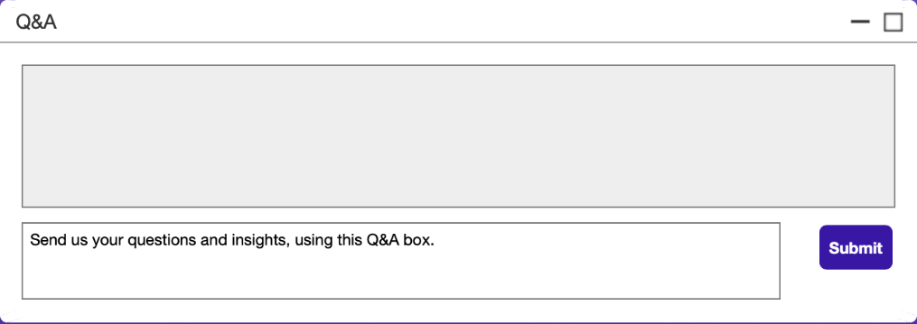
Asking Questions, Sharing Insights
SUBMIT QUESTIONS VIA THE Q&A BOX
mmaglobal.com/identifiers
Join the Discussion: #IdentifiersDebate

Slide 6
Today’s Presenters & Moderators
LiveRamp’s Identity Product Overview
Travis Clinger
SVP of addressability
and ecosystem
Dennis Ellis
VP Product,
GM Identity Infrastructure
Moderators:
Alex Barocas
BCG Partner &
Associate Director
Adil Riaz
Expert Project Leader

Slide 7

MMA: The Great Identifier Debates
May 21, 2021

Slide 8




Agenda – LiveRamp and Identity
LiveRamp
and Identity
Identity Infrastructure
Identity
in the Cloud
Securing the Future of Identity
Notes:
TRAVIS

Slide 9
Our Vision is to Make it Safe and Easy for Companies to Use Data Effectively
Notes:
TRAVIS
Here’s what we do… very high level...
TALKING POINTS: A confluence of forces and trends are reshaping the landscape. Data is still too hard to access and make sense of; too hard to control and activate across touchpoints. Security and data privacy concerns are paramount, data monopolization is forcing brands and publishers to find other ways to maintain control over and access data, and data deprecation (end of 3PC and Apple’s iOS 14.5 implementation) is driving a complete re-examination of marketing fundamentals. All the while, digital transformation is reshaping customer experience, and while data is at the very center of this shift, marketers remain plagued by fragmented and disconnected data, as well as a trust deficit built up over the past 20+ years. At the highest level, LiveRamp’s vision is to make it safe and easy for companies to use data effectively.

Slide 10
We believe strong network effects deliver value for all
Brands
Platforms
Agencies
More
Usage
Better
Results
Better
Identity
More
Data
Data
Providers
Publishers
Consumers
Notes:
TRAVIS
TALKING POINTS: From the very beginning, LiveRamp has believed in building and supporting an interconnected network. Today we have deep client and partner relationships across the ecosystem, helping connect, control, and activate data safely and easily. We are driving better results and improving experiences for consumers By providing better identity, strong interoperability and privacy-enhancing technology.
[Data Providers]

Slide 11
Identity is More Complex than Ever
Privacy compliance within a changing regulatory
environment
Loss of third party data, Google/Facebook/
Amazon audience control
More data is being created: sources, types, volumes
The consumer experience continues
to fragment
Global presence increasingly necessary
Cloud computing, data connectivity, digital-first relationships
End-to-End Identity is Essential for Today’s Customer Experience
Notes:
DENNIS
TALKING POINTS:
Headwinds… leading into current solutions we’ve brought to market
Identity Is Not Getting Easier
Third-party data is becoming scarce, regulations are rising, and pressure is rising to get insights faster
What is different about these factors today… There will be multiple identity solutions that marketers and publishers will have to adapt based on their needs. There is no single solution or silver bullet. Multifaceted approach.
[Dennis to revisit titles]
Becky’s Notes:
Ask Design to remove all builds
Success in the next era of marketing will require [Change the head and subhead] -- every slide slide should tie back to why we’re doing this
End-to-End identity

Slide 12
The 3 Phases of the Customer Data Lifecycle
End-to-End, identity is at the core
1
2
3
Data Infrastructure
Analytics
Activation
Bringing together data about and created by the customer.
Establishing trends across profiles
Getting value from the data, ranging from marketing to product development.
Notes:
DENNIS

Slide 13
End-to-End Connectivity
vv
LiveRamp
and Identity
Identity Infrastructure
Identity
in the Cloud
Securing the Future of Identity
AbiliTec
IDL
Notes:
DENNIS

Slide 14

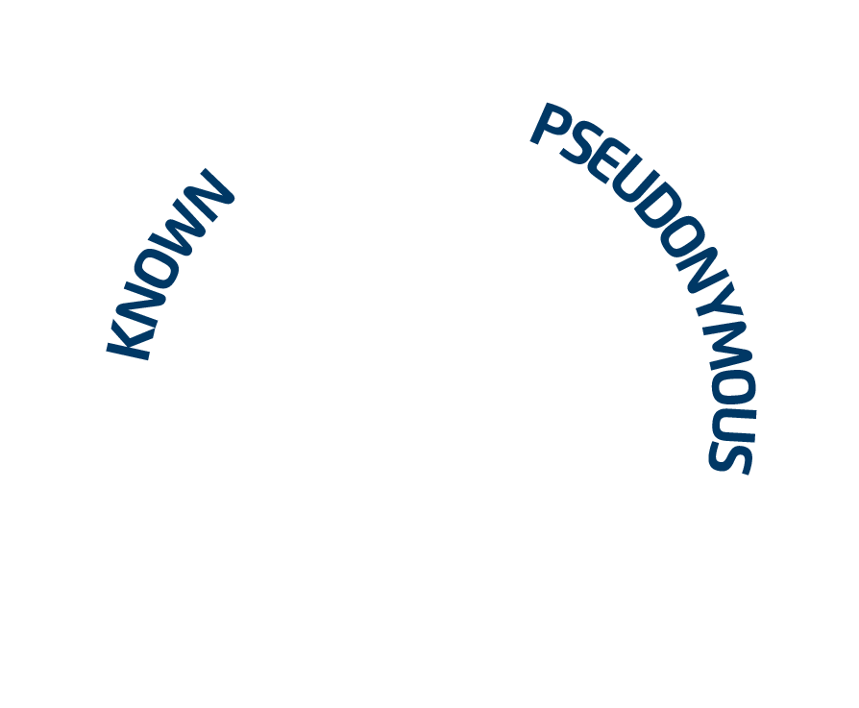


We tie together consumer touchpoints with stable and configurable identity in a privacy-conscious way
Cookie
Premium Publisher
Email address
Mobile
Cookie 123
@JSmith
Telephone
Johnjsmith@gmail.com
CTV
AAID 456
Cookie XYZ
Jf_smith@1
650.987.1234
John.Smith@LiveRamp.com
IP Address
73.15.102.238
Android ID
lm.98.no.76
Name & Postal
Other TV
John Smith
123 Main Street
MAC 12:AB:34:CD:56:EF
John Smith Jones
456 Sleepy Hollow Lane
Note: Coverage metrics represent adult US consumers and are approximate figures
Notes:
DENNIS
KNOWN + CONNECTIVITY
TALKING POINTS: Everyone should be familiar with this slide. We tie together consumer touchpoints with stable and configurable identity. We help with our translation asset, our graph, we bring those data points together and ensure that we can help our customers bring those together for their needs. Ultimately we want them to be able to tweak that knowledge to better suit their purposes - that could be use case based or it could be macro-graph based. Best example I can give is FS clients - they have massive amounts of customer data. There are times when they want the view of their world to tie to their record - but they also want to connect other pieces of information. Moving into the anonymous space with an anonymous ID like IDL, they want to be able to connect together a mobile id or a cookie (and that will change over time). What we do is allow them to build their offline view of their customer and connect that in the anonymous space to these other data assets or device identifiers.
[OTHER NOTES: network and translation layer across the ecosystem. TALKING POINTS: With the proper permissions in place, we can leverage our Identity Infrastructure to tie together consumer touchpoints on persistent, omnichannel Identity in a privacy-conscious way. Can we touch here - each of these buckets are their own identity space. We help our customers bring all those spaces together and then we translate that between others - network of identity spaces… AbiliTec Graph - LiveRamp has the largest independent identity footprint in the US, and is the largest open internet deterministic graph. IdentityLink is grounded in the AbiliTec Knowledge Base, a vast, multi-sourced historical identity graph containing over 50 years of consumer contact information from over 150 data sources, including over 4.5 billion name and postal records, over 900 million email addresses, and over 450 million phone numbers. A one-way translation between AbiliTec and IdentityLink allows IdentityLink to bring that offline view of the customer to bear in a privacy-centric way. Stable & Configurable Durable, person-based identifier that operates across all of your partners and platforms, with the ability to tailor to your direct needs and uses Scale & Accuracy 245MM deterministic profiles, giving the same person-based reach as the walled gardens across 500+ integration partners in the ecosystem]

Slide 15
AbiliTec by the Numbers
Averages 12 PII touch points per person including email, phone numbers, and postal
More than 4 billion entity representations of offline records
Email touchpoint covers over 2.5 billion email addresses
Unparalleled depth and breadth of graph content with 45+ years of historical data
Core of IDL for digital activation and measurement
High throughput processing more than 10k records per second
Notes:
DENNIS
A few metrics to help you understand our offline graph:
We can tie an average of 12 historical and current pieces of PII to individuals in the strong parts of our graph
There are more than 4 billion records, includin 2,5 billion email addresses alone
All gathered data close to 50 years, since 1973. This significantly strengthens our graph and is unparalleled.
We’ll talk today about the robust API-access mechanism, which can handle robust production throughputs
Most importantly, it is the core of LiveRamp’s online graph, so normalizing data using this identifier will improve identity throughout LiveRamp’s IDL ecosystem.

Slide 16











Building the ID Graph
Liz S. Wilson
20 Stag Dr
Chicago, IL
Strong IDLs have an average of 12 PII touchpoints associated to them.
E. S. Jones
10 Main St
Plano, TX
XY12345.1
Elizabeth Jones
ejones@workpc.com
IP 222.58.1.10
XY12345.2
PII is associated to an AbiliTec ID, in order to maintain privacy and security between PII and anonymous ID spaces.
AbiliTec® ID
abc12345
IDL
XY12345
Liz Jones
I23 Sunrise Ave
Plano, TX
Phone 555-1212
XY12345.3
AbiliTec IDs take PII in and return an AbiliTec ID, which is used to match new connections to existing consumers.
Elizabeth Wilson
20 Longhorn Ave
lizzy@homepc.com
Elizabeth Jones
Cell phone:
555-2323
XY12345.4
Notes:
DENNIS
We keep our digital graph/PII graph separate; in the same way we recommend to our customers
It’s complex because of Privacy
IDL = person
Let’s dive into how that offline data spine is built, and where it intersects with our online graph.
Abilitec is a non-discoverable database that collects a huge amount of known data about an individual and associates it to a single ID. These include current and former addresses, telephones, email, and much more.
There is a lot of this data. The average strong IDL connection has 12 PII touchpoints that help us pinpoint an individual.
This is a non-discoverable database, so it will only return an abilitec link when you send it any pierce of PII. This ensures that no customer PI is ever exposed.
This also functioning well to help us know when we see a certain PII, like a phone or email, of it belongs to one person, and what other unknown touchpoints it is connected to.

Slide 17
End-to-End Connectivity
vv
LiveRamp
and Identity
Identity Infrastructure
Identity
in the Cloud
Securing the Future of Identity
AbiliTec in Cloud
Safe Haven
Notes:
DENNIS

Slide 18

Unified Customer View
Extract the maximum value from your data with accurate, safe data unification; Consolidate to a golden record to improve analytics, measurement, activation, and addressability.
Advanced Customer Insights
Surface accurate and meaningful insights in your cloud data warehouse to optimally plan, engage and measure across all marketing channels.
&
Improved Downstream Performance
Join data sets that don’t share a common key and align to the identity space that’s adopted and bid on across the ecosystem
Customer Data
Enrichment
Augment your view of your customer within your own data set by leveraging third-party demographic data
Identity Where Your Data Lives
LiveRamp is committed to strengthening the value of your customer data where it lives
Notes:
DENNIS
TALKING POINTS
We expect to have many of the same products in every cloud in the near future

Slide 19
Safe Haven Audience and Analytic Collaboration
Data is securely permissioned at a granular level
1
Pseudonymize your data using IdentityLink matching to remove directly identifiable
personal data
IDL
Your Data
Partner Data
2
Once data is pseudonymized, it cannot leave the environment — a virtual desktop lockdown
LiveRamp
Safe Haven
GDPR/CCPA Compliant
Marketer Environment
Data Science Environment
3
Permission data at the taxonomy, audience, and
data view level: edit, limit, or revoke access at any time
4
Collaborate by use case: insights, modeling, combination, distribution, reporting, and analytics
Client
Tenant
Partner
Tenant
Client
Tenant
Partner
Tenant
Segmentation and Activation
Analytics and Modeling
Notes:
TRAVIS
EXTRA TALKING POINTS
Data is private until permissioned
Firewalls and VPC perimeters prevent data leakage
Collaboration with Customer Profiles (audience segments) is focused on Activation and Reporting
Collaboration with Analytics Environment (individual record level data) is focused on Modeling and Measurement

Slide 20
Safe Haven’s holistic approach- integrating multiple privacy-preserving technologies
Providing customers with flexibility to configure based on business needs,
removing the need to compromise data security and privacy with data utility
Encryption In-use
Speed
Simplicity
Federated Learning
Synthetic Data
Utility
Multi-party
Federated Analytics
Privacy
Security
Differential Privacy
Distributed Compute
Notes:
TRAVIS
[COMMS TO PROVIDE DRAFT TALKING POINTS AND RUN BY GARETH/DAVID GILMORE FOR REVIEW]

Slide 21
End-to-End Connectivity
vv
LiveRamp
and Identity
Identity Infrastructure
Identity
in the Cloud
Securing the Future of Identity
Authenticated Traffic
Solution
NEW – Portrait Engine
Notes:
Travis

Slide 22

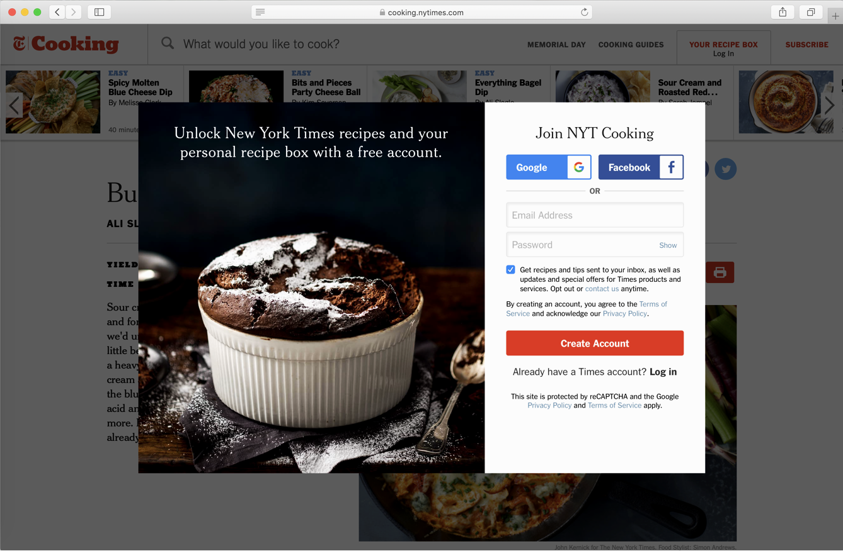
ATS: Identify and Engage your Audience with a Consent-Based Approach
Benefits
Authenticated Traffic Solution (ATS) enables you to identify your audience and create addressability without third-party cookies
Revenue Increase
Increases yield on previously unidentifiable inventory including
Safari and Firefox
Transparent & User Friendly
Provides consumers with more transparency and choice on how their data is being used
Open & Scalable
All authentication events are supported, such as registration walls and newsletter sign-ups
Control your data
Publishers select which platforms can leverage their identity
IDL
Monetize Cookieless Environments
Note: New York Times is for example purposes only
Notes:
TRAVIS
TALKING POINTS
When to use it: If a prospect is totally unfamiliar with ATS and needs more information on why it’s necessary
First party relationship…
Key takeaway:
ATS prepares you for a cookieless world
Slide narrative:
Authenticated identity has become the gold standard in digital and LiveRamp is bringing it to the open internet at scale and unlocks addressability on Safari and Firefox. When a consumer shares their email with a publisher, the LR code on the page is able to translate the PII to an IDL and store in a first party cookie. The SSP can then pass this IDL in the bid request so that an advertiser can buy on IDL. And if a consumer wants to opt out, they can opt out once through LiveRamp as opposed to the current state where they have to opt out of each vendor (TTD, Criteo, Google, etc.)
Notes:
We are leveraging SSP to implement code in their header solutions, but publishers still need to have registration walls/PII collection events
Publisher can collect PII through registration wall, newsletter sign up or any other set-up
If a consumer use FB or Google single sign on, ATS isn’t able to translate the PII to an IDL
For initial authentication events, an IDL may not be passed to the DSP on the first look, but would be for any subsequent impressions
If we have an IDL for the cookie, the SSP will be able to pass to the DSP
While third party cookies are viable, we’ll still use them for scale

Slide 23
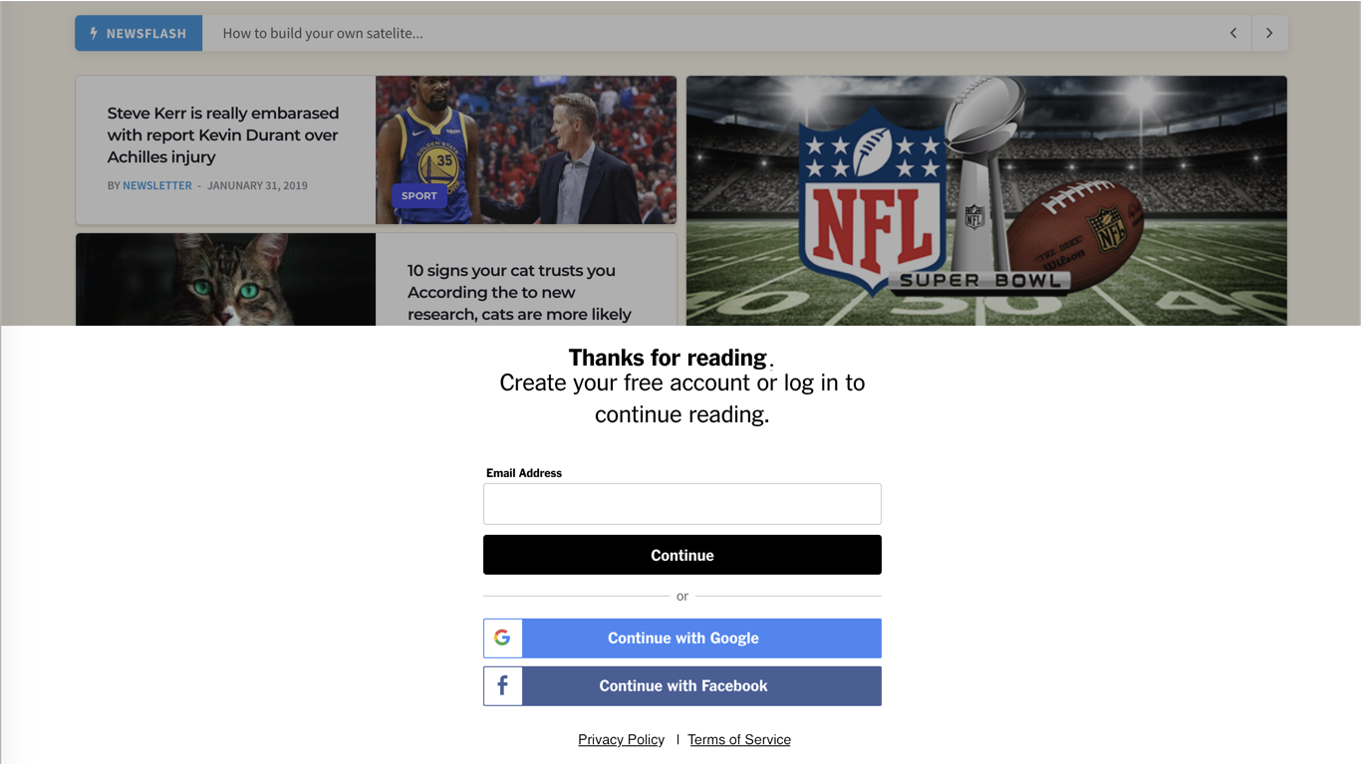
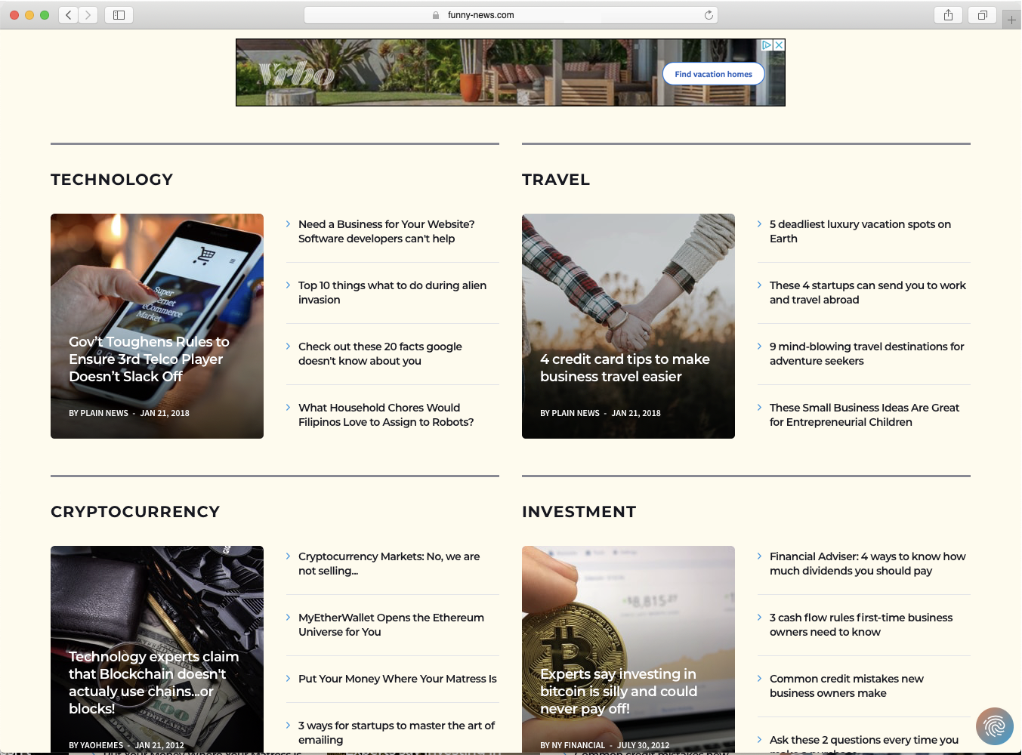
ATS: A Privacy-First Solution for Authenticated Traffic
≈
Email is converted into encrypted IDL envelope
SSP decrypts IDL envelope and retrieves IDL
SSP translates IDL to DSP-encoded IDL & passes in bid request
DSP decisions on bid request and logs IDL in exposure logs
1
2
3
4
DSP 1
Ad Server
PII to Identity Envelope
SSP
DSP 2
johnsmith@mail.com
DSP 3
Notes:
TRAVIS
FYI, Dan wants us to make this clear that this is for a publisher audience.
TALKING POINTS
IF AN ENVELOPE is captured, it’s worthless. If a hashed email is captured, it can be used. The challenge with the single id or multiple ad id - you're allowing 3tf party actors to aggregate in an unknown context and passes to a known context - we are NOT allowing that to happen in the ecosystem. That’s why it enforces privacy and secure for the data owner to use. WE don’t want universal ID or an id for known and anonymous use cases. secutity of the economic value of the data - and even gets to brand safety.
Key takeaway:
ATS is a privacy-first solution
Slide narrative:
1. When a user authenticates, the LiveRamp javascript or API hashes PII and looks up IDL. IDL is returned to publisher in an encrypted envelope and the pub stores it in a first party cookie.
2-3. The SSP grabs the IDL envelope from the first party cookie, decrypts it and then translates it in real time to the specific encoding for each DSP since we encode IDLs specific to each platform. This enabled added security and increased privacy.. IDLs are then passed to the DSPs in the bid request with other information about the inventory and the DSP can make a decision on that impression.
4. DSP makes optimally informed bid with onboarded data from LiveRamp and if they win the auction, their add serves and they log the impression in their exposure logs
Notes:
Safari has a 7 day expiration window on 1P cookies. This that if a consumer doesn’t visit within that 7 days, they must re-authenticate. For Chrome and Firefox, we are setting a 30 day expiration on the IDL envelope for privacy purposes so a consumer would have to authenticate 1x a month.
We do support a more robust implementation where a publisher can store the IDL envelope in their CDN (content delivery network) layer which would then not be subject to any browser restrictions. LR would set and expiration on the IDL at 30 days for privacy purposes
Addressability is at the publisher level and not cross site

Slide 24
End-to-End Connectivity for an Open Ecosystem
Opportunity for Publishers
Redefine value exchange with consumers through first-party
authentication events
Leverage authentication to identify visitors, enable
addressability, and increase
yield without third-party cookies
Actively manage reader consent and preferences
for an improved user experience
Opportunity for Marketers
Maximize reach by enabling buyers to maintain scale and
reach your most valuable
audiences
Enable cross-screen audience addressability in 3P cookieless environments
Maximize precision by deterministically
linking audiences
Notes:
TRAVIS
TALKING POINTS
Key takeaway:
ATS opens the gateway to sustainable business strategies for a cookieless world while unlocking immediate revenue opportunities
Slide narrative:
A well established value exchange hinged on first-party authentication means a tighter relationship with site visitors
Doing so also enables business sustainability since ATS is people-based, not cookie-based
Privacy Manager is also free for ATS adopters meaning you’ll be better posed to provide transparency and insight to visitors in jurisdictions that require it to continue building and establishing trust
Provide brands with high-value audiences tied directly to IdentityLink, via first-party authentication
Key takeaway:
ATS opens the gateway to sustainable business strategies for a cookieless world while unlocking immediate revenue opportunities
Slide narrative:
A well established value exchange hinged on first-party authentication means a tighter relationship with site visitors
Doing so also enables business sustainability since ATS is people-based, not cookie-based
Privacy Manager is also free for ATS adopters meaning you’ll be better posed to provide transparency and insight to visitors in jurisdictions that require it to continue building and establishing trust

Slide 25
Independent Study Evaluates Quantifiable Benefits of ATS
2021 Forrester Consulting Total Economic Impact (TEI) Report
Savings from the ability to suppress customers
Cost avoidance:
less third-party data
for targeting
“
Advertisers who use LiveRamp ATS* can
achieve
11%
9%
”
343% ROI
Total three-year, risk adjusted benefits: $4.8M
51%
29%
Increased marketing
budget efficiency
    * 343% ROI is based on over three years with payback within only six months of initial investment.
    *Based on a composite organization with an annual overall marketing budget of $125 million growing 5% annually.
Incremental ROAS from people-based cookieless advertising
“The Total Economic Impact™ Of LiveRamp Authenticated Traffic Solution (ATS),” a study by Forrester Consulting, commissioned by LiveRamp.
Notes:
TRAVIS
TALKING POINTS: A new Forrester Consulting study commissioned by LiveRamp, found advertisers who use LiveRamp’s ATS can achieve 343% ROI over three years with payback within only six months of initial investment. Total risk-adjusted benefits are nearly $5M for a company spending $125M on marketing annually. In addition to these benefits, the report also outlined a number of non-quantifiable but valuable benefits including: enhanced customer data privacy, a more holistic view of their customers, greater freedom to choose tools to use and measurement across multiple platforms against specific audiences.
The full report is available to download from on our website now: https://liveramp.com/lp/eb/forrester-total-economic-impact-liveramp-2021-eb-registration/
Brand Stats from ATS Release
403% increase in travel bookings for a leading international hotel chain
85 - 95% Video Completion Rate (VCR) for a leading social health non-profit
84.3% average increase in sustained ROAS from multiple brands over the last year
Danone: “In the first test alone, ATS delivered a 4% increase in video completion rate on top of 40% more efficient cost metrics when compared to the cookie.”

Slide 26

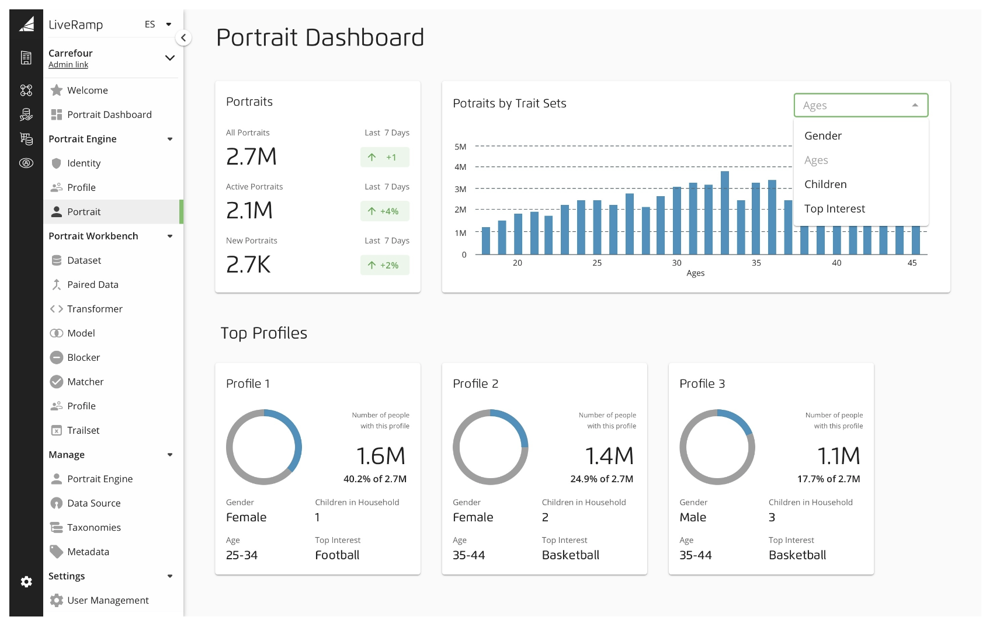
Introducing
Portrait
Engine
LiveRamp’s first-party identity resolution system that reconciles customer data from any source to generate a stable identifier and build the most relevant customer view—
the portrait.
Notes:
DENNIS

Slide 27
Meeting the Identity Challenge
1
Modeling First-Party Relationships
Benefits
First Party
CRM
Support
Events
Xacts
Control
2
Produces Portraits: Brand IDs + Customer Data Views
Access
Global
BrandID001
BrandID002
BrandID003
BrandID004
Best Name
Best Email
Best Channel
Best
Recommendation
Notes:
DENNIS
TALKING POINTS
General benefits…
In response to challenges I talked about earlier, this is what we’re hearing from all of you; foundation of our design principles.
First-Party
Customers want help to build a first-party data strategy and they want to leverage their first-party assets
Control
More control over their customer identity processes
Access
Value in choice and benefits that come from connecting first-party data with LiveRamp’s leading ecosystem of partners
Value as well as from LiveRamp’s own innovation with privacy-enhancing solutions that extend the possibilities for data
Global
Access global markets more quickly
More choice in how those processes resolve to an individual profile

Slide 28
Resolution Challenge
Data Can Be Inconsistent, Incomplete, And Inaccurate
Match possibilities
Portrait 1
r#
Source
ipHash
ID
cookie
name
address
email
Unstructured Text
1
S1
0.84
r3
0.74
2
S1
r4
r3
r2
0.31
3
S2
0.88
4
S3
0.81
0.98
0.29
r7
5
S2
0.91
0.41
Portrait 2
6
S3
r8
r6
7
S4
r5
0.88
8
S3
No clear common identifier across sources of data
Inconsistent values
(eg. typos, misspelling)
Missing values
Resolved cluster
Notes:
DENNIS
TALKING POINTS:
Data is messy. Good news -- we’ve done this really well for 20 years. Now we’re exposing this IP for you to take control…

Slide 29

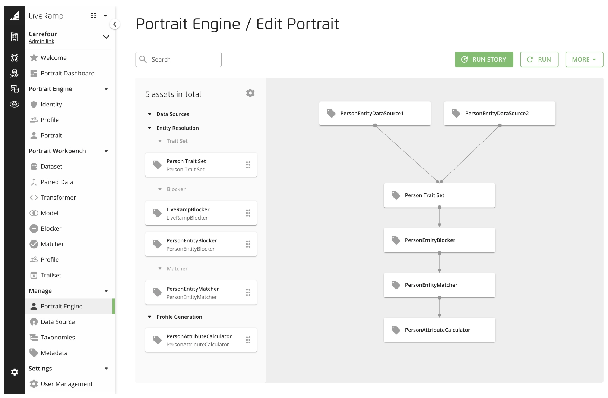
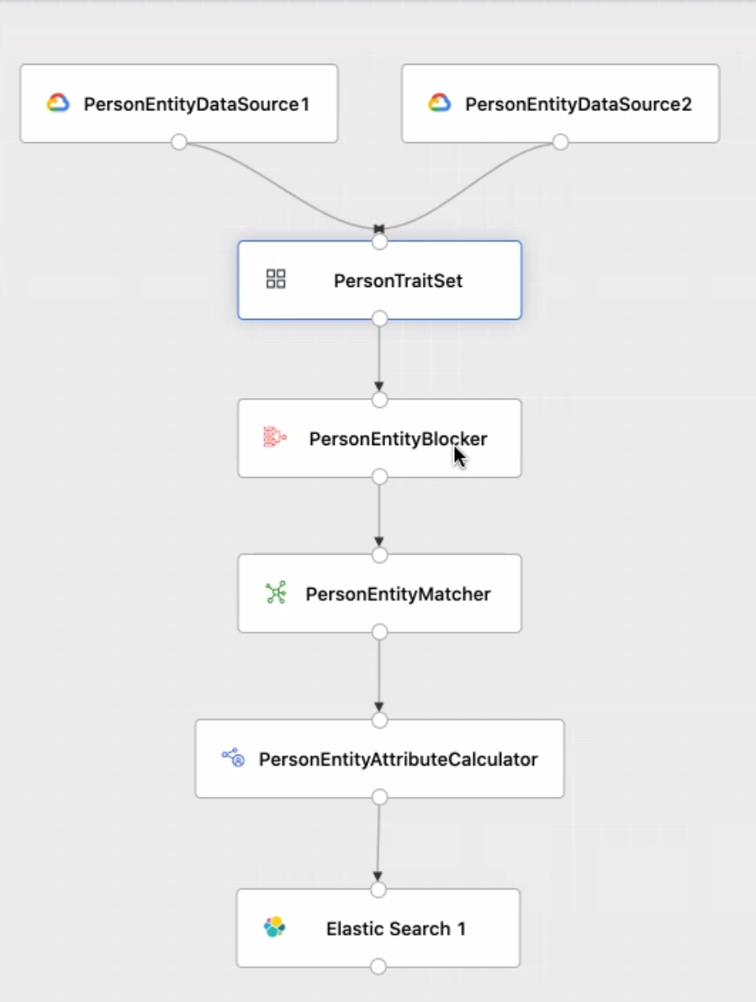
Let’s Take A Peek: Portrait Engine UI
Part Of The Workbench Workflow
Notes:
DENNIS
RESOLUTION PROCESS
Workflow to customize how we are resolving identity and understanding your customer.
Not limited to one way of building a portrait
[DENNIS TO THINK THROUGH TALK TRACK WITH USE CASES]

Slide 30
Critical Capabilities
Resolution
Enrichment
Translation
Notes:
DENNIS
DRAFT NOTES FOR TALKING POINTS
We’re creating this portrait… doing 3x things for you…
This makes the continuous identity…
What needs to happen with the evolution of identity?
We need more than just an ID append
We and other companies are saying, you need a big managed service to do this or we’re saying here’s an ID attached to your data, and you can figure it out
Neither is right for the modern ecosystem
By doing this, we’re enabling customization and configurability while keeping the core assets, all the IDs underneath; becoming a step obfuscated from the meat of it; we’re no longer pitching an ID, we’re pitching a customer profile and customer knowledge…
Enrichment is connecting that to all the other data you’re going to need to bring in b/c very few companies can manage a first-party only data strategy (you don’t have enough data that you’re collecting from the customer in order to get a robust view)… so what else do you need to do?
Translation piece (we’ve always done this really well): how does that identity move between spaces when you want to collaborate or activate that data
Or measure that data from other activations you’ve already done, etc.
This is where we’re heavily investing

Slide 31
End-to-End Connectivity
LiveRamp
and Identity
Identity Infrastructure
Identity
in the Cloud
Securing the Future of Identity
Notes:
TRAVIS
At every phase of the data life cycle
Not just an identifier…
Work w/ clients end-to-end

Slide 32
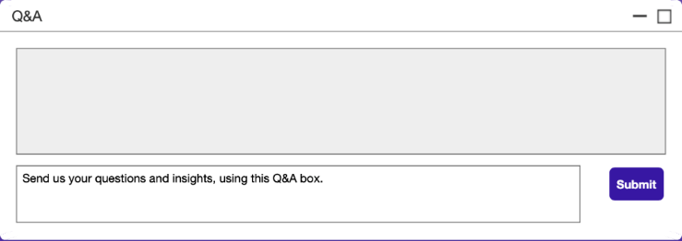
Audience Q&A
Moderators:
Alex Barocas
BCG Partner &
Associate Director
Adil Riaz
Expert Project Leader
Travis Clinger
SVP of addressability
and ecosystem
Dennis Ellis
VP Product,
GM Identity Infrastructure
SUBMIT QUESTIONS VIA THE Q&A BOX
JOIN THE DEBATE ON SOCIAL
#IdentifiersDebate

Slide 33

THE GREAT IDENTIFIER DEBATES:
After-session Panel Discussion
Matt Prohaska
CEO & Principal
Prohaska Consulting
Jeremy Hlavacek
Head of Revenue
IBM Watson Advertising
Vincent Rinaldi
Head of Investment and Activation
Wavemaker @ GroupM
Joel Rubinson
MMA MTA Expert
President
Rubinson partners, inc.

Slide 34

THE GREAT IDENTIFIER DEBATES
In partnership with:
30
9
5
ALL IDENTITY SOLUTIONS IN ONE PLACE
TO REGISTER & LEARN MORE:
mmaglobal.com/identifiers
Join the Discussion: #IdentifiersDebate
MARKETING EXPERTS
PRODUCT REVIEW SESSION
PANEL
DEBATES
Neustar Fabrick: Identity Product Overview
Fabrick™ — Neustar's identity-based customer cloud — powers data management, media activation, and marketing analytics without a reliance on cookies or mobile ad IDs. Brands, publishers and platforms can leverage innovations in identity-powered media and measurement to drive better marketing outcomes and competitive advantage in a post device-ID future.
UP NEXT
Michael Schoen
SVP, GM Marketing Solutions
Neustar Fabrick
11 June, 2021
11:00 am ET

Slide 35

THANK YOU
For Questions or More Information:
Greg Stuart
greg@mmaglobal.com
mmaglobal.com/identifiers
Join the Discussion: #IdentifiersDebate
THE GREAT IDENTIFIER DEBATES

