Slide 1
The Future of Brand-Human Messaging
April 27, 2021
Jeremy Goldman
Principal Analyst

Slide 2
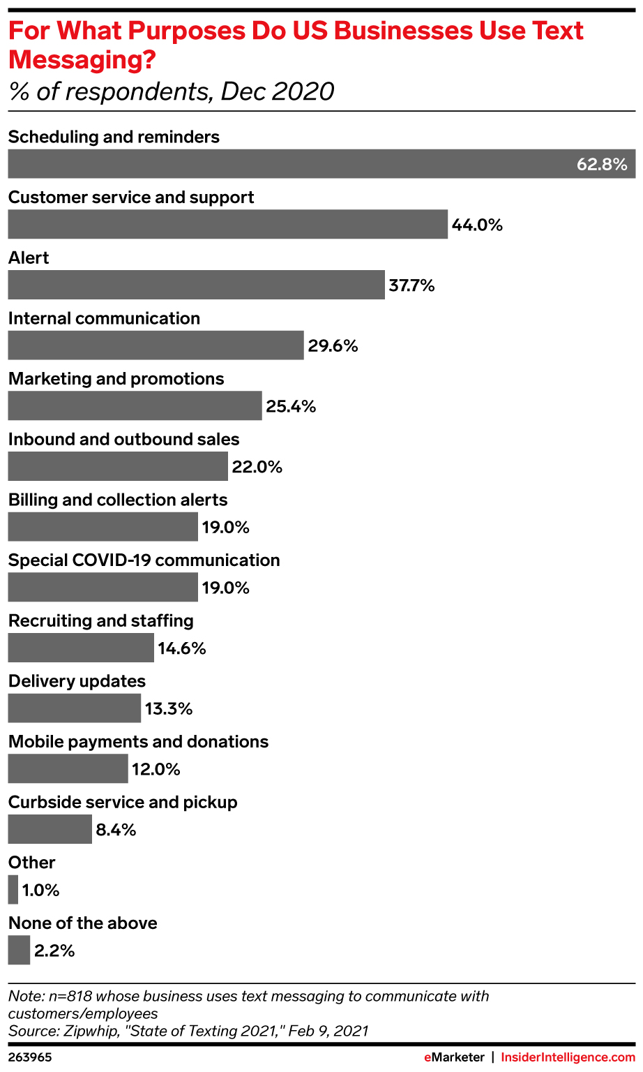
B2C messaging has a multitude of use cases.
As time goes on, we expect brands to discover an increasing number of potential applications for this technology.
Notes:
While RCS adoption is expected to grow in the US, it will likely grow faster in other markets, in part because iPhones are more prevalent in the US than elsewhere. Mobile intelligence firm Mobilesquared projects that the US will be the fifth largest RCS market in 2023 with 101.1 million users but will drop to 10th overall by 2028.
Of note: Nigeria 105% 5-year growth;
=117.6/43.6

Slide 3
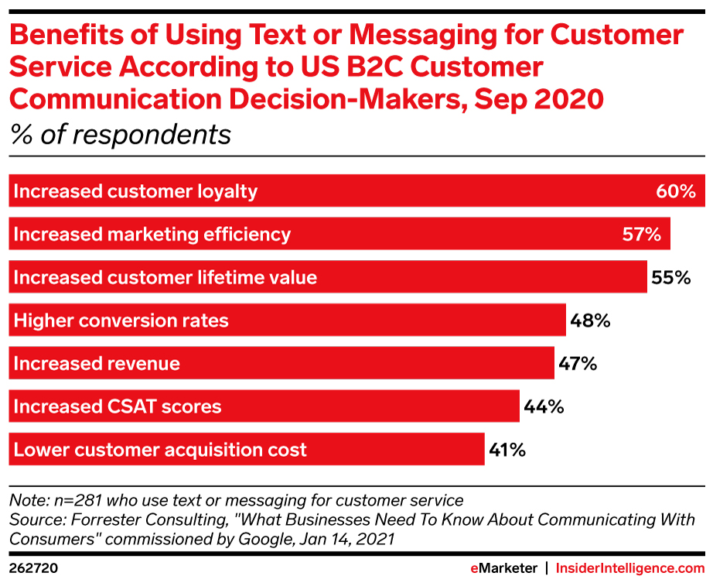
US B2C marketers are turning to texts for many reasons.
With customer loyalty an increasingly difficult thing to attain, it remains one of the main reasons to message with customers. Increasing customer LTV is another oft-cited reason to communicate this way.
Notes:
While RCS adoption is expected to grow in the US, it will likely grow faster in other markets, in part because iPhones are more prevalent in the US than elsewhere. Mobile intelligence firm Mobilesquared projects that the US will be the fifth largest RCS market in 2023 with 101.1 million users but will drop to 10th overall by 2028.
Of note: Nigeria 105% 5-year growth;
=117.6/43.6

Slide 4
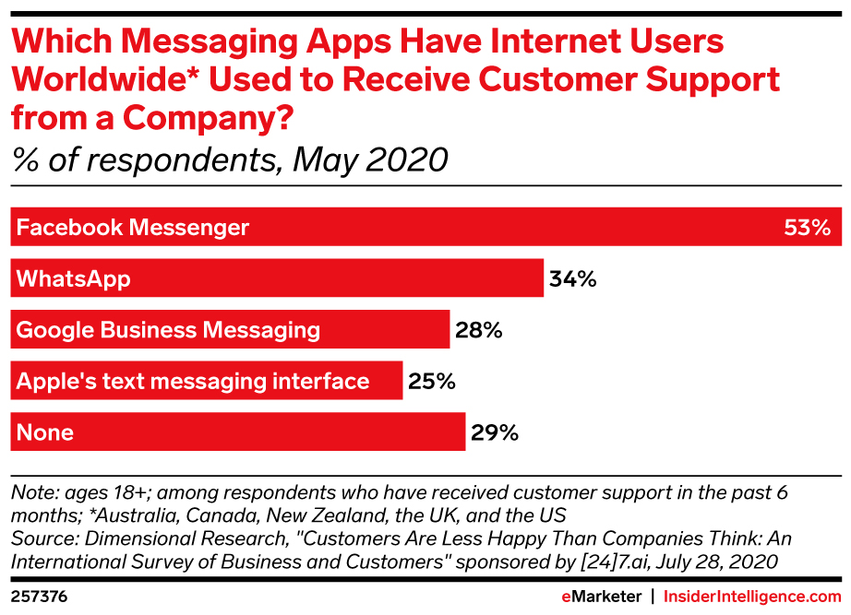
Increasingly, consumers are getting comfortable with support through messaging apps.
Notes:
While RCS adoption is expected to grow in the US, it will likely grow faster in other markets, in part because iPhones are more prevalent in the US than elsewhere. Mobile intelligence firm Mobilesquared projects that the US will be the fifth largest RCS market in 2023 with 101.1 million users but will drop to 10th overall by 2028.
Of note: Nigeria 105% 5-year growth;
=117.6/43.6

Slide 5
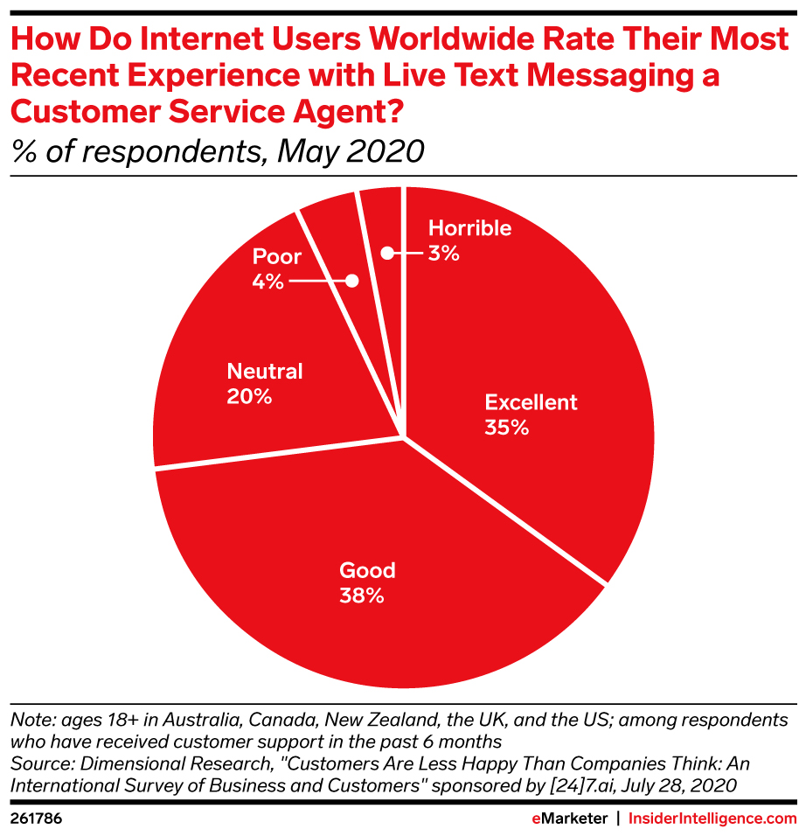
Fully 73% of internet users worldwide rate texting with customer service as good or excellent.
This bodes well for the industry, considering the technology is relatively new and bound to improve in the coming years.
Notes:
While RCS adoption is expected to grow in the US, it will likely grow faster in other markets, in part because iPhones are more prevalent in the US than elsewhere. Mobile intelligence firm Mobilesquared projects that the US will be the fifth largest RCS market in 2023 with 101.1 million users but will drop to 10th overall by 2028.
Of note: Nigeria 105% 5-year growth;
=117.6/43.6

Slide 6
Rich Communication Service (RCS) Advantages
RCS offers features more akin to a robust social messaging app such as WhatsApp, WeChat, iMessage, or Facebook Messenger. Brands may gravitate to RCS for its:
Custom branding and colors
Rich cards: app-like experiences but within a standard texting app
Suggested actions: a set of buttons suggesting responses or actions, such as “find a location near me” or “have a representative call me”
Quick replies: the ability to tap buttons within an RCS exchange to receive a quick precomposed message from a brand, like what users might find in a chatbot
SMS/MMS fallback: customers who cannot receive RCS messages can receive a “backup” SMS/MMS from the brand
Notes:
RCS is almost certainly the future of B2C text messaging. SMS is an old workhorse, but RCS is capable of far more.
In many ways, RCS offers features more akin to a robust social messaging app, such as WhatsApp, WeChat, iMessage, or Facebook Messenger. Some features that brands might be particularly interested in include:
Custom branding and colors
Rich cards: app-like experiences but within a standard texting app
Suggested actions: a set of buttons suggesting responses or actions, such as “find a location near me” or “have a representative call me”
Quick replies: the ability to tap buttons within an RCS exchange to receive a quick precomposed message from a brand, like what users might find in a chatbot
SMS/MMS fallback: customers who cannot receive RCS messages can receive a “backup” SMS/MMS from the brand
While SMS and MMS are for short exchanges and basic visual elements, the possibilities with RCS are anything but limited: Just about anything built within an app can be built within RCS. For example, a retailer could allow consumers to send an RCS message with their zip code and receive an automated reply. Once a consumer’s mobile operator launches RCS, their device will automatically upgrade from SMS to RCS.
While RCS’s features won’t render texting campaigns entirely obsolete, the expectations around customer experience will undoubtedly change. In 2020, brands may receive some praise for allowing customers to text with them; within a few years, the bar will be substantially higher.

Slide 7
RCS Use Cases
Almost anything built within an app can be built within RCS, including a rich back-and-forth conversation.
Potential applications:
A customer in search for a particular item sends a message with their postal code and receives a reply from a retailer indicating where that product is in stock.
A customer shares a product’s serial number to check warranty status.
A restaurant patron places an order, all while asking questions about allergens, adding customizations, etc.
A customer asks a brand for real-time status updates as to where a serviceperson is on their route.
Notes:
RCS is almost certainly the future of B2C text messaging. SMS is an old workhorse, but RCS is capable of far more.
In many ways, RCS offers features more akin to a robust social messaging app, such as WhatsApp, WeChat, iMessage, or Facebook Messenger. Some features that brands might be particularly interested in include:
Custom branding and colors
Rich cards: app-like experiences but within a standard texting app
Suggested actions: a set of buttons suggesting responses or actions, such as “find a location near me” or “have a representative call me”
Quick replies: the ability to tap buttons within an RCS exchange to receive a quick precomposed message from a brand, like what users might find in a chatbot
SMS/MMS fallback: customers who cannot receive RCS messages can receive a “backup” SMS/MMS from the brand
While SMS and MMS are for short exchanges and basic visual elements, the possibilities with RCS are anything but limited: Just about anything built within an app can be built within RCS. For example, a retailer could allow consumers to send an RCS message with their zip code and receive an automated reply. Once a consumer’s mobile operator launches RCS, their device will automatically upgrade from SMS to RCS.
While RCS’s features won’t render texting campaigns entirely obsolete, the expectations around customer experience will undoubtedly change. In 2020, brands may receive some praise for allowing customers to text with them; within a few years, the bar will be substantially higher.

Slide 8
Technical Hurdles to RCS Adoption
Google’s RCS is now available worldwide through the Google Messages app available to Android users.
Samsung Messages app users are also starting to gain access to RCS features to communicate in feature-rich group chats, send large video files, respond to messages with reactions, enable client-to-server encryption, and more.
Android phones are getting messaging features that somewhat resemble Apple’s iMessage.
Apple prefers to keep iMessage as its standard, as the iPhone 12 shipped without RCS support. The company has not indicated whether it will support RCS.
Once a consumer’s mobile operator launches RCS, devices automatically upgrade from SMS to RCS.
Notes:
Google’s RCS, based on the Universal Profile RCS standard, is now available worldwide through the Google Messages app available to Android users.
Samsung Messages app users are also starting to gain access to RCS features to communicate in feature-rich group chats, send large video files, respond to messages with reactions, enable client-to-server encryption, and more.
Android phones are getting messaging features that somewhat resemble Apple’s iMessage.
As of this writing, Apple prefers to keep iMessage as its standard, as the iPhone 12 shipped without RCS support. The company has not indicated whether it will support RCS.
Once a consumer’s mobile operator launches RCS, their device will automatically upgrade from SMS to RCS.
While RCS’s features won’t render texting campaigns entirely obsolete, the expectations around customer experience will undoubtedly change.

Slide 9
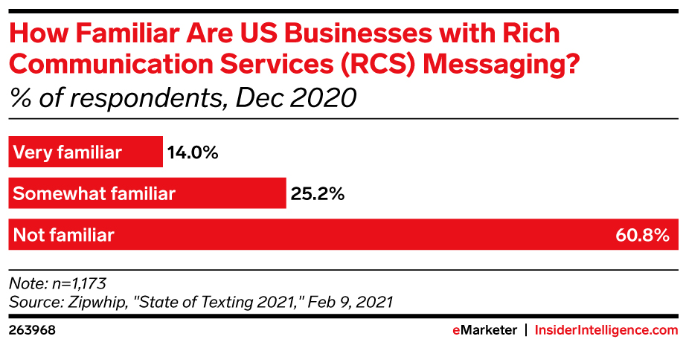
Many businesses are only now becoming aware of the possibilities of RCS.
Nearly 61% of US businesses aren’t familiar with RCS messaging. As more prominent use cases go online, expect this number to decrease.
Notes:
While RCS adoption is expected to grow in the US, it will likely grow faster in other markets, in part because iPhones are more prevalent in the US than elsewhere. Mobile intelligence firm Mobilesquared projects that the US will be the fifth largest RCS market in 2023 with 101.1 million users but will drop to 10th overall by 2028.
Of note: Nigeria 105% 5-year growth;
=117.6/43.6

Slide 10
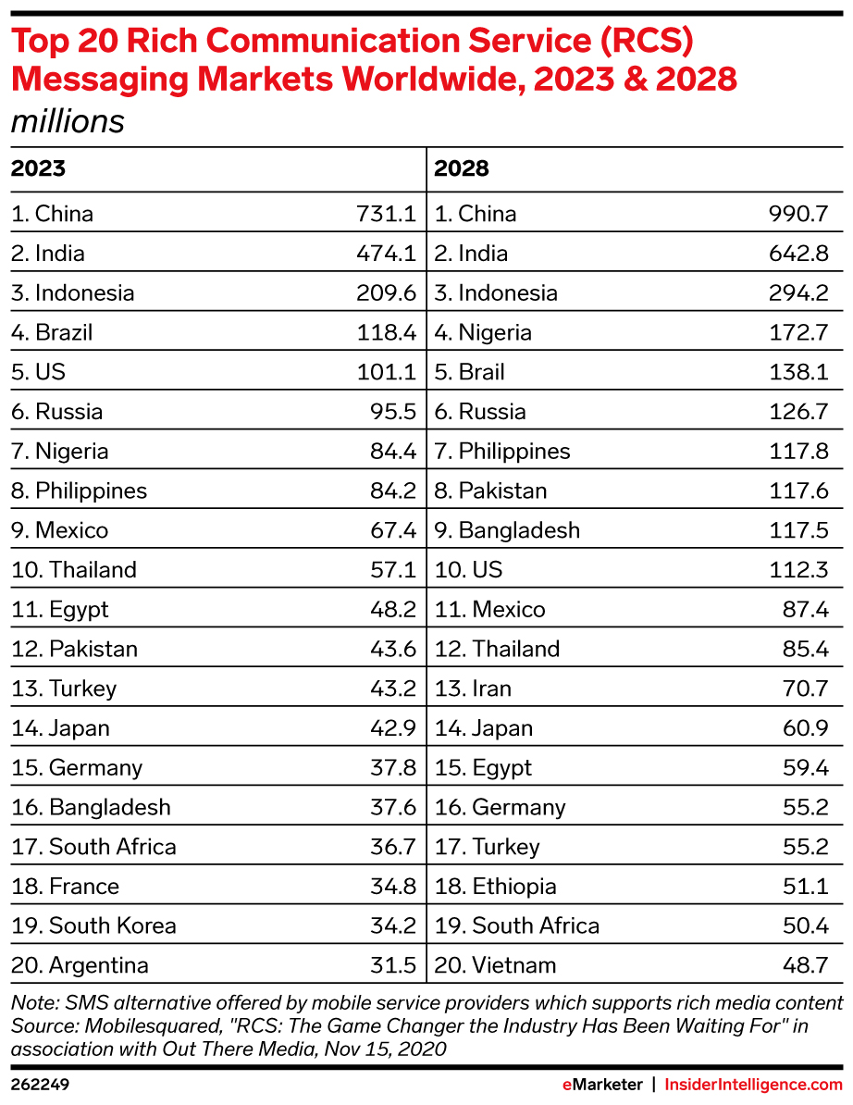
RCS’s five-year growth is more than promising.
iPhones are more prevalent in the US than elsewhere, which will impact US RCS adoption growth.
Some markets will experience significant five-year growth:
Pakistan: 170%
Nigeria: 105%
Mobilesquared projects that the US will be the fifth-largest RCS market in 2023, with 101.1 million users, but it will drop to No. 10 overall by 2028.
RCS users will go from 1.2 billion in 2020 to 3.9 billion in 2025 (Juniper research).
Notes:
While RCS adoption is expected to grow in the US, it will likely grow faster in other markets, in part because iPhones are more prevalent in the US than elsewhere. Mobile intelligence firm Mobilesquared projects that the US will be the fifth largest RCS market in 2023 with 101.1 million users but will drop to 10th overall by 2028.
Of note: Nigeria 105% 5-year growth;
=117.6/43.6

Slide 11
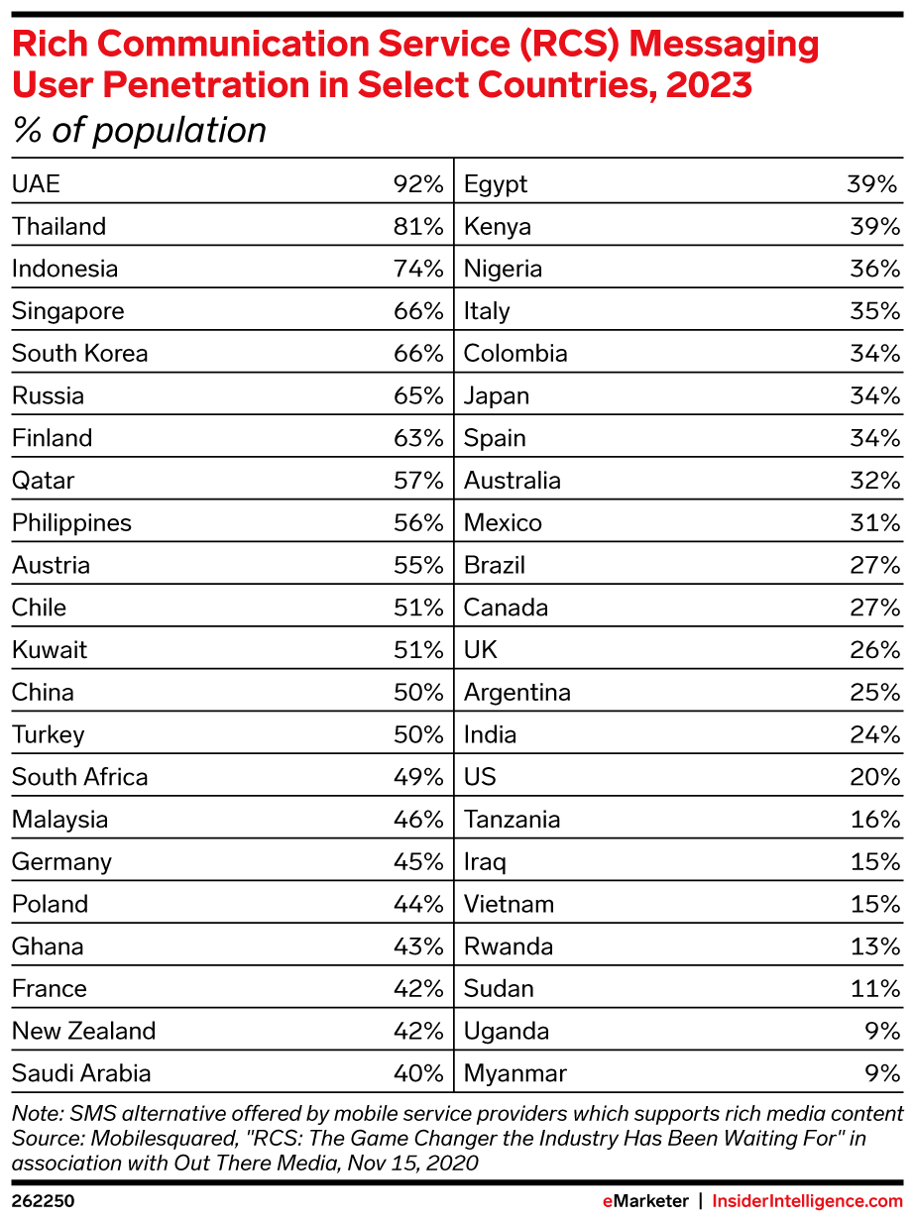
Even at present, RCS penetration is significant.
Mobilesquared estimates that by 2028, brands will be able to reach 61% of smartphone users via RCS and that “just like SMS today, RCS will offer universality.”
RCS business messaging traffic worldwide will grow from 160 million in 2020 to 415 billion by 2025, per Juniper Research.
Notes:
Mobilesquared estimates that by 2028, brands will be able to reach 61% of smartphone users via RCS and that “just like SMS today, RCS will offer universality.” RCS business messaging traffic worldwide will grow from 160 million in 2020 to 415 billion by 2025, per Juniper Research.

Slide 12
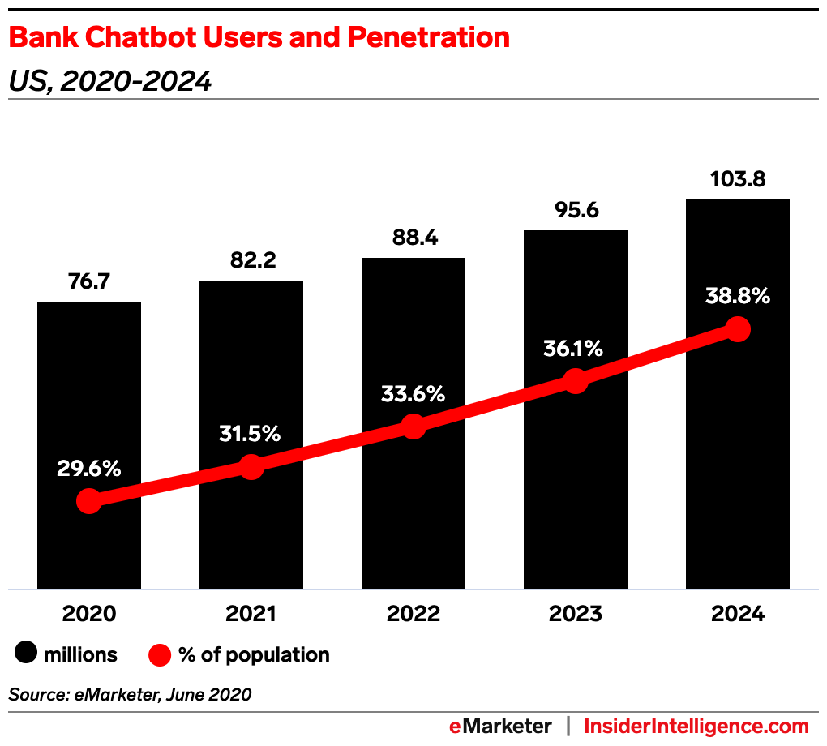
In US banking alone, chat penetration will reach almost 40% of the population by 2024.
By the end of our forecast period in 2024, nearly 50% of US digital banking users will use a bank chatbot at least once a year.
Notes:
Having a complete & accessible view of all customer interactions, be they sales, ecommerce, or marketing, leads to better interactions with the customer. Across the board, top performers give greater visibility, underperformers give poor visibility.
What’s more, 79% of service professionals say
it’s impossible to provide great
service without a complete view of
customer interactions.

Slide 13
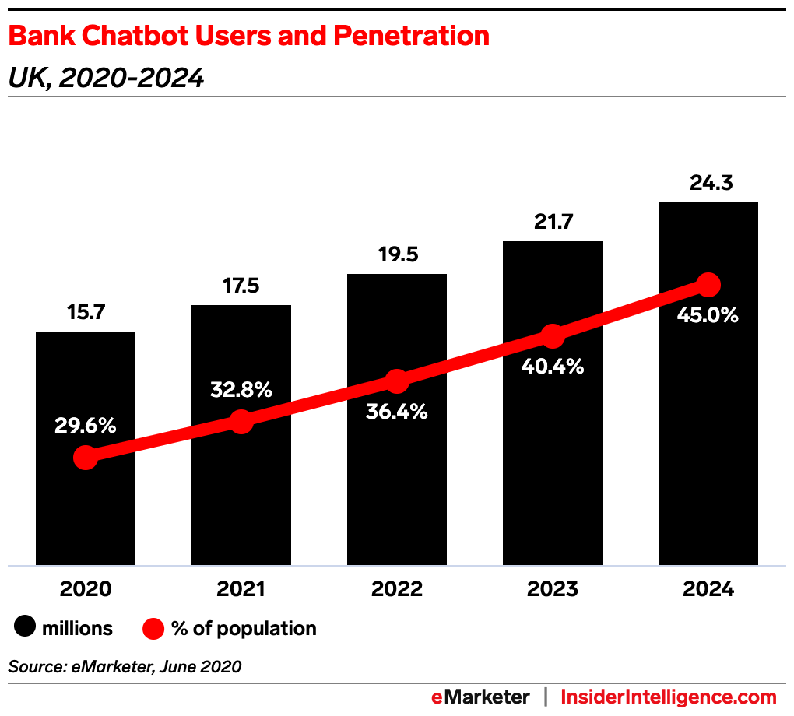
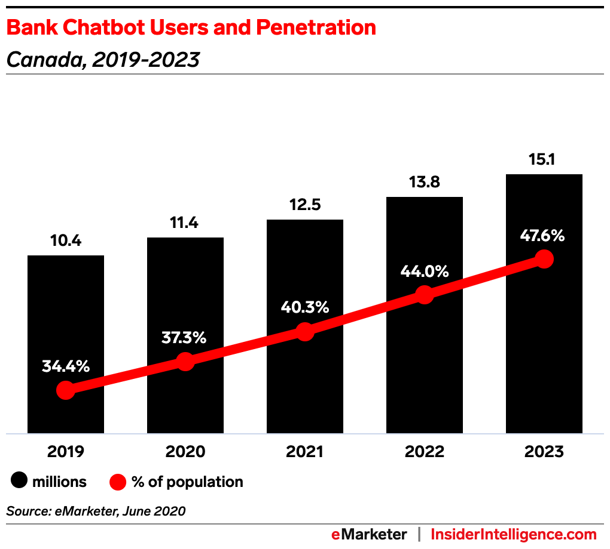
This is far from a US-specific phenomenon.
In the UK, 60.9% of digital banking users will be using chatbots to engage in conversations by 2024. In Canada, 65.9% of digital banking users will be engaging in chatbot exchanges by 2023.
Notes:
Having a complete & accessible view of all customer interactions, be they sales, ecommerce, or marketing, leads to better interactions with the customer. Across the board, top performers give greater visibility, underperformers give poor visibility.
What’s more, 79% of service professionals say
it’s impossible to provide great
service without a complete view of
customer interactions.

Slide 14
We predict that consumer retail spend via chatbots worldwide will reach $142 billion by 2024—up from just $2.8 billion in 2019.

Slide 15
Conversational AI & Chatbots
Nearly 40% of internet users worldwide prefer interacting with chatbots than virtual agents (Mittel).
Nearly 81% of marketing leaders consider chatbot sessions to be a “very effective” way of connecting with customers (CMO Council).
With major industries including retail and healthcare turning to digital technology, chatbots will likely increase in popularity moving forward.
The Asia-Pacific region is projected to experience the highest growth between now and 2025 (Adroit).
The global chatbot market size is anticipated to reach nearly US$15 billion by 2025, growing at a CAGR of between 22% (Valuates) and nearly 30% (Adroit) from 2018 through 2025.
Notes:
RCS is almost certainly the future of B2C text messaging. SMS is an old workhorse, but RCS is capable of far more.
In many ways, RCS offers features more akin to a robust social messaging app, such as WhatsApp, WeChat, iMessage, or Facebook Messenger. Some features that brands might be particularly interested in include:
Custom branding and colors
Rich cards: app-like experiences but within a standard texting app
Suggested actions: a set of buttons suggesting responses or actions, such as “find a location near me” or “have a representative call me”
Quick replies: the ability to tap buttons within an RCS exchange to receive a quick precomposed message from a brand, like what users might find in a chatbot
SMS/MMS fallback: customers who cannot receive RCS messages can receive a “backup” SMS/MMS from the brand
While SMS and MMS are for short exchanges and basic visual elements, the possibilities with RCS are anything but limited: Just about anything built within an app can be built within RCS. For example, a retailer could allow consumers to send an RCS message with their zip code and receive an automated reply. Once a consumer’s mobile operator launches RCS, their device will automatically upgrade from SMS to RCS.
While RCS’s features won’t render texting campaigns entirely obsolete, the expectations around customer experience will undoubtedly change. In 2020, brands may receive some praise for allowing customers to text with them; within a few years, the bar will be substantially higher.

Slide 16
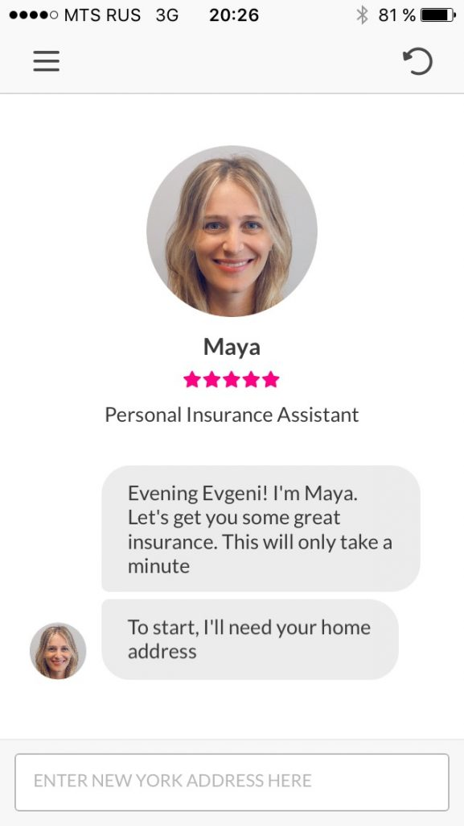
Lemonade’s chatbot, Maya
Insurtech firm Lemonade’s chatbot, Maya, uses NLP to collect the necessary information from consumers to provide them with a quote, handle payments, and personalize policies.
This enables Lemonade to onboard users in as little as 90 seconds, compared with the 10 minutes it takes for traditional insurers online.
Notes:
RCS is almost certainly the future of B2C text messaging. SMS is an old workhorse, but RCS is capable of far more.
In many ways, RCS offers features more akin to a robust social messaging app, such as WhatsApp, WeChat, iMessage, or Facebook Messenger. Some features that brands might be particularly interested in include:
Custom branding and colors
Rich cards: app-like experiences but within a standard texting app
Suggested actions: a set of buttons suggesting responses or actions, such as “find a location near me” or “have a representative call me”
Quick replies: the ability to tap buttons within an RCS exchange to receive a quick precomposed message from a brand, like what users might find in a chatbot
SMS/MMS fallback: customers who cannot receive RCS messages can receive a “backup” SMS/MMS from the brand
While SMS and MMS are for short exchanges and basic visual elements, the possibilities with RCS are anything but limited: Just about anything built within an app can be built within RCS. For example, a retailer could allow consumers to send an RCS message with their zip code and receive an automated reply. Once a consumer’s mobile operator launches RCS, their device will automatically upgrade from SMS to RCS.
While RCS’s features won’t render texting campaigns entirely obsolete, the expectations around customer experience will undoubtedly change. In 2020, brands may receive some praise for allowing customers to text with them; within a few years, the bar will be substantially higher.

Slide 17
Key Takeaways
Texting and messaging with brands is becoming a norm. This growth is being fueled by both the consumer and brands.
RCS is the future. Rich communications will enable many potential use cases, improving customer experience in the process.
Frictionless conversations will move to the mainstream. Conversations— human, AI, and hybrid—will become a standard feature of the marketing landscape for years to come.

