Slide 1
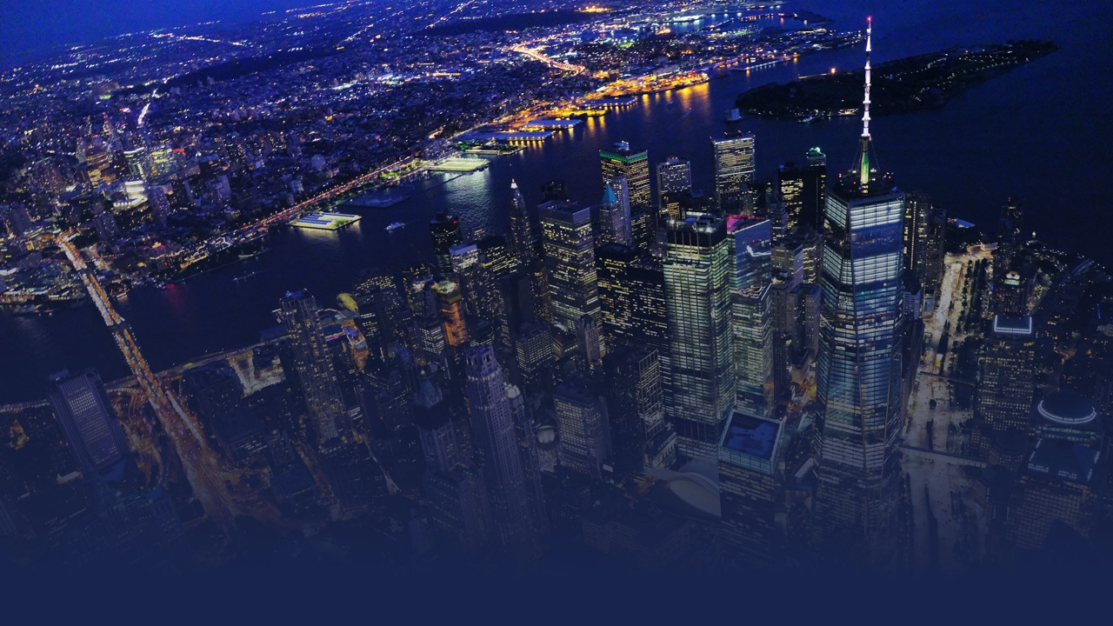

Maximize OTT performance:
How dynamic creative technologies and AI can influence the streaming advertising landscape

Slide 2





















MMA is the Global Industry Association for Marketing
Started in 2003; turned around in 2013
Operations in 15 countries
Marketer led; plus media sellers, tech and agencies
55+ team worldwide
25+ conferences in 15 countries
CHRIS BABAYODE
chris@mmaglobal.com
EMEA
LATAM
EMEA
Mexico
France
mdellapenna@inmarket.com
Brazil
Germany
Colombia
Middle East
HQ
Argentina
South Africa
APAC
Spain
China
Turkey
Vietnam
India
United Kingdom
ROHIT DADWAL
rohit.dadwal@mmaglobal.com
APAC
FABIANO LOBO
fabiano.lobo@mmaglobal.com
LATAM

Slide 3








































MMA Is 800+ Members Strong
MARKETERS, AGENCIES, MEDIA SELLERS, TECHNOLOGY & SOLUTION PROVIDERS
Notes:
x

Slide 4
MMA Mission: Architecting the Future of Marketing While Relentlessly Delivering Growth Today!
At the MMA, we believe the best way to thrive —and the only way to
survive — is to capture this zeitgeist NOW by aggressively adopting proven, peer-driven and scientific best practices, without compromise.
In all that we do, we are committed to bringing the right people together to challenge the status quo and provide a path forward.
We invest millions of dollars in rigorous research to arm marketers with unassailable truths and actionable tools.

Slide 5



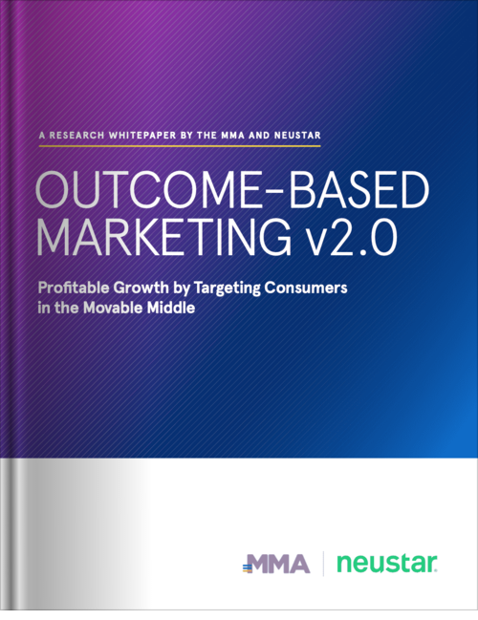









Outcome-Based Marketing 2.0 (OBM2)
Profitable Growth by Targeting The Movable Middle
  A new marketing growth framework that has been scientifically validated to outperform reach-based planning by more than 50%
  A practical approach to identify, quantify and target the most responsive audience for any brand
  A profitable strategy to win over non-buyers who are more likely to respond and build for the future of the brand
  Learn More & Download Whitepaper*
  mmaglobal.com/OBM
  Get Involved & Join the OBM2 Community
  OBM@mmaglobal.com
Academic Advisors
Marketer Advisors
Data Partner

Slide 6






A Year’s Worth of Insights & Education
Events designed to #ShapeTheFuture of marketing:
mmaglobal.com/events
Deep dive into the future of attribution.
Connected TV is at a tipping point –
discover how to add it into
your next campaign.
An invitation-only intimate gathering of industry thought leaders.
Event for data geeks or wannabe marketing data geeks.
Deep dive into marketing organization insights and knowledge.
Deep dive into the future of innovation & creative effectiveness.

Slide 8






TURNING THE CUSTOMER EXPERIENCE (CX) INTO A COMPETITIVE ADVANTAGE
JOIN THE FINAL SESSION!
MAY 18
The Future Of Messaging: How Companies Should Prepare for the Next Generation of Messaging
Rich messaging will become a more critical part of the customer journey in the future….
REGISTER NOW

Slide 9
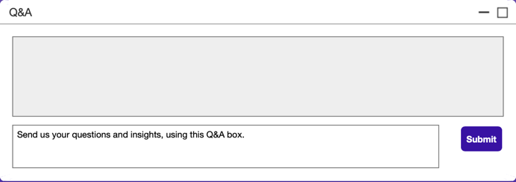

Asking Questions, Sharing Insights
#
#MMA #WeAreInItTogether #ShapeTheFuture

Slide 10


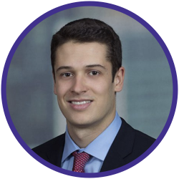
Maximize OTT performance:
How dynamic creative technologies and AI can influence the streaming advertising landscape
Clare Clifford
Product Marketing Lead
IBM Watson Advertising
Rachel Chukura
Offering Manager, IBM Watson Advertising Accelerator
IBM Watson Advertising
Tom Koch
Associate Director, Strategic Sales & Partnerships
Xandr

Slide 11
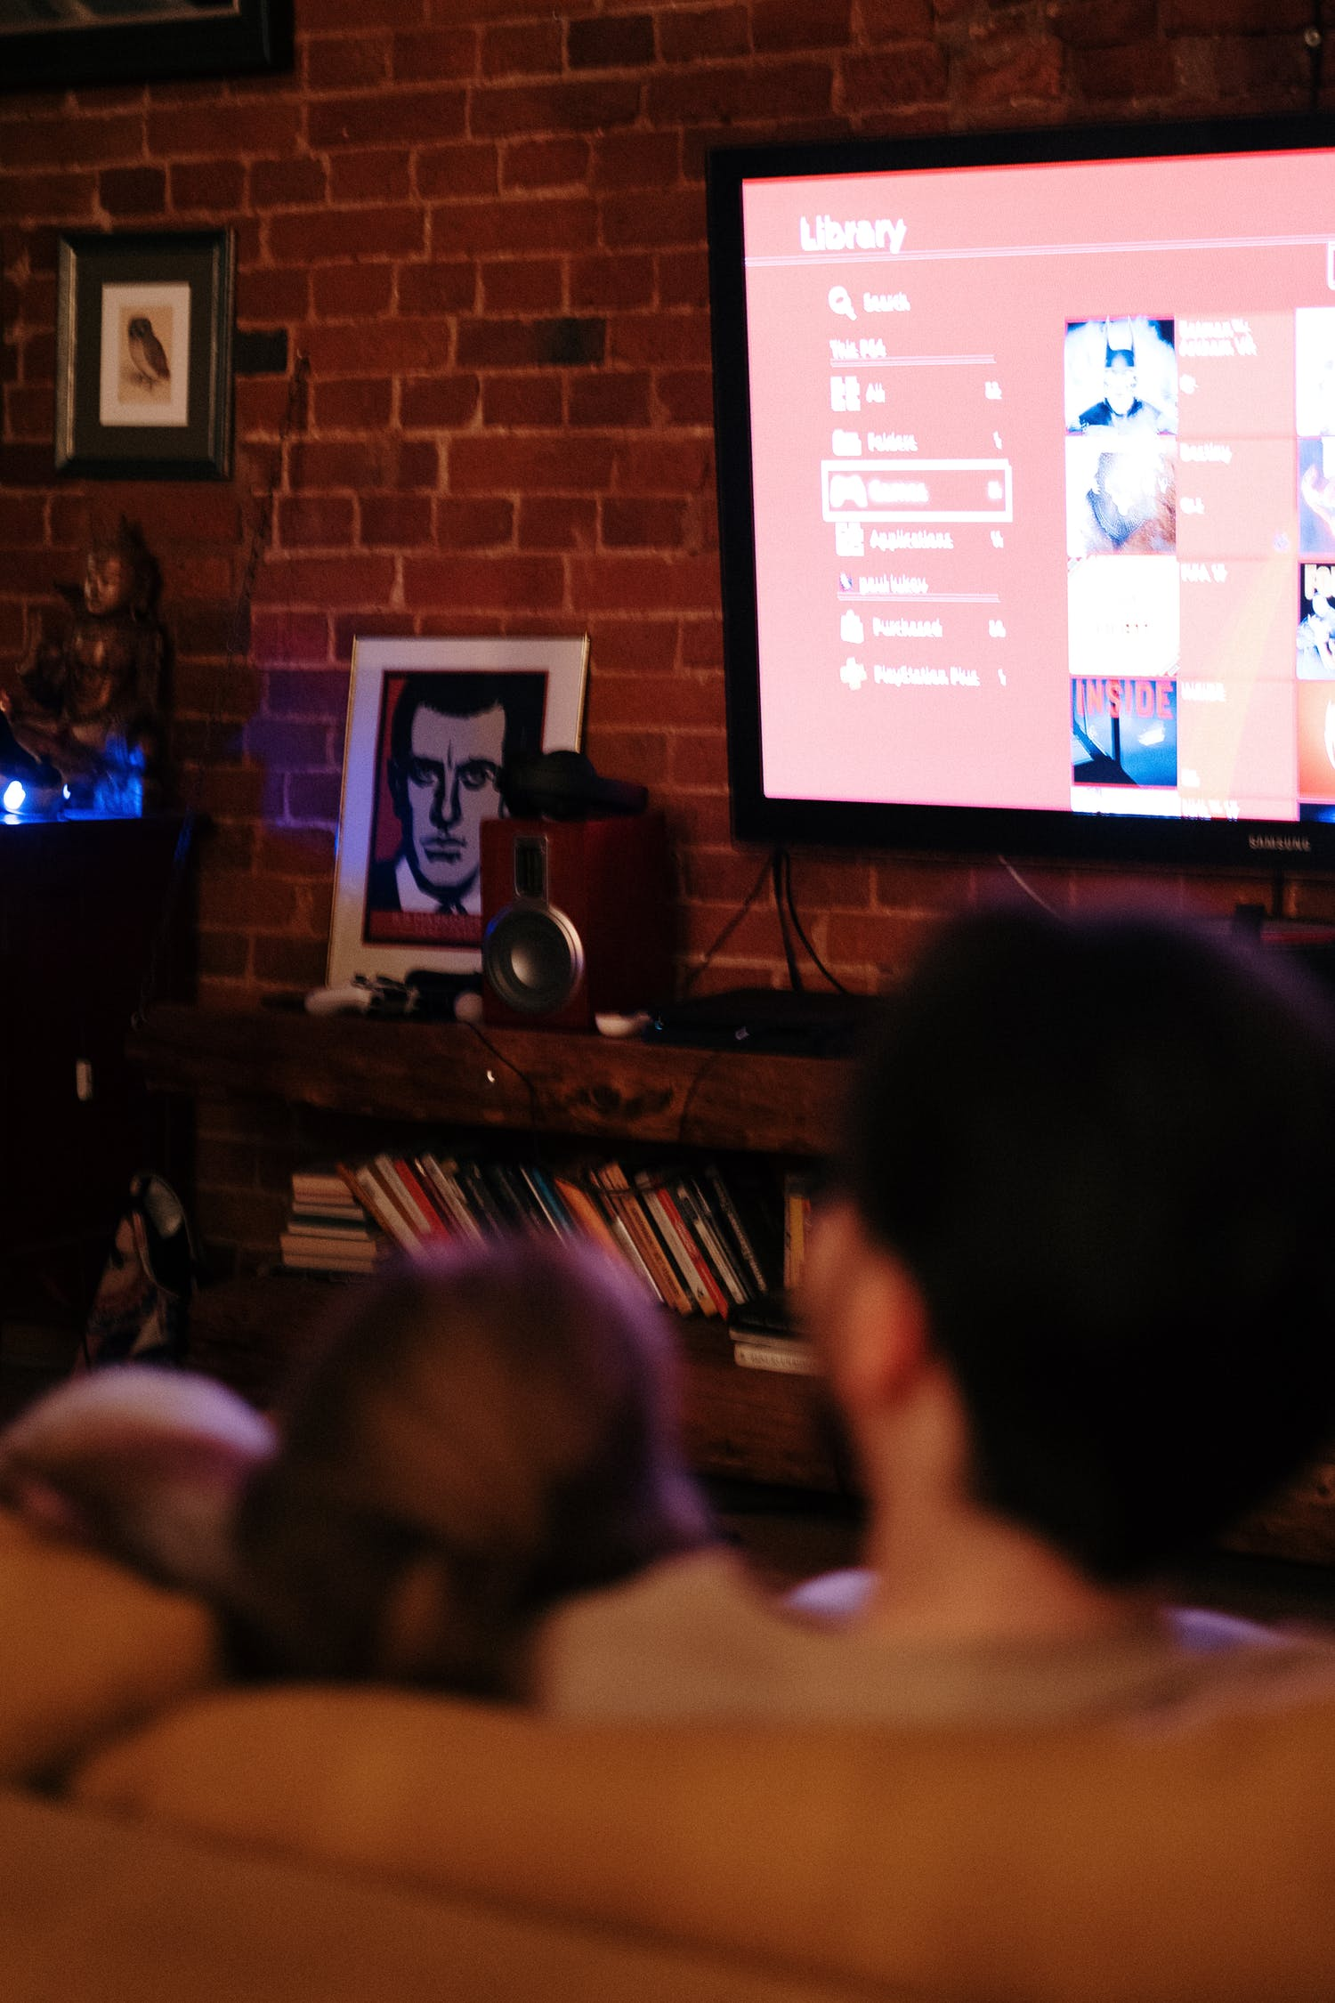
OTT
Over-the-top
video content streamed via the internet
=
CTV
Connected TV
the device used to stream OTT content
=

Slide 12
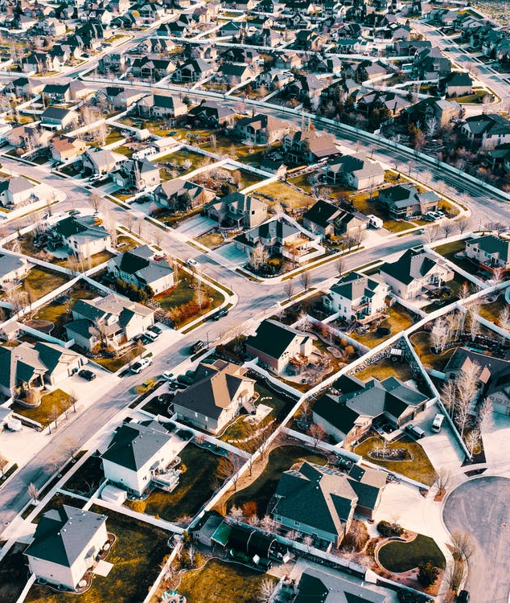
Via connected, streaming TV services, advertisers can reach more than
84 million households
=
Source: eMarketer 2021

Slide 13





Slide 14
Asking Questions, Sharing Insights
#
#MMA #WeAreInItTogether #ShapeTheFuture

Slide 15

Thank you!
Up Next:
Messaging Webinar Series:
The Future Of Messaging - How Companies Should Prepare For The Next-Generation Of Messaging
18 May - 11am ET - Register @ https://www.mmaglobal.com/webinars

