Slide 1
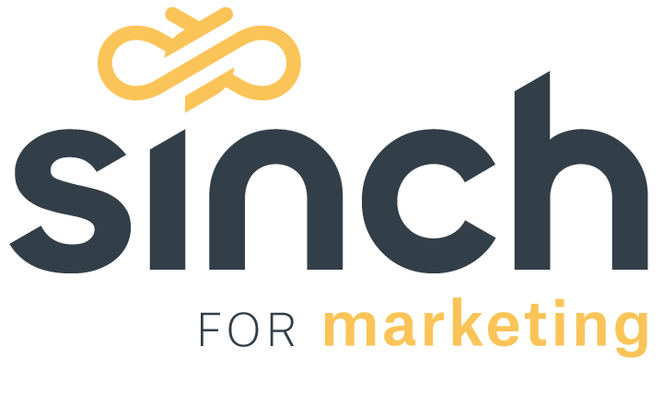
Notes:
Good day, my name is Matt Ramerman
President of Sinch for Marketing
A division of Sinch, the global leader in voice, video and messaging solutions for Enterprise’s world wide.
My team’s mission is to help Enterprises transform Customer Experience by
Leveraging the very best mobile marketing solutions from our broad suite of products and solutions.
I want to thank everyone for giving us this hour today to have a discussion around a subject I am personally very passionate
I want to thank the MMA for hosting
And I want to thank my co presenter Jeremey Godlman for his insight on this subject

Slide 2
Notes:
I want to open with a bold statement:
I believe this concept of “conversational marketing”
Is the most important paradigm shift for marketers
interested in driving campaign performance
as well as providing their customers with an
excellent service experience

Slide 3
What about?
96%
Notes:
What is Conversational Marketing?
The easiest way to understand “Conversational Marketing” is to think about it in context of the 96%
\96% is the average number of non-responders to average direct marketing efforts from Black Friday 2020

Slide 4
eMarketer “SMS Marketing Report”, 2020 Black Friday SMS conversion rate
4%
Notes:
That means, the inverse 4% is conversion rates from average direct marketing campaigns from last year
(as reported by my friend Jeremey from eMarketer)

Slide 5
eMarketer “SMS Marketing Report” 2020 Black Friday SMS conversion rate
4%*
* Up from 1% in 2019
Notes:
And at scale, 4% is meaningful
Especially when the 2019 average was 1%

Slide 6
5%
Notes:
However, is there more we can do as marketers
To serve the needs of the “Targeted audience”

Slide 7
6%
Notes:
That will both deliver excellence in brand experience

Slide 8
7%
Notes:
While driving up overall Marketing performance?

Slide 9
8%
Notes:
By inviting those customers to have a conversation
Instead of just pushing and trying to sell?

Slide 10
Today
Brand X
Notes:
I am a fan of the late David Ogilvy
And his method has defined Direct for much
Of the last 30 years

Slide 11
Today
Brand X
Customers
Notes:
Brands proactively or reactively
Identify an audience
Propensity
Buy
Churn

Slide 12
Today
Brand X
Customers
Notes:
We package a pithy carefully considered
Message
We send
And we wait and measure

Slide 13
Today
Brand X
Customers
Notes:
What MOST marketers don’t realize…
Something is happening
Consumers are responding
Here is an incredible FACT
in a recent study by Facebook & Boston Consulting from Holiday 2020 said, “2 out of 3 people GLOBALLY tried to message a business” about a promotion or offer.
2 out of 3 people GLOBALLY tried to message a business

Slide 14
Today
Brand X
Customers
Notes:
And unfortunately, the vast majority of brands are not prepared to listen capture or act on those reponses.

Slide 15
Next
Brand X
Customers
Notes:
The imperative today is to change the way we think and execute consumer direct communications
By inviting customers to have a conversation—to ask questions, not to just drive to urgency in an attempt to sell

Slide 16
Brand X
Customers
Notes:
We can still package tighly crafted outbound coomms

Slide 17
Brand X
Customers
Notes:
But we would suggest inviting customers to respond, to ask questions, to go deep

Slide 18
Brand X
Customers
Notes:
And thanks to powerful 2-way messaging technologies
Like the Sinch Engage Platform and our simple omni-channel APIs
Using powerful multilanguage, natural language understanding technologies
We can quickly understand the consumers intent

Slide 19
Brand X
Customers
Notes:
And respond with appropriate answers
Or refined offers

Slide 20
Brand X
Customers
Notes:
And the result , is highly satisfied customers and marketers

Slide 22
Evolution
Welcome to the
“Conversational Era”
Notes:
Weclome to the imperative
The Conversational Era

Slide 23
Four Steps to Greatness
Conversational Marketing
“Method & the Approach”
Notes:
So how do we pull this off with great success?
I am going to give you all the answers
First, its important to understand: Conversational Marketing
Is both a method and a approach
It is both technology powered, but it also requires a shift in how programs are designed and executed

Slide 24
First Step
Connect Where They Live
Notes:
First and most important
You have to connect with your customers where they live

Slide 25
First Step
Notes:
Its hard to over emphasize how important mobile messaging is to the customer journey
We all know messaging is wehre your customers live, it is how we communicate in all aspects of our lives
Messaging, in our view, should be the priority channel for all aspects of enterprise communications
Fueling alerts, marketing communications, transactions and customer service connections
Unlike email this channel is naturally 2-way and also a powerful channel for pushing video, images, coupons, wallet objects.

Slide 26
Second Step
Act Like a Friend

Slide 27
“Messaging is a privileged channel, bringing brands into the inner circle where you talk to your closest friends.” WIRED
Notes:
Its important to remember, messaging is a privileged channel (one reserved for those closest to your customer)
And with privilege comes tremendous responsibility

Slide 28
“Messaging is a privileged channel, bringing brands into the inner circle where you talk to your closest friends.” WIRED
Implications:
1. Personalization is cost of entry
2. Lead with an invitation to discuss
3. Soft-sell vs. hard-sell
Notes:
That privilege dictates
Personalization of content is cost of entry
It is a channel that expects a conversation and openness to have dialogue
It is a soft-sell, not hard sell channel

Slide 29
Third Step
Show Don’t Tell

Slide 30
Notes:
These channels are powerful multi-media devices
Which means you can take advantage of the most powerful format availlbe to you
Personalized video and rich media

Slide 31
Fourth Ingredient
Move to Conversation

Slide 32
Fourth Step
Conversational messaging is the single biggest paradigm shift taking place in the communications between brands and consumers.
By 2021, 50% of businesses will spend more on Conversational Applications than on mobile apps (Gartner)
Notes:
And lst is desigining your program to invite a conversation
To personalize your brand’s response
Lack customer data? You can discover preferences at the time of engagement by using conversational marketing and better target your offer.

Slide 33
Solution
Mobile Engagement Agency
Strategy, Conversational Design, Analytics, Program and Account Management, Content Development
Conversational Messaging Platform
Personalized Content (video, images, landing), 2-way NLU, Campaign Management
Global Omni-Messaging API
MMS, SMS, RCS, WhatsApp, Messenger, Line, Viber, Kakou Talk
Notes:
How do you bring together method & approach
Sinch can help from design to execution.
Global reach from our vast network
Simple connections using our omni-channel messaging API
Powerful 2-way conversational messaging platform with end-to-end personalization capabilities
And the best in the industry strategists and consultants to help design & deliver transformative programs

Slide 34
Vision
Bryan building end-to-end emulation
Conversation, product selection, handoff to live chat
Notes:
And the final slide. Is the ultimate vision for ”conversational marketing’ and the bridge between marketing and customer service is complete
In this

Slide 35
Turning your audience of a million into a million audiences of one
Seattle | Atlanta | San Francisco | Paris | Stockholm | Munich

