Slide 1
VIỆT NAM RURAL REPORT
Cốc Cốc Ad Platform
Honorably Published @ MMA Website

Slide 2
Rural definition
Vietnam rural is also changing rapidly in both demographics and lifestyles
URBAN: refers to the audiences living in 6 key cities in Vietnam including: Hanoi, Ho Chi Minh, Da Nang, Can Tho, Hai Phong, Bien Hoa
RURAL: geographical audiences in Tier 2 provinces in Vietnam, including both the sub-urban area (the capital city of the province) and areas outside of the city of those provinces.
RURAL in this context does not refers to income level of the audience.
More knowledgeable
Individuals 18+ YO
2018
2012
Post-high school
Grade 6-9
No formal education
Grade 10-12
Grade 1-5
More white collar workers
Individuals 18+ YO
2018
2012
Government staff / officials
White collar workers
Farmer / fisherman
Self-employed
Blue collar workers
Part-time jobs / others / unemployed
Source: Kantar

Slide 3
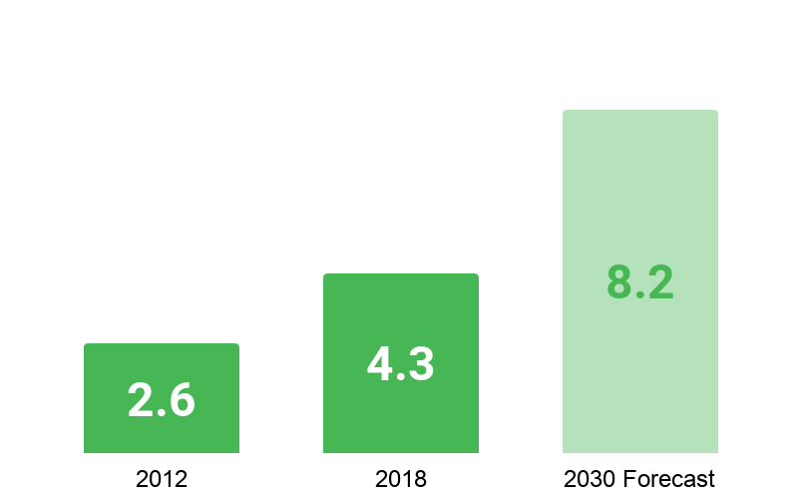
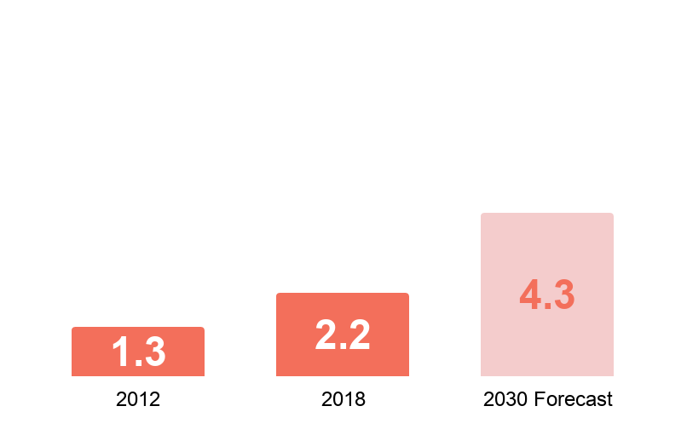
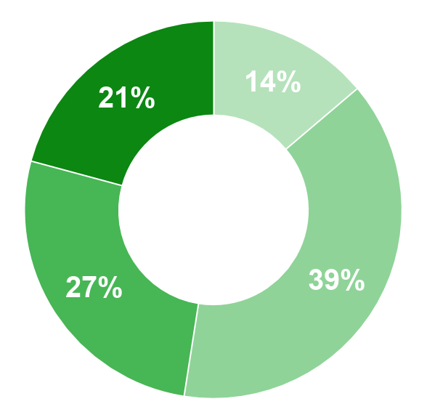
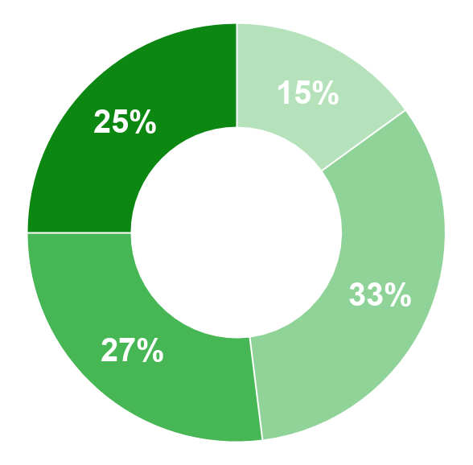
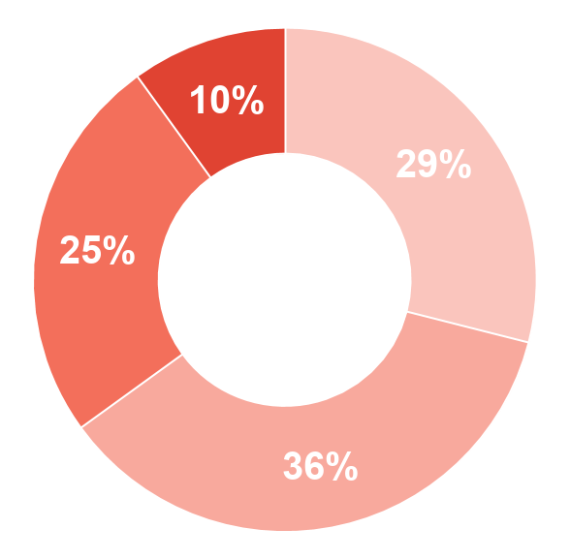
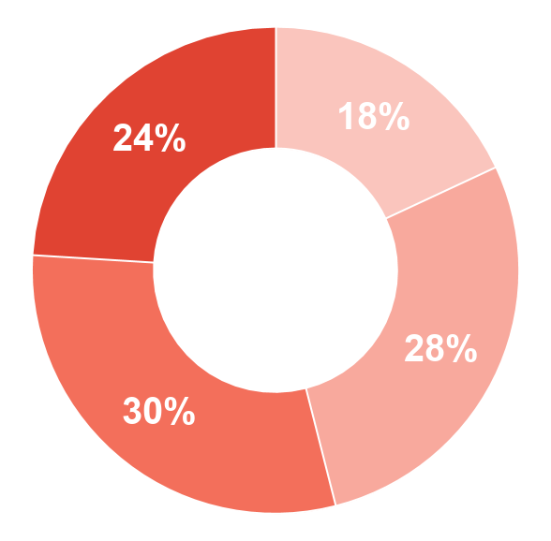
Economic growth
Urban
Rural
CAGR 2012-2030F
+6.5%
CAGR 2012-2018
CAGR 2012-2030F
+8.5%
+7.0%
Average monthly income per capita (million VND)
CAGR 2012-2018
+9.9%
% Households by income
2012
2019
2012
2019
High income
Mid Low income
High income
Mid Low income
Mid High income
Low income
Mid High income
Low income
Source: Kantar Worldpanel Division | Household Panel 12 months to September 2019 & Lifestyle Survey 2018

Slide 4
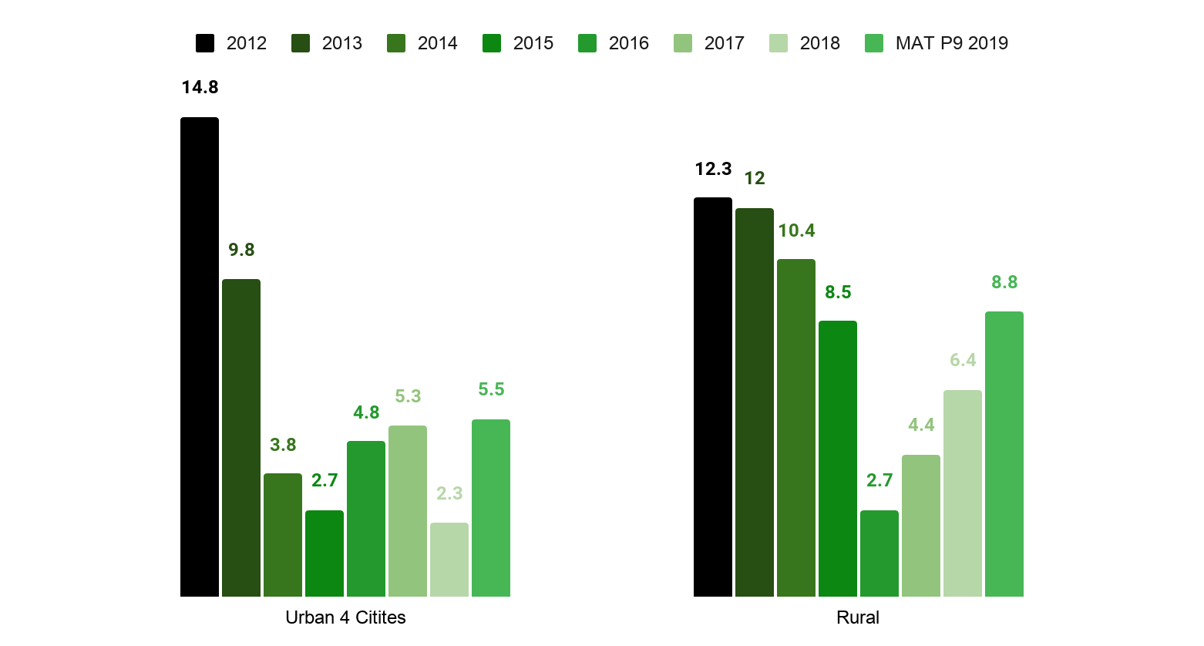
The FMCG growth for in-home consumption moves to a single-digit era, however showing positive signals to bounce back in rural
FMCG growth: rural vs urban
CAGR (2012 - 2019) | Urban 4 cities | Rural
Value | +6% | +8%
Volume | +4% | +7%
Avg. paid price | +2% | 0
Forecasted for 2020 - 2025
5% - 6%
Value Growth
Source: Kantar
Notes:
Source: Check lại slide Kantar

Slide 5
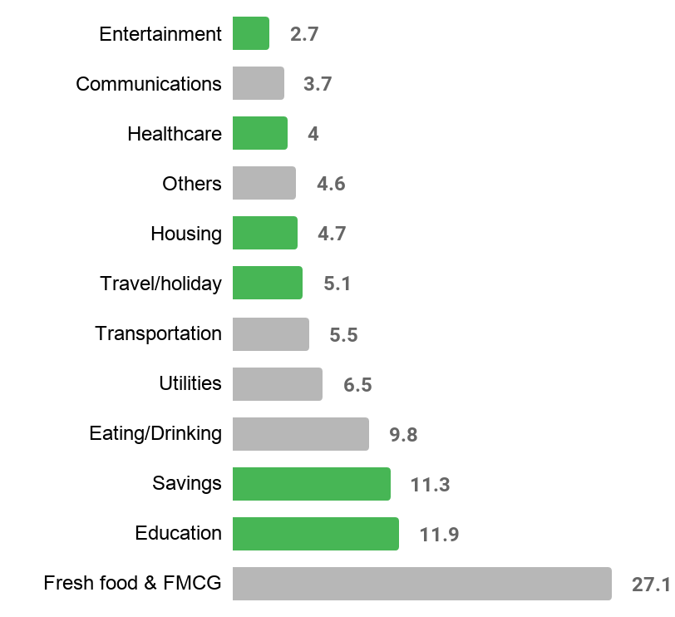
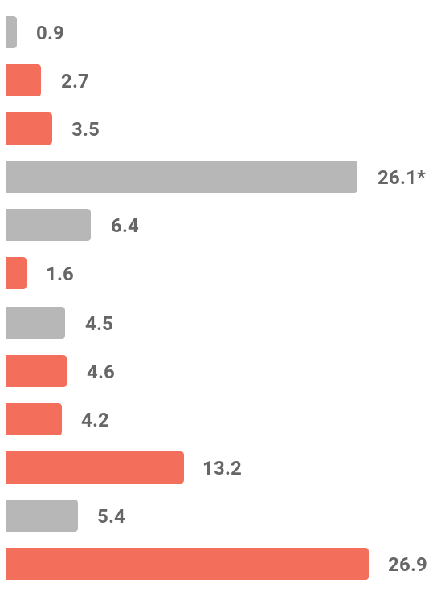
Consumer’s share of wallet
% Spending per month
Urban
Rural
Increase vs 3 YA
*Others in Rural include: Investment and Farming
Source: Kantar Worldpanel Division | Expenditure Survey 2018 | Urban 4 cities & Rural Vietnam

Slide 6
Rural shopping potential
Monthly household spending on Fresh food & FMCG
Spending per trip to Hyper & Supermarket
Spending per online shopping session
2.1M VND
164K VND
242K VND
44% of Urban cities
84% of Urban cities
68% of Urban cities
Monthly household income
Penetration
Penetration
7.9M VND
30%
9%
42% of Urban cities
78% in Urban cities
25% in Urban cities

Slide 7
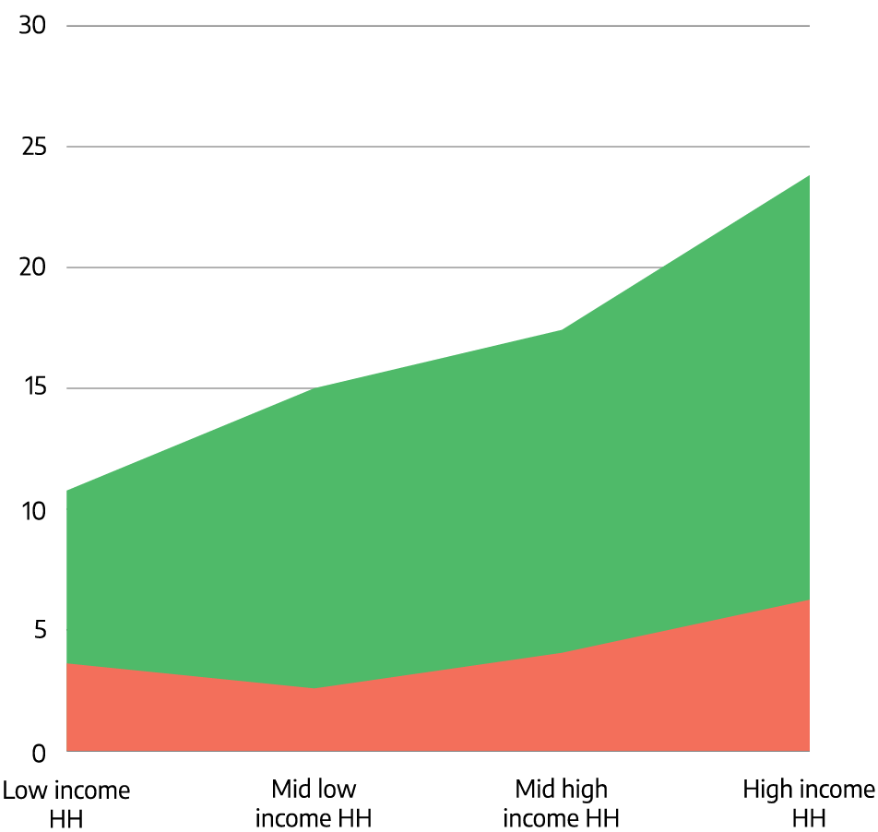
Shift from traditional to modern retailers: Mini-markets are winning rural consumers with the aggressive expansion of many players
Mini-markets - % Penetration
% shoppers in Minimarket by demographic
KEY ADVANTAGES:
Product Assortment: Similar to modernized street shops yet offering a wider/ more diverse range of products/ choices, high quality/ premium choices
Product Quality: Hybrid format between street shops & wet markets to offer branded fresh foods/ or with product origins
4%
15%
3%
2018
2019
2020
X5 Shopper Base
2 Mil
New Rural Household acquired
2019
2020

Slide 8
Rural Vietnam is on the edge of transformation:
gap between urban and rural is closing fast
Accelerating on the urbanization pathway
Highly polarized across rural regions
Annual Income
 | Urbanization speed | Poverty household
Red River | 63.33% | 1.7%
South East | 63.22% | 5.6%
South Central | 30.87% | 8.2%
Mekong Delta | 29.43% | 19.2%
Central Highland | 22.5% | 26.4%
Northern Midlands and Mountains | 15.53% | 18.5%
32M VND
University/ college graduate increases by
2.5 TIMES
FMCG consumption
51% National Sales
HUGE SOURCE OF GROWTH FOR BUSINESS
ONE SIZE DOES NOT FIT ALL
Source: Adtima
Notes:
Source: Check lại slide Kantar

Slide 9
60% OF VIETNAM POPULATION IS STILL RURAL AND THEY ARE BECOMING MORE AND MORE DIGITAL

Slide 10
Media Penetration in Rural Vietnam
TV is declining while internet is growing, especially smartphone, since 2018 in rural
89
86
84
75
82
70
68
69
27
25
10
6
a
TV programs
Internet
Mobile Internet
OOH
Radio
Newspaper
(print)
2017
2018

Slide 11
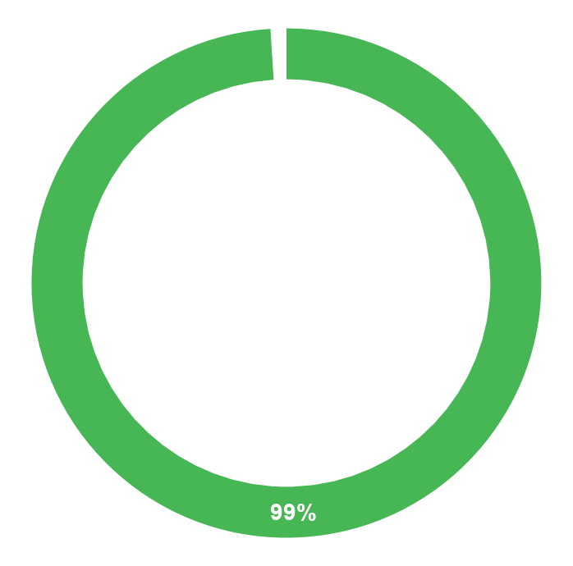
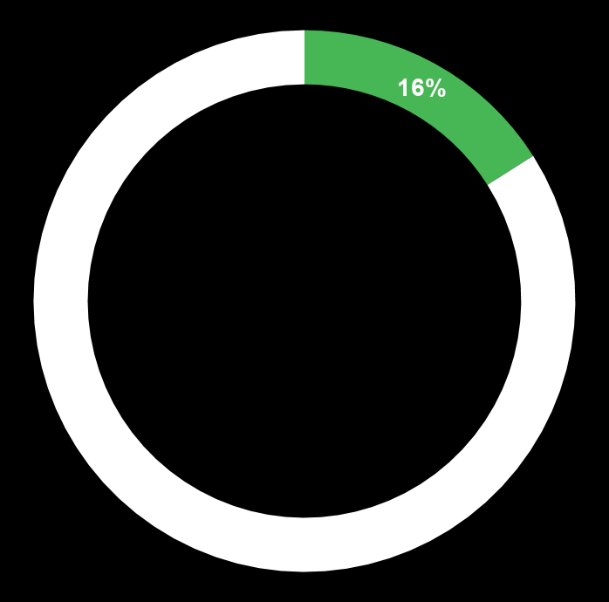
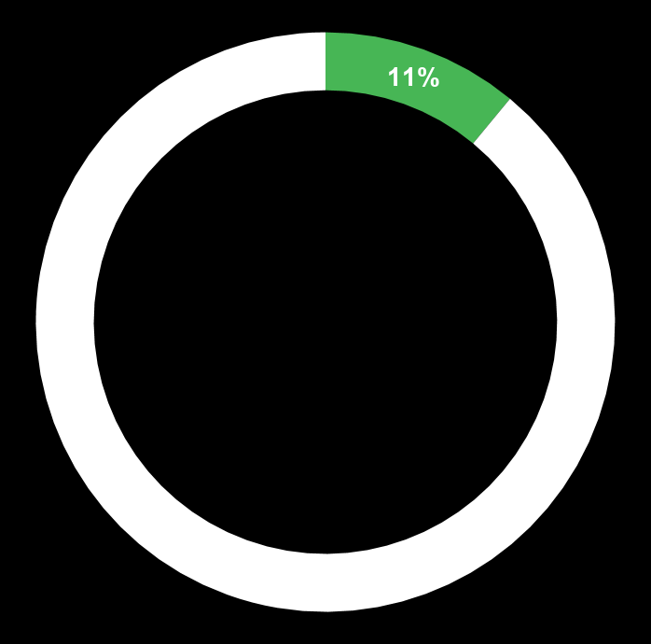
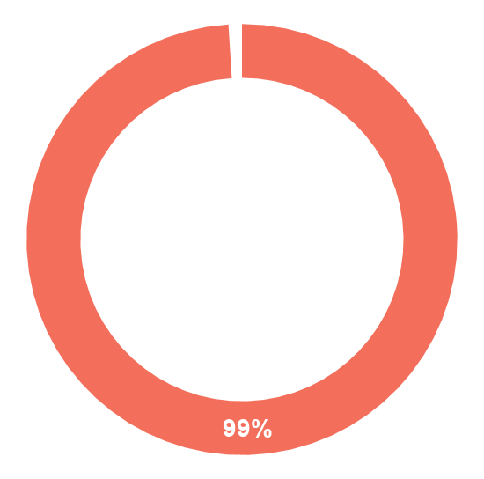
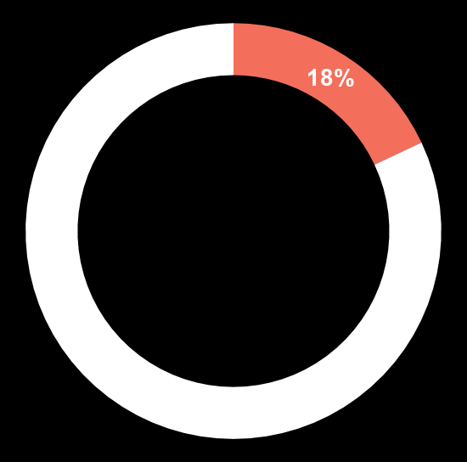
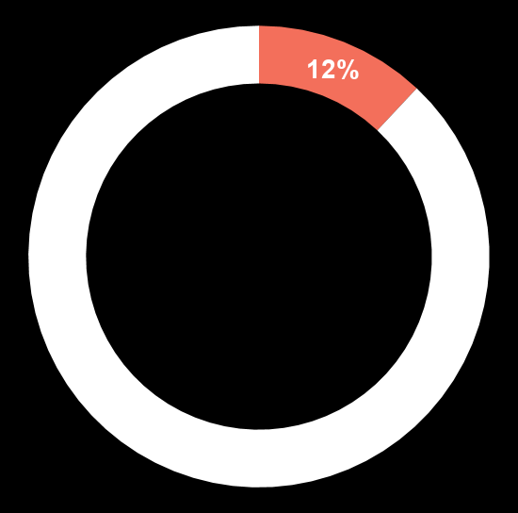
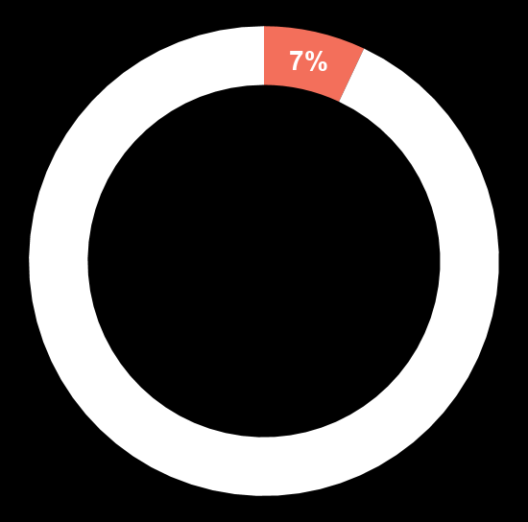
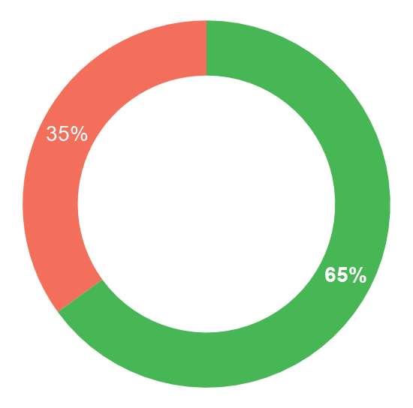
Online Devices in Rural Vietnam
Similar to Urban, Smartphone is the most popular device to access to the Internet in Rural. However, the other devices in Rural have significantly lower usage rate compared with smart phone due to limited affordability of rural audience.
Smart phone
Smart TV
Laptop
Desktop
99%
18%
12%
7%
Currently owned
Used to access the Internet
Smartphone is definitely the key device to go online in Rural. It’s noteworthy that accessing internet via TV - screen is also quite common in this region, which spend around 160 minutes to be online per day.
65% use smartphone only
Average time spent online
Number of device online
2.7Hour per day
1.48 per person
35% Smartphone with another device
Sources: Infocus

Slide 12
Internet acceleration in Rural Vietnam
Internet penetration in rural Vietnam is now very high
77%
of people in rural Vietnam have Internet access, of which 91% access the Internet daily
% of searches from Rural Vietnam:
The Internet is an enabler for rural consumers: they can access online resources relevant to their needs
70%
79%
76%
Online shopping
Entertainment
Health & education
Sources: Consumer Barometer, Vietnam; Cốc Cốc Data, Vietnam, H1 2020
Notes:
The point we are trying to make here is: digital is accelerating the growth of commerce in Rural area. Making Rural the next source of growth for brands

Slide 13
Rural People Thrive For Connecting
Routine & Slow pace of life
Limited offline entertainment activities
Friends/ Relatives studying/ working in urban
Distant neighborhood
LIVING CONTEXT
Aspire of urban lifestyles
Phobia of being lagged behind
Thirst for small happiness to delight their daily routine
Desire to connect & catch up with what’s going on in urban lives
EXPECTATION
ONLINE ACTIVITIES HAVE BECOME THEIR ASPIRATION TO AIM FOR MORE COMFORTABLE AND EXCITING LIFE AS WELL AS KEEP THEMSELVES INFORMED ABOUT DAILY LIVES
Notes:
Insights người dùng

Slide 14
Heading Towards Expectation Through Mobile Activities
Rural consumers having slightly higher penetration of social media browsing and watching video
Weekly usage using mobile phones %
Source: Infocus

Slide 15
And Sharing With Online Communications
Average time spent on daily online communication
Chatting website/ apps as
news update source
Top 5 positive factors in advertising content/ format
65 MINS per day
28% update news
Informative
54%
Key characteristics on daily online communication
Humorous
53%
Sincere
Relevant to my need
50%
Straightforward message and
simple steps
Authenticity
Fun music
43%
Simplicity
Short & concise
41%
Source: Adtima & Kantar Millward Brown – Rural Online study 2018

Slide 16
Search Is Another Top Information Source
for online rural consumers across popular categories
% of consumers using Search
They also depend on Search to make purchase decisions
apparel
97%
shopping
96%
consumer electronics
97%
entertainment
95%
Compare
products and brands
Discover
unknown products
Validate
purchase decision
jobs and education
93%
food and cooking
93%
Source: Google

Slide 17
OTHER SUPPORTS FOR
RURAL DEVELOPMENT

Slide 18
Mobile Data & Infrastructure
Joint Development from local brands
(Vsmart x Viettel)
4G widespread
Viettel to set up 12,000 4G base transceiver stations since 2015 in rural areas across Vietnam.
The 4G network will first offer services in communes, followed by districts, provinces and cities.
The fact that VinSmart joined hands with businesses to develop the national smartphone model - Vsmart Bee Lite shows the efforts in realizing the aspirations for technology popularisation.
In particular, popularising smartphones is the first step towards 4G and 5G coverage as well as creating the foundation for the national digital transformation program, especially for rural development.
Source: Vietnam Plus, Online Press

Slide 19
Great potential for E-commerce growth
E-commerce payment method split by value
GREATLY SUPPORT BY
34%
The growth of mobile devices & network
Payment system (cards, e-wallet)
22%
19%
19%
6%
BUT BARRIERS REMAIN
Bank transfer
Card
Other
Digital Wallet
Cash
Barriers to Vietnam’s e-commerce growth include relatively underdeveloped infrastructure to support both the digital processes involved with e-commerce and also physical transport and delivery infrastructure to complete orders.
Vietnam has rural and mountainous regions currently underserved by e-commerce providers, leading to high logistic costs for online merchants who do sell in these regions.
Logistics costs are estimated to take 30 percent of revenues in Vietnam for e-commerce companies. However, Vietnam’s logistics capabilities are improving. Vietnam jumped 25 places in WB logistics performance index, from 64 in 2016 to 39 in 2018.
Preferred e-commerce methods
$3.3 billion
$1.6 billion
$1.7 billion
E-commerce completed on a mobile device
Mobile commerce completed in-app
Mobile commerce completed on a browser
Source: JP Morgan Research for Vietnam

Slide 20
COVID-19: ACCELERATING ADOPTION OF DIGITAL SERVICES AND CLOSING THE GAP BETWEEN RURAL AND URBAN CONSUMERS

Slide 21
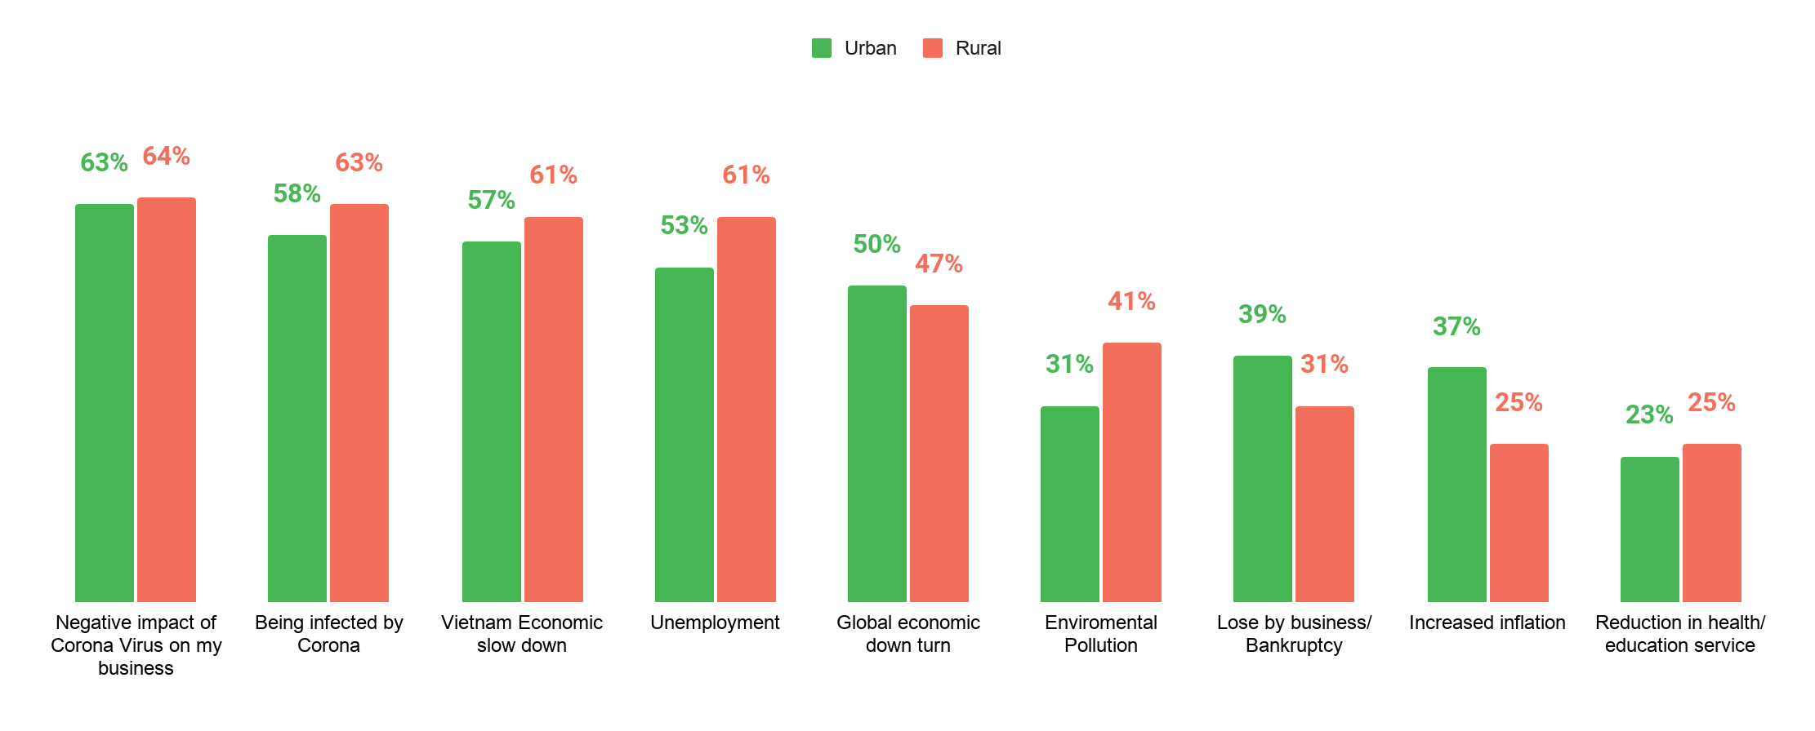
Covid on consumer mind across the board, including adjacent topics
Rural consumer care about items impacting directly their daily life
Biggest fears for 2020
Source: Infocus

Slide 22
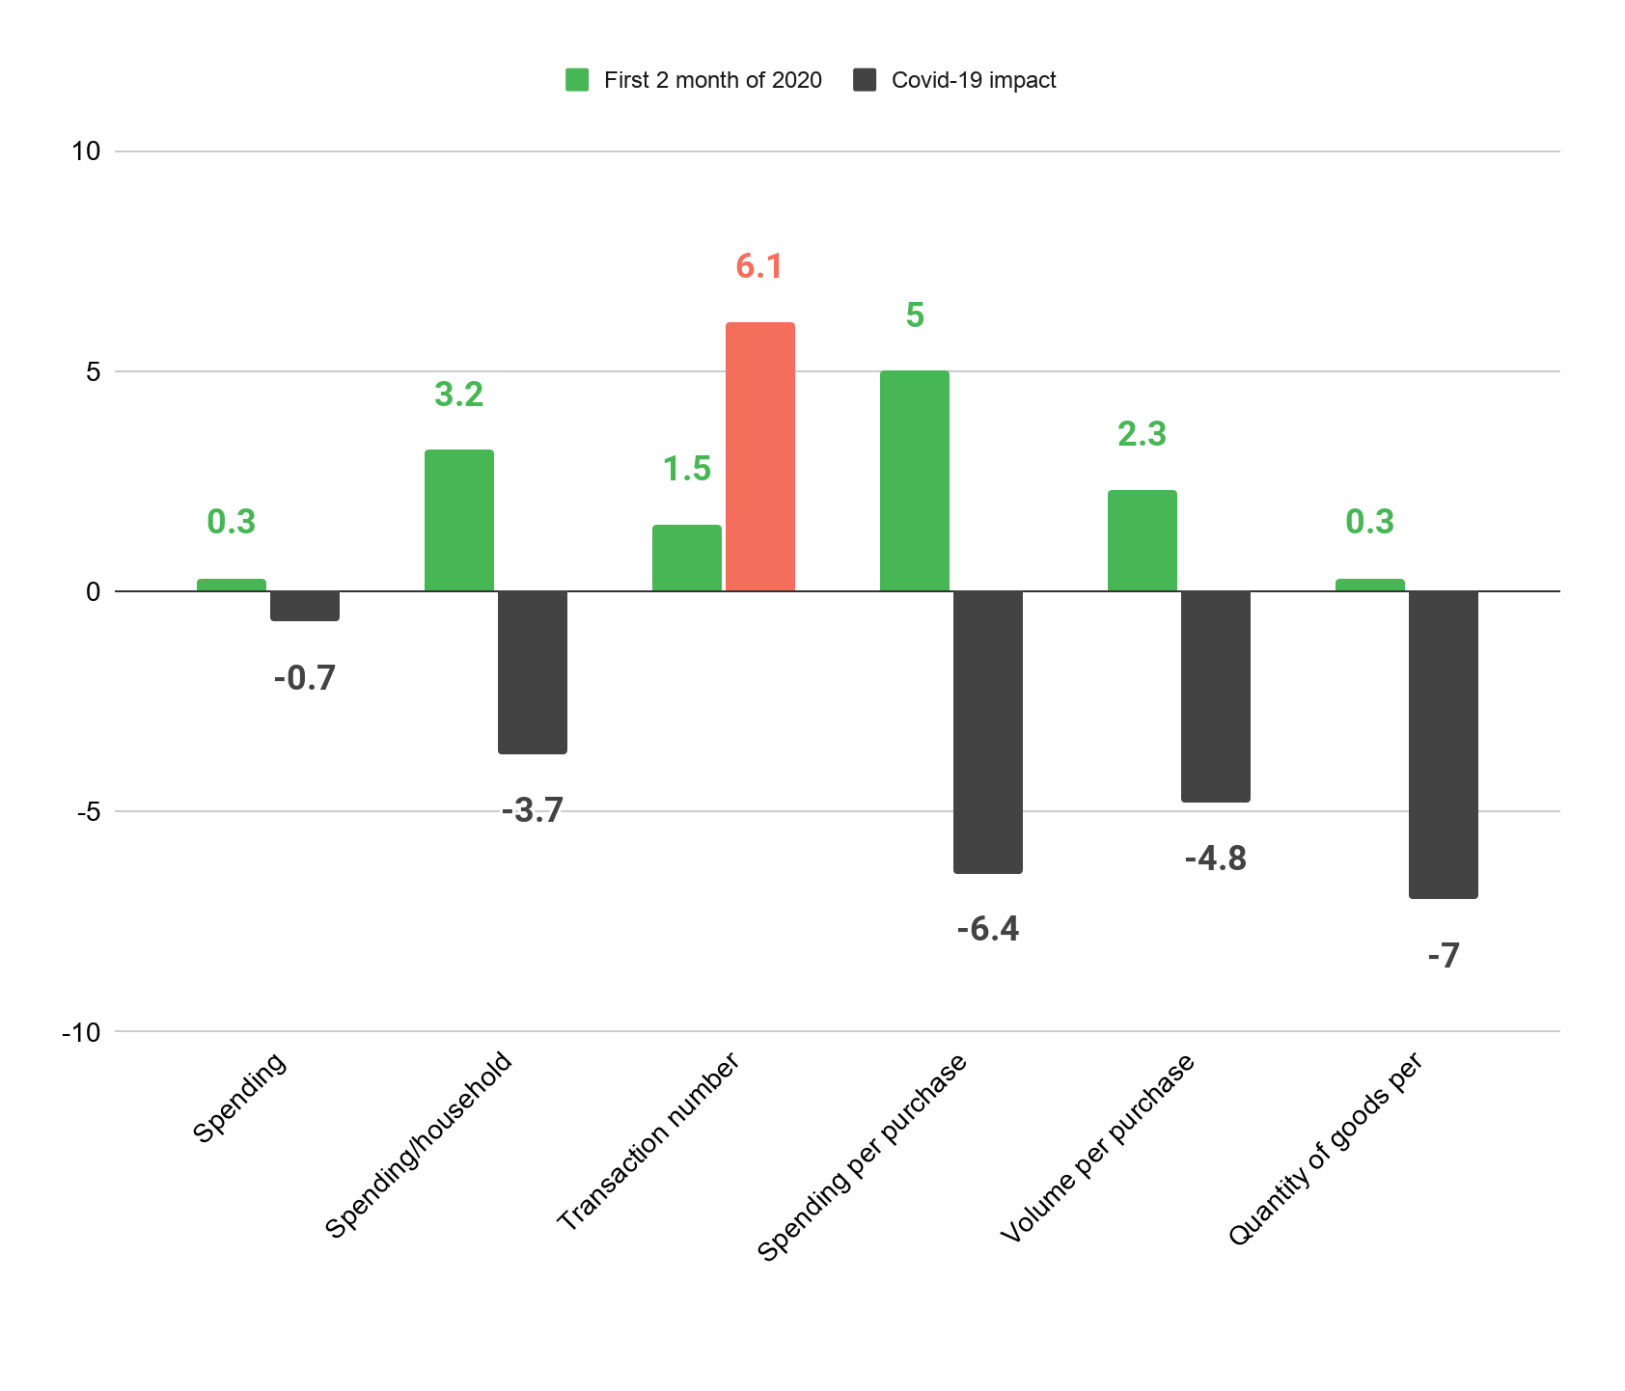
And it leads to the changes in rural consumer’s purchasing behavior
Rural consumers only purchase additional goods during the pandemic re-outbreak, after a large bundle shopping for Tet.
Source: Kantar World Panel, Covid Impact in Vietnam

Slide 23
And making them to reconsider their wishlists
Preparing for “pandemic”: home care and personal care; immunity booster; other convenient necessaries.
Increasing shopping frequency for packaged food or packaged products.
Dropping out list
Stocking up list
Candy | -58%
Soft Drinks | -46%
Biscuits | -40%
Beer | -32%
Liquor | -24%
Fruit Juice | -21%
Soya Milk | -16%
1. PERSONAL & FAMILY HYGIENE
Bathroom Cleaner | 86%
Showering gel | 74%
Bar Soap | 66%
Hair Conditioner | 58%
Insecticide | 45%
Table Napkins | 17%
Floor Cleaner | 14%
2. IMMUNE-BOOSTING PRODUCTS
Milk Powder For Kid | 65%
Drinking Yogurt | 17%
3. CONVENIENT FOODS & NECESSITIES
Instant Noodle | 27%
Canned Fish | 16%
Packaged Bread | 16%
Source: Kantar World Panel, Covid Impact in Vietnam

Slide 24
They also keep eyes on e-commerce & delivery services
Usage of e-Commerce before, during and after COVID-19 lockdown, indexed to pre-COVID-19 levels
Consumer sentiment on the change in usage of Food Delivery, indexed to pre-COVID-19 level
2.0
1.6
1.4
1.2
1.0
1.0
Before
During
After
Before
During
After

Slide 25
Shift in mindset with accelerating new trends as a result
Ecommerce
Marketplaces
Malls
Direct to Consumer
Online Media
Advertising
Gaming
Video on Demand
Music on Demand
Financial Services
Payment
Remittance
Lending
Insurance
Investing
HealthTech
EdTech
Trending this year due to Covid-19
Source: e-Conomy SEA 2020

Slide 26
COVID: impact on mindset
EdTech:
some missed opportunities, but demand is there
HealthTech:
clear shift in mindset in line with the challenges

Slide 27
Think about rural consumers for growth
IMPLICATION
Take into account modernization trends
Empathise with consumers

Slide 28
Cốc Cốc Data, H1 2020
Indochina Research, Map Of Vietnam, 2020
Google’s Year In Search 2020
Adtima Rural Understanding, 2020
Kantar World Panel, Rural Fmcg Consumption, 2020
Infocus, Rural Findings, 2020
Jp Morgan, E-commerce Research For Vietnam, 2019
Vietnam Plus, Online Press, 2020
BIBLIOGRAPHY

