Slide 1
Vibes RCS Demos
Vibes Labs Development around RCS
OCTOBER, 2018

Slide 2


RCS OVERVIEW
RCS
Enhanced Messaging
Rich Communication Services (RCS) is a new protocol that enhances text messaging inline with today's more robust text messaging behaviors. RCS allows for chat with a group, read receipts, video calls, easily send and receive large photos and other files, and the ability to build into the conversation to make actions like reserving a table, checking into a flight, or making a payment more convenient.
Currently only offered through Sprint network on select Android devices
Vibes is a Partner in Google’s Early Adopter program with opportunities to provide direct input to the buildout of their RCS Framework
Have working prototype that explores features for platform implementation

Slide 3
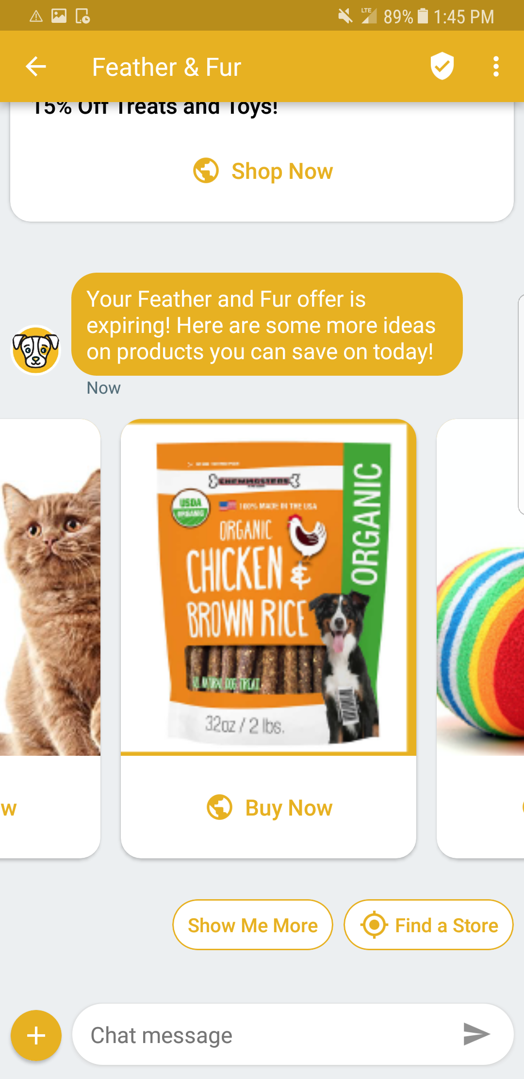
RCs features
VERIFIED SENDER
Customers have peace of mind, no short code
BRANDING
Name, logo, color
Additional features:
QR CODES
For tickets, tracking, and redemptions
TRUE METRICS
Client based DLRs, read receipts for brands
RICH MEDIA
Images, videos, GIFs, carousels
SUGGESTED ACTIONS
Customized reply button's, preprogrammed by brand
SUGGESTED REPLIES
URL, Map, Calendar, or Dialer
Notes:
Given the growth in the peer to peer communication space, brands can now start leveraging RCS to engage with consumers.

Slide 4




Overview | Who & What is behind RCS?
Google is backing a standard called Universal RCS Profile
Only open to Android devices
In US, Sprint currently supports
Vibes is part of the early adoption program
*Additional US carriers expected Q4 2018 - Q1 2019
Notes:
With reliable global infrastructure and a consistent user experience, Google’s RCS technology helps the mobile community deliver better messaging everywhere.
• Different approaches made it difficult and costly for carriers to bring it to users.
• By aligning on the GSMA's universal RCS profile - with the Android Messages RCS client app - carriers can now provide RCS messaging across the Android ecosystem.
• Google is partnering with carriers and OEMs to offer a native messaging client, Android Messages, for RCS, SMS and MMS messaging. Android Messages supports the GSMA’s Universal Profile for interoperability across operator networks and devices.

Slide 5
THE RCS FEATURE SET
_
In partnership with Google, Vibes has been testing and exploring a number of features of Google’s RCS framework. Vibes is reviewing use-cases of customers to see how RCS features provide more value to the end-user.
ENHANCED UI
BUSINESS FEATURES
FUTURE ENHANCEMENTS
Suggested reply
Suggested actions
High resolution photos
Videos
Solve MMS incompatibility
Full brand name instead of random ID
Brand Customization
Web Viewer
Native Calendar Integration
Proven Delivery Receipt
Read receipts including open-time
Verified business checkmark
Block unwanted conversation / unwanted brands
Dynamic QR Codes
Location Services
AI Intent analysis
Live Video

Slide 6



RCS Framework and the Vibes Platform
How Does RCS Work?
GSMA PROFILE
with RCS engine
RCS program (bot)
RCS framework
Brand Agent
Carrier
Device
Notes:
RCS is currently in exploratory phases of development. Many carriers, OEMs, and other partners are developing the technology and user experience on Android Messages application. Android Messages supports the GSMA’s Universal Profile for interoperability across operator networks and devices. Currently in the US, this is limited to the Sprint carrier and Android devices.
The Framework is set up for brand to register an Agent that will act as the point of contact with the end user. These registered agents will run RCS programs that adhere to the GSMA’s RCS protocol.
Vibes RCS beta product will build on Vibes CRM Platform, utilizing the compliance, aggregation, data processing, and reporting tools.

Slide 7
Rcs Experience & features
RCS drives higher conversions than current approaches
Google has been driving the launch of RCS business messaging by pushing for global carrier adoption
Vibes has been a Google Early Launch Partner since early 2017
Early launch programs have shown cross-industry success stories with food, travel, retail and delivery services in the U.S. and Mexico
$65.57
$35.09
$2.09
2011
2018
2020
(Revenue / mobile subscriber)

Slide 8
Redbox Demo for MWC
This prototype was developed for Mobile World Congress. The RCS program showcases how the new text messaging protocol RCS could be utilized for, transferring from SMS to RCS, finding a Kiosk, seeing new releases, signing up to hear about specific content.

Slide 9
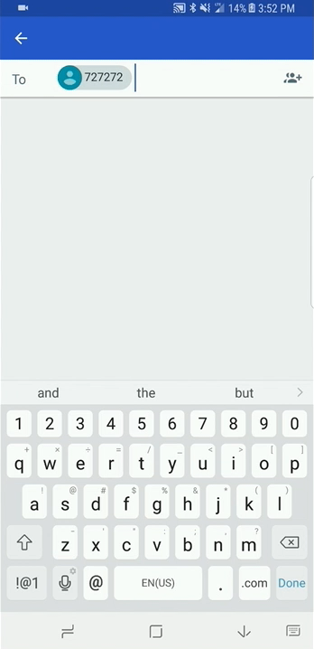
RCS DEMOs
REDBOX RCS DEMO
Feature 1: Transferring to RCS from SMS and Finding a Kiosk
Ensure compliance in signing up new users to RCS
Provide menu set with option to select Find Kiosk
Utilize location operations from messenger app
API call to Redbox Kiosk locator brings back locations in proximity to user’s defined area

Slide 10
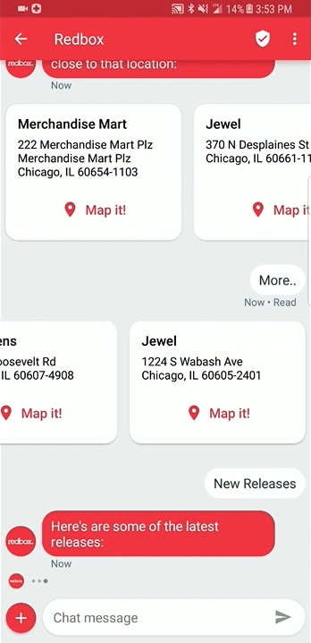
RCS DEMOs
REDBOX RCS DEMO
Feature 2: New Releases
Provide contextual access to Redbox’s most popular rental products
Utilize Movie API to pull in latest New Releases from feed
Build carousel from product images and title info for user to scroll
Click back to .com Movie detail page

Slide 11
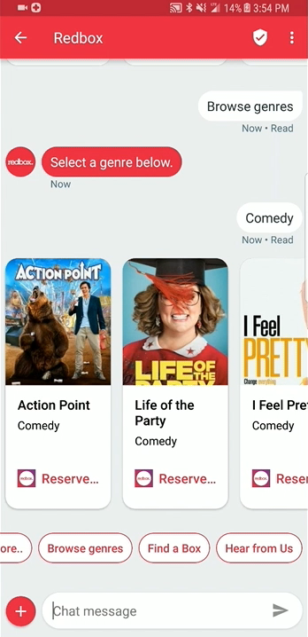
RCS DEMOs
REDBOX RCS DEMO
Feature 3: Content Preferences
Provide user with ability to select content they receive from Redbox RCS program
Confirm subscription to each content feed
Bring back other options to the conversation in a contextual manner

Slide 12
Chipotle Conversational Ordering
While .com and app are the most utilized channels for transactional processes, the conversational tools utilized in chat and voice are quickly finding market fit for the appropriate occasion. Vibes built a demo that can showcase how a user can order from favorites, history, or start a whole new order. Then Vibes showed how payment + Loyalty services create a seamless one-point of interaction for the user’s ordering experience.
Notes:
This prototype was developed for a conversation Alex had with new stakeholders at Chipotle, including the new head of CRM (Jason). The interest here is showing Chipotle how Vibes is thinking differently about mobile and we help Chipotle open up new channels for order including messaging. The new messaging protocol is perfect to build a stronger relationship with the customer through personalization in the ordering experience with features like order favorites, order history, and application of Loyalty.

Slide 13
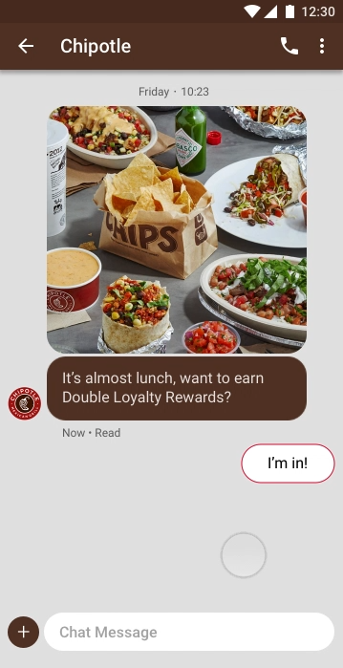
RCS DEMOs
Chipotle RCS Ordering Concept
Alert customer of time relevant to ordering
Spread awareness of loyalty promotion
Introduce new product, along with easy access to order quickly
Show how UI provides similar ordering experience to in-store
Complete order with addition to add to favorites
Utilize mobile payment options
Fulfill loyalty promotion and provide status

