Slide 1
RCS Business Messaging (A2P)
Platform Programs and Features
MAY 2018

Slide 2
The marketing landscape has changed. Users want ease of use that aligns to their preferences and behaviors.

Slide 3
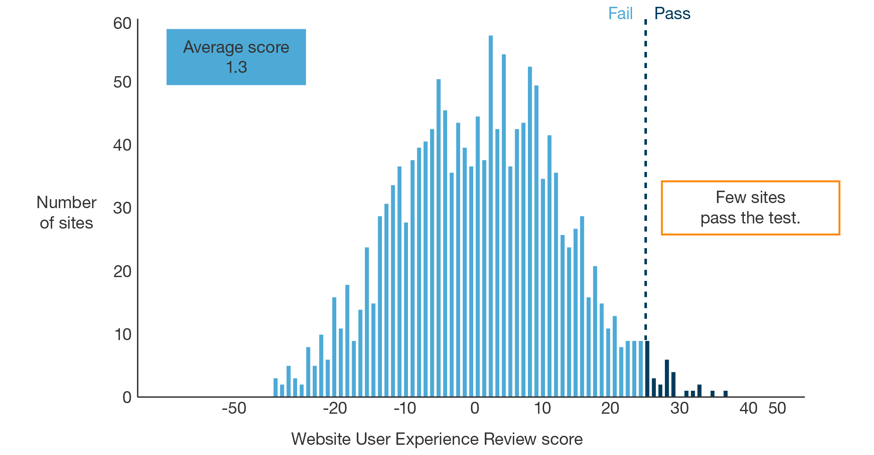
Websites are NOT delivering it

Slide 4
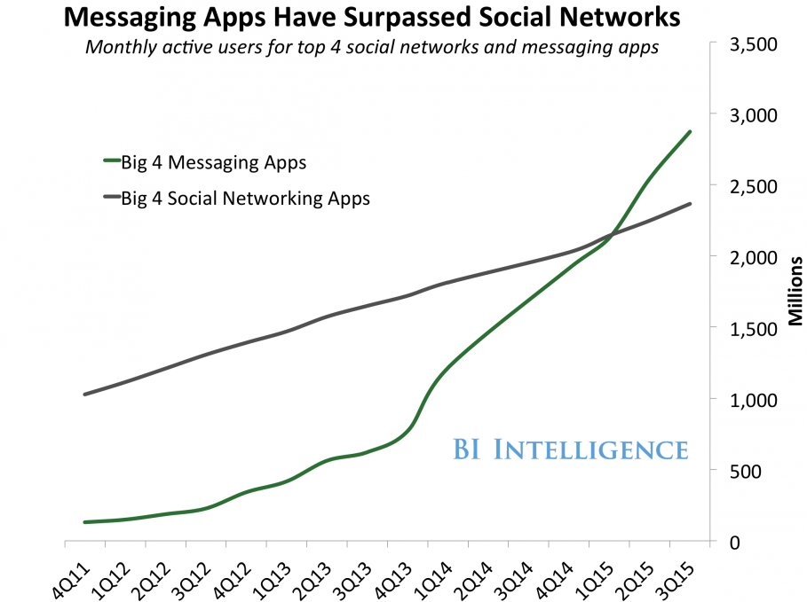
…and apps are being overtaken by messaging

Slide 5
Today messaging connects more people than
any other platform
Worldwide in Millions (1Q 2015)

Slide 6
Which is why it’s essential to get your brand active on
Rich Communication Services

Slide 7
WHAT IS RCS?
Rich Communication Services (RCS) is a new protocol that enhances text messaging. Texting has changed the way we communicate and connect. RCS allows for chat with a group, read receipts, video calls, easily send and receive large photos and other files, and the ability to build into the conversation to make actions like reserving a table, checking into a flight, or making a payment more convenient.
Notes:
Messaging technology continues to evolve and the user has higher expectations. They expect the ability to share high-res photos and larger files, chat with a group, know when messages are read, or make video calls as a standard set of features in their messaging experience.

Slide 8
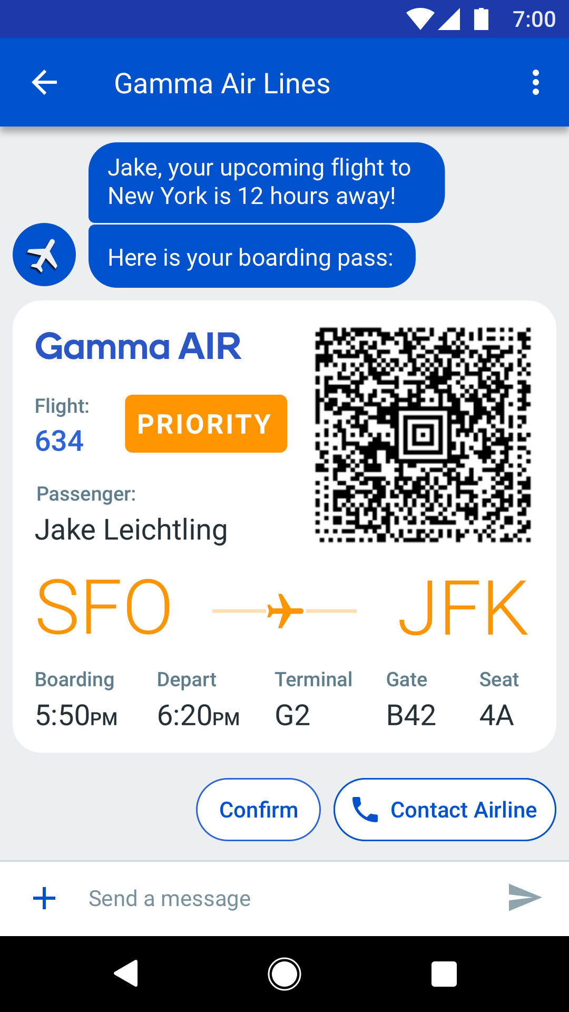
WHAT ARE THE FEATURES?
Verified Sender
Customers have peace of mind
Branding
Name, logo, color
QR Codes
For tickets, tracking, and redemptions
Rich Media
Images, videos, GIFs, any color
True Metrics
Client based DLRs
Read Receipts for Brands
Suggested Replies
Customized reply button's, preprogrammed by brand
Suggested Actions
URL, Map, Calendar, or Dialer
Notes:
Update to include media and read receipts possibly?

Slide 9
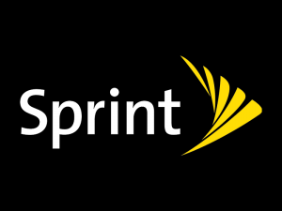
WHO/WHAT IS BEHIND RCS
At this initial stage and in the US, RCS is only open to Android phones on the Sprint network. However, more carriers are working to open up their networks to the RCS protocol because of GSMA’s universal RCS profile.
Vibes is a partner in the early adopter program with Google. As a partner with Google, Vibes provides direct input to the build out of Google’s RCS framework and the services behind it.
US Market Today
GSMA PROFILE
Preferred Partner
Program
Notes:
With reliable global infrastructure and a consistent user experience, Google’s RCS technology helps the mobile community deliver better messaging everywhere.
• Different approaches made it difficult and costly for carriers to bring it to users.
• By aligning on the GSMA's universal RCS profile - with the Android Messages RCS client app - carriers can now provide RCS messaging across the Android ecosystem.
• Google is partnering with carriers and OEMs to offer a native messaging client, Android Messages, for RCS, SMS and MMS messaging. Android Messages supports the GSMA’s Universal Profile for interoperability across operator networks and devices.

Slide 10
RCS vs. OTT
While many users have adopted OTT messaging apps, there are millions of businesses, service providers, brands, and of course consumers that use SMS to communicate. Vibes approach to RCS retains the reach SMS with the rich experience customers have come to expect from a messaging application.
4,700
SMS
Email
3,700
WhatsApp
1,200
Fixed Telephony
1,013
Worldwide
Communication
Platforms
Ranked by Active Users
(Millions)¹
FB Messenger
1,000
WeChat
889
Fixed Broadband
720
Snapchat
300
Skype
300
Viber
249
LINE
217
Telegram
100
KakaoTalk
49
Sources: 1) Radicati Group “Email Statistics Report, 2017-2021,” January 2017. 2) Statista “Number of Fixed Telephone Lines Worldwide,” 2016. 3) Ooyala “Fixed broadband subscribers worldwide,” July 2015. 4) Statista “Messaging Apps Worldwide, based on MAU,” January 2017.
Notes:
NOTES / TALK TRACK:
Whether they’re sending a bank fraud alert or package delivery notification.
While the Over-the-top messaging apps have provided a more rich user experience,
This makes it easier for the end user to access, as there is no app to download and no website a user must go to register.

Slide 11
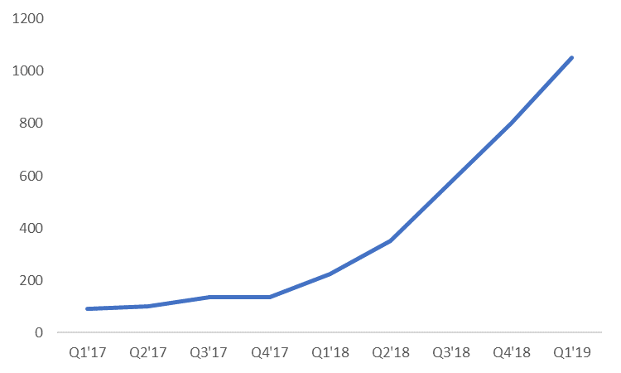
GSMA RCS MAU GROWTH
WHY NOW?
“Early adopting brands are seeing RCS deliver 20 times higher conversion rates compared to SMS, with customer satisfaction increasing 20 percent in some instances.”
2017 - 2019
1.05B
200%
Growth
Millions of RCS MAU at Quarter
350M
172%
Growth
92M

Slide 12
Projected growth of mobile messaging customer
2020
2017
2015
$50.12
$30.72
$22.36
SMS
SMS
RCS
WHY NOW?
RCS market share is growing, and growing fast. As of today, there are 43 carriers and device manufacturers worldwide involved in bringing RCS messaging capabilities to their Android users. Google’s Early Access Program has been in effect for over a year. Industries from food, travel, retail and delivery services in the U.S. and Mexico are using RCS as part of the Early Access Program.

Slide 13
RCS Features

Slide 14
FEATURES OF RCS
In partnership with Google, Vibes has been testing and exploring a number of features of Google’s RCS framework. Vibes is reviewing use-cases of customers to see how RCS features provide more value to the end-user.
ENHANCED UI
BUSINESS FEATURES
FUTURE ENHANCEMENTS
Suggested reply
Suggested actions
High resolution photos
Videos
Solve MMS incompatibility
Full brand name instead of random ID
Brand Customization
Web Viewer
Native Calendar Integration
Proven Delivery Receipt
Read receipts including open-time
Verified business checkmark
Block unwanted conversation / unwanted brands
Dynamic QR Codes
Location Services
AI Intent analysis
Live Video

Slide 15
CAPABLE FEATURES OF VIBES PILOT
BRANDED CONVERSATION
No Short-code
Color options
ENHANCED RESPONSE UI
Suggested replies
Read Receipts
MEDIA INTEGRATION
Images
Carrousel Modules
Native Web Client
NATIVE DEVICE ACTIONS
Location
Calendar
Wallet
QR Codes
Notes:
Re-Reworking flow here

Slide 16
RCS Framework and the Vibes Platform

Slide 17
RCS NETWORK
RCS is currently in exploratory phases of development. Many carriers, OEMs, and other partners are developing the technology and user experience on Android Messages application. Android Messages supports the GSMA’s Universal Profile for interoperability across operator networks and devices. Currently in the US, this is limited to the Sprint carrier and Android devices.
The Framework is set up for brand to register an Agent that will act as the point of contact with the end user. These registered agents will run RCS programs that adhere to the GSMA’s RCS protocol.
RCS FRAMEWORK
GSMA PROFILE
Brand Agent
Brand Agent
Brand Agent
Carrier
Carrier
Carrier
Carrier
Carrier
Carrier
RCS Compliant Devices

Slide 18
THE VIBES PLATFORM
Vibes RCS beta product will build on Vibes CRM Platform, utilizing the compliance, aggregation, data processing, and reporting tools.
PLATFORM
RCS ENGINE
RCS FRAMEWORK
RCS PROGRAM
(BOT)
Partner Integration
Brand Agent
Carrier
RCS Compliant Device
Notes:
Replace ‘best’ with diff positioning

Slide 19
Early Access Program

Slide 20
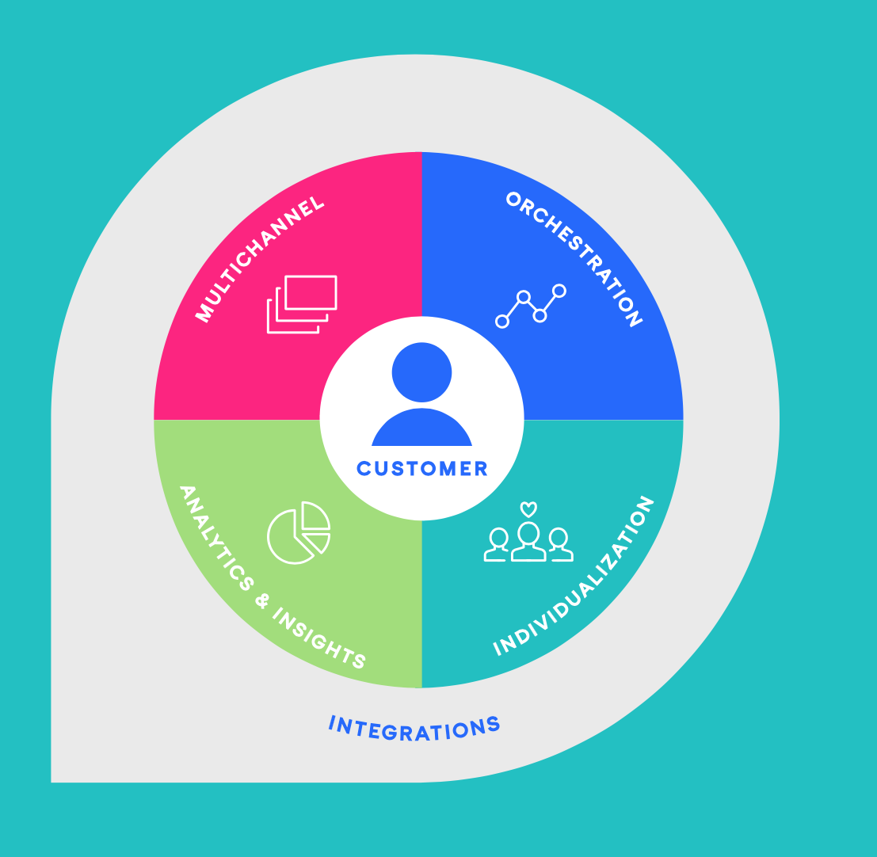
RCS AND THE VIBES ADVANTAGE
While RCS is new territory, the value of the Vibes platform and the build of SMS lists transfers to the initiation of RCS pilot programs. While RCS requires opting in customers again, the current members of SMS programs on Vibes platform afford pilot customers the ability to initiate RCS with available customers more easily.

Slide 21
PARTICIPATE IN THE EARLY ACCESS PROGRAM
BE FIRST
LEARN THE TECHNOLOGY
INFLUENCE
THE ROADMAP
Early Access Members will be the first to market
Building best practices
Validating hypothesis of interaction in mobile
PR benefits are early adopter with Google
Learn the new features and API
Understand limits of technology
Build to your own campaign and analytics
Give input on new features to Google’s RCS framework as well as the developing platforms of carriers like AT&T and Verizon
Help prioritize features timing
Influence the Future Roadmap

Slide 22
In Market Case Studies

Slide 23
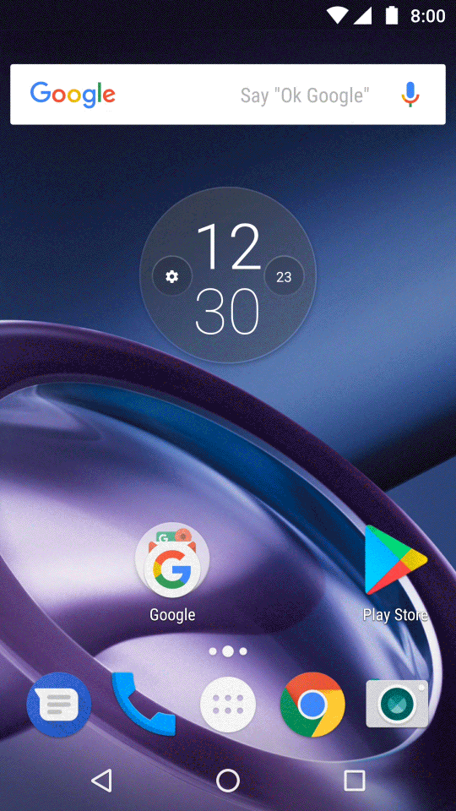
DEMO VIDEOS: BEST BUY
Best Buy customers get personalized product suggestions based on their recent in-store pickup orders
They can order products and pay for it with a credit card on-file or in-store while picking up the product
They can also schedule appointments with a Geek Squad agent and chat with the agent prior to the appointment
Available at: https://www.gsma.com/futurenetworks/rcs/demos-case-studies/?ID=003w000001iwe8FAAQ&BU=

Slide 24
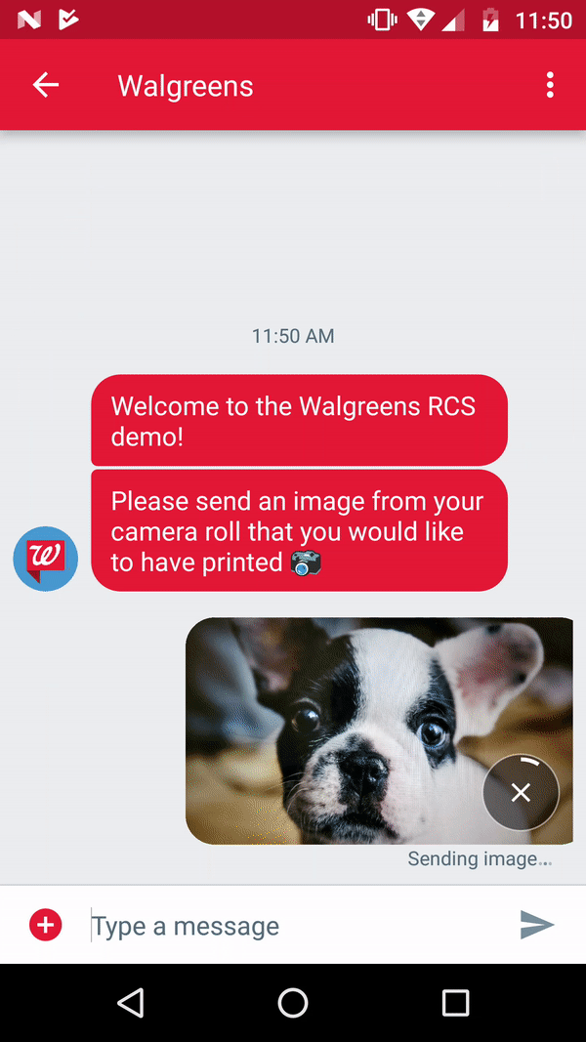
DEMO VIDEOS: WALGREENS
Staying beautiful and on top of all the things that matter is just a few mobile taps away!
Walgreens customers can easily order the latest shade of concealer or print their favorite picture at their nearest location
They get personalized solutions based on their selection
Available at: https://www.gsma.com/futurenetworks/rcs/demos-case-studies/?ID=003w000001iwe8FAAQ&BU=

Slide 25
DEMO VIDEOS: MULTIPLUS
Multiplus is the largest loyalty program in Brazil
To take advantage of Multiplus offers, customer need to link their credit cards to their Multiplus account
With RBM, Multiplus customers will be able to
Link their credit cards to their Multiplus account
Check their point balance
See what they can get with their points
Go to the Multiplus website to redeem
Available at: https://www.gsma.com/futurenetworks/rcs/demos-case-studies/?ID=003w000001iwe8FAAQ&BU=

Slide 26
DEMO VIDEOS: NATURA
Natura is one of the largest cosmetics companies in Brazil
They sell through a network of local resellers (similar to Avon)
Their main challenge is keeping resellers informed of their latest products and promos
With RBM, Natura resellers can now stay on top of all the latest product deals and promos
They can easily view the latest offers and call to order products
Available at: https://www.gsma.com/futurenetworks/rcs/demos-case-studies/?ID=003w000001iwe8FAAQ&BU=

Slide 27
DEMO VIDEOS: BANAMEX
Banamex is required to send customers their statements every month
They currently send statements by mail, which is slow and unreliable
Banamex will use RBM to send customers a monthly statement summary with a link to the full statement
Available at: https://www.gsma.com/futurenetworks/rcs/demos-case-studies/?ID=003w000001iwe8FAAQ&BU=

Slide 28
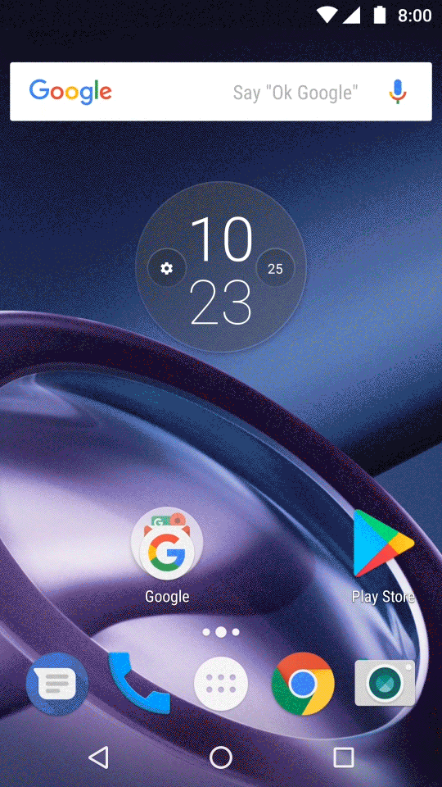
DEMO VIDEOS: CLARO
Claro pay-as-you-go customers can enjoy uninterrupted carrier service
They can buy extra data, renew their current bundle or redeem latest offers with micro-credit from Tiaxa/Claro
Available at: https://www.gsma.com/futurenetworks/rcs/demos-case-studies/?ID=003w000001iwe8FAAQ&BU=

Slide 29
DEMO VIDEOS: SUBWAY
Subway fans can place orders from menu in conversation
Determine location of pick-up
Options in UI to customize meals
Place pick-up time
Available at: https://www.gsma.com/futurenetworks/rcs/demos-case-studies/?ID=003w000001iwe8FAAQ&BU=

Slide 30
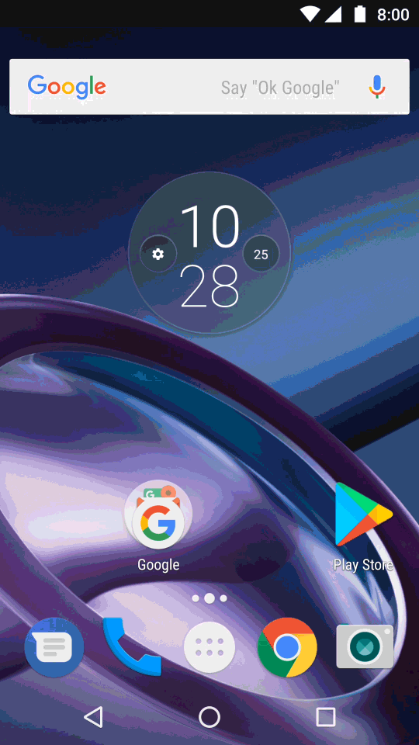
DEMO VIDEOS: BMW SEATTLE
Scheduling BMW car service appointments is now a breeze
BMW of Seattle customers receive maintenance reminders
Service coupons
Loaner vehicles options
Directions to the service center
Available at: https://www.gsma.com/futurenetworks/rcs/demos-case-studies/?ID=003w000001iwe8FAAQ&BU=

Slide 31
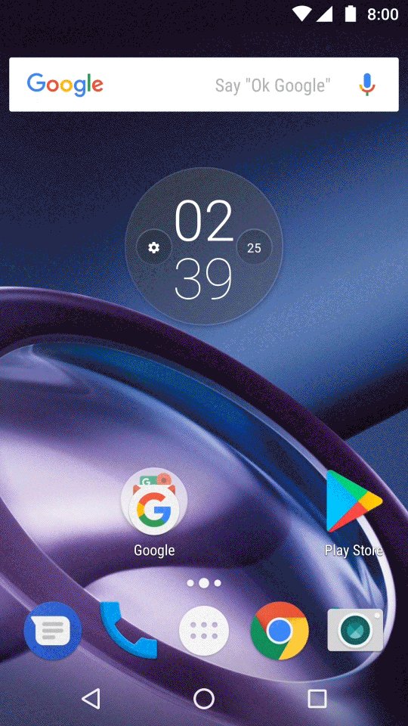
DEMO VIDEOS: DETROIT PISTOLS
Never miss a Detroit Pistons game anymore!
Get game ticket updates
Option to purchase tickets right when they go on sale
Add game to your calendar
View your tickets
Map venue location
Opt-in to receive game updates
Available at: https://www.gsma.com/futurenetworks/rcs/demos-case-studies/?ID=003w000001iwe8FAAQ&BU=

Slide 32
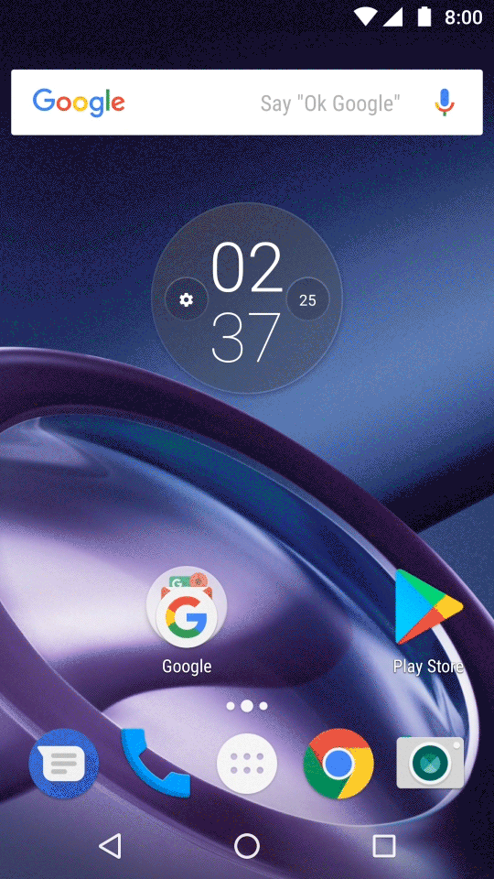
DEMO VIDEOS: 1 800 CONTACTS
1-800-Contacts can now ensure their customers always have clear vision and get the best deals on all their products by sending them:
Order confirmation and order updates
Reminders to stock up on products they might be running low on
Available at: https://www.gsma.com/futurenetworks/rcs/demos-case-studies/?ID=003w000001iwe8FAAQ&BU=

Slide 33
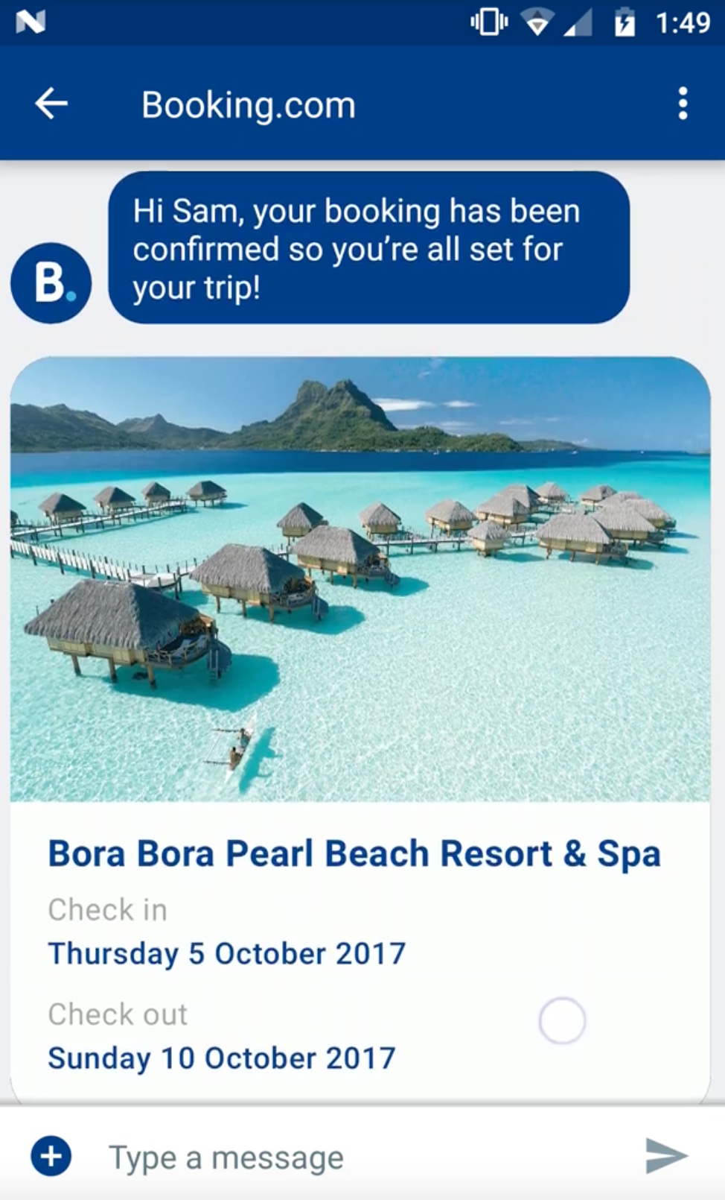
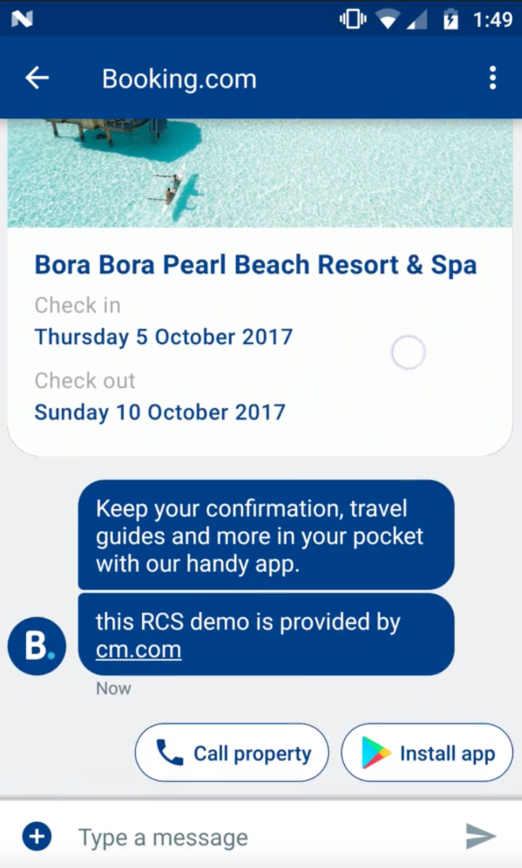
DEMO VIDEOS: BOOKING.COM
Booking.com customers can easily view, share and add their upcoming reservations to their calendar.
They’ll also be prompted to download the Booking.com mobile app
Available at: https://www.gsma.com/futurenetworks/rcs/demos-case-studies/?ID=003w000001iwe8FAAQ&BU=

