Slide 1
Introduction to Rich Communications Services
August 2018

Slide 2
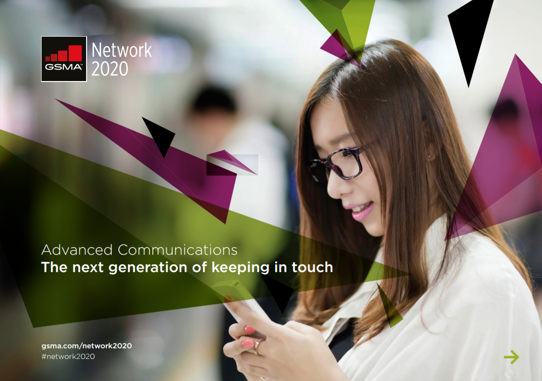
What is RCS?
Rich Communications Services
Global standard, sponsored by GSMA, backed by 53 operators, 11 OEMs, Google, Microsoft – and growing.
RCS transforms traditional SMS, enabling new, richer interaction experiences across devices on any network.
Universal Profile
A single, industry-agreed set of features and technical enablers developed to simplify the product development and global operator deployment of RCS
Release 1 (Nov 2016) – Includes core features such as capability discovery, chat, group chat, file transfer, audio messaging, video share, multi-device, enriched calling, location share and live sketching.
Release 2 (July 2017) – Introduces the key enablers for Messaging as a Platform (MaaP). MaaP includes support for Application-to-Person messaging, Rich Cards, privacy control and spam protection.
Release 2.1 (Dec 2017) & Release 2.2 (May 2018) – A2P enhancements
RCS: The Future of A2P Mobile Messaging
Global launches, specifications, market size, other resources --
www.gsma.com/futurenetworks/rcs/

Slide 3
Google (Android) is Driving the Industry Forward
“Adopted” the RCS global standard as Android’s answer to Apple’s iMessage
Acquired Jibe Mobile in 2015
Google providing technology for
Android phones
Operator networks
Global connectivity
RBM – RCS Business Messaging – Introduced by Google, the industry is largely using this term for Application-to-Person (A2P) RCS Messaging
Other main RCS infrastructure providers include: Samsung, Mavenir, WIT & some smaller players

Slide 4
RCS launch status
58 Live Networks
90 announced
100% Launched
Multiple RCS launches
Forecast to go from one to multiple launches in 2018
RCS launched
RCS launch forecast for 2018

Slide 5
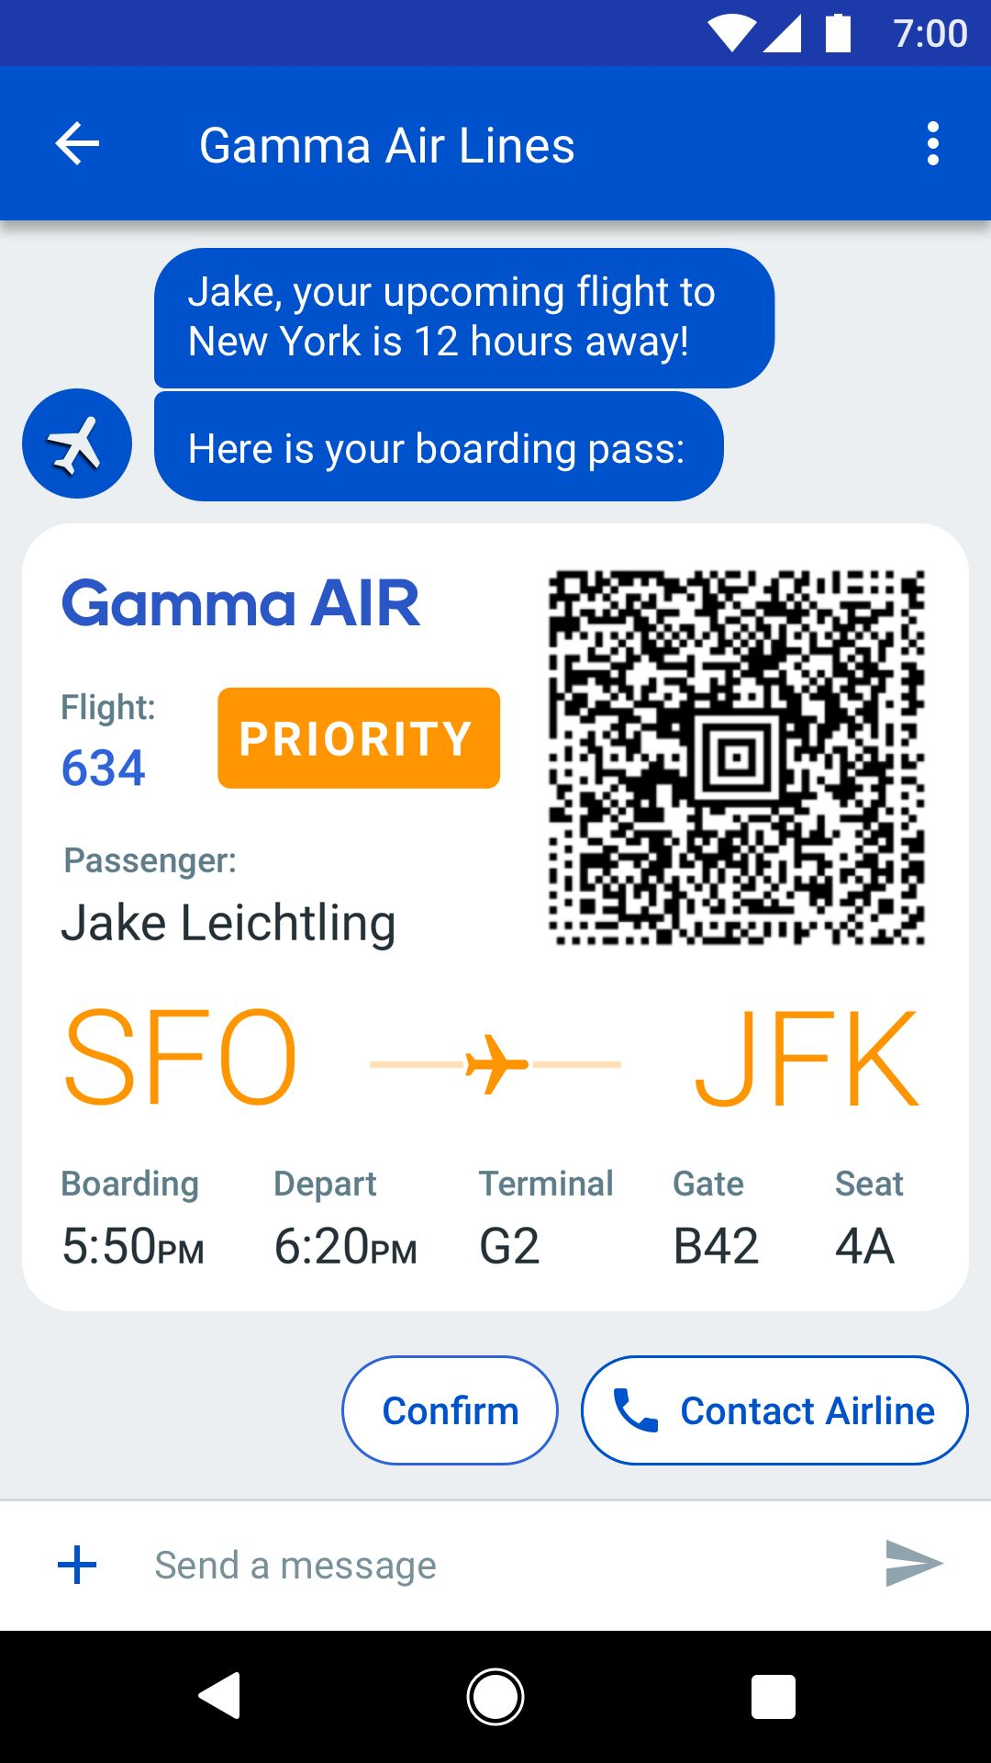
User Experience
Branding
Company Name, Color & Logo
RCS Business Messaging allows business and consumers to interact around branded, verified rich-content experience
Verified name of business
Conversation is Brand’s color
Messages include Brand logo
Large content (10MB -- 50MB)
Images, video, text, audio, vCard
Chips: reply & action buttons
Suggested replies send a text back
Action buttons invoke other apps
Maps, Call, Web, Calendar
Rich dynamic content
Wide width images/videos/GIFs, boarding passes, loyalty cards & tickets with dynamic fields, etc.
Suggested Replies
Tapping responds with suggested text
Suggested Actions
Tapping action-enabled icon & text deeplinks to key apps
Synchronous Connection
Typing indicators, delivery & read receipts, etc.

Slide 6
RCS Bank DEMO
Pop-Up Alerts from Default Messaging App
Brand, color and logo frames conversation
Message includes chips – suggested replies & actions
Selecting a Reply returns a text – 2-way conversation
New chips follow new content
Selecting an Action opens another App – like Maps
Large content also arrives in-line – allows interaction

Slide 7
RCS Optician DEMO Appointment Reminder
No short code or long code – only company name
Supports many types of emoticons – Wavy hand
Replies have text only – Actions have icons
Easy to provide list of options to choose from
Dialer opens with pre-populated number
Can return to message and select a Reply

Slide 8
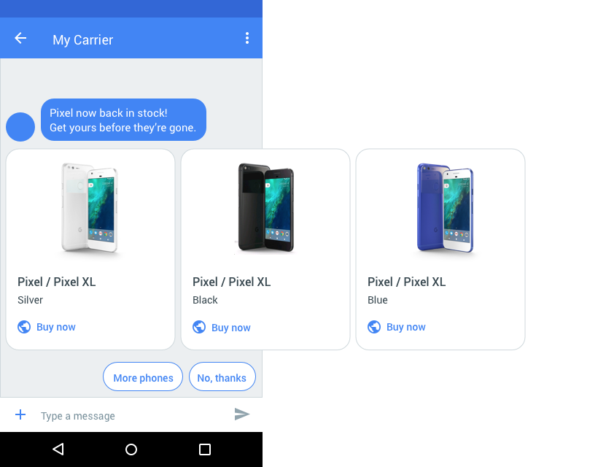
Universal Profile 2.0 adds new features
Rich Card Carousels
Verified Sender
Location Sharing
Anonymization of Users
Directory Query

Slide 9
BIG QUESTIONS
How many phones can support RCS?
What about Apple?
How will it be priced?

Slide 10
Answer 1: RCS Market Deployment
Statistics from GSMA
RCS has been launched by 58 operators in 40 countries
40 more in 30 countries expected in the next 12 months
Currently 167M Monthly Active Users (MAUs)
Projecting 350M MAUs by end of 2018
Projecting 1B MAUs by end of 2019
Projected growth for A2P Messaging: $60B now to $90B in 2021
1B MAU
End of 2019
350M MAUs
End of 2018
RCS Handset Penetration
Upon launch of P2P RCS, penetration starts at 0%, but many phones can be upgraded
In networks that have deployed P2P RCS, penetrations rates have achieved 25-30% so far
167M MAUs
NOW

Slide 11
Answer #2: RCS IS PART OF the MESSAGES Inbox
3 Ways to Reach it
5B
RCS
50MB
Active users!
Email: 3.7B
Whatsapp: 1.2B
Line: 217M
Mobile #
Global
Unique
Ubiquitous
Personal
Verifiable
MMS
1MB
How
long
have
you
had
yours?
SMS
160 Chars
Highest attention rate:
98% read rate
90% within 3 minutes
Make each Interaction the best

Slide 12
Apple’s Deployment of RCS
Apple Inc. represents under 15% of handset sales globally but up to 40% in some markets
Recently, Apple has engaged in discussions with GSMA and Operators about including RCS in iOS to:
Provide a better fall-back than SMS, when messaging non-iMessage devices (Apple to Apple would still use iMessage)
Improve the Apple-to-non-Apple messaging experience for its customers
Meet the needs of Operators in high-Apple-concentration markets deploying RCS
Prepare for the post-2G, post-SMS future
Operators putting pressure on Apple to launch RCS

Slide 13
RCS Pricing
Pricing Model is still evolving – Actual Prices mostly not announced
Expected to be slightly more expensive than SMS
Data (images, videos) may be additional charge
Messaging expected to be free to end user, however they may be charged for data, just like OTT messaging & apps
Per event
Single message, like most SMS messaging today
Session based
Starts after user respond
Lasts a short time (e.g. 4 hrs.)
Single price for all messages (e.g. 2-3 times single message)

Slide 14
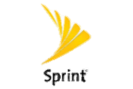
GSMA Universal Profile Commitments
The GSMA ensures interoperability between RCS clients, networks and hubs.
53 Operators
QUESTIONS?
11 OEMs
2
OS Providers
Google

Slide 15
Handset adoption
QUESTIONS?

