Slide 1
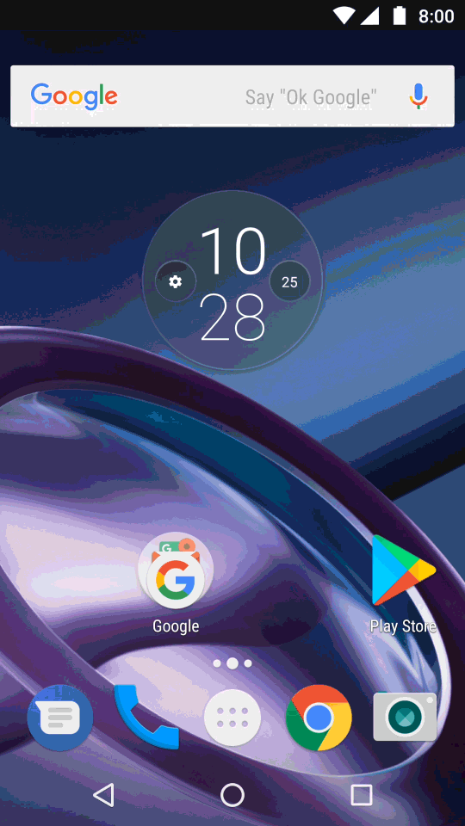
TAP-TO-join
RCS
Enhanced Messaging
Rich Communication Services (RCS) is a new protocol that enhances text messaging inline with today's more robust text messaging behaviors. RCS allows for chat with a group, read receipts, video calls, easily send and receive large photos and other files, and the ability to build into the conversation to make actions like reserving a table, checking into a flight, or making a payment more convenient.
Currently only offered through Sprint network on select Android devices
Vibes is a Partner in Google’s Early Adopter program with opportunities to provide direct input to the buildout of their RCS Framework
Have working prototype that explores features for platform implementation

Slide 2
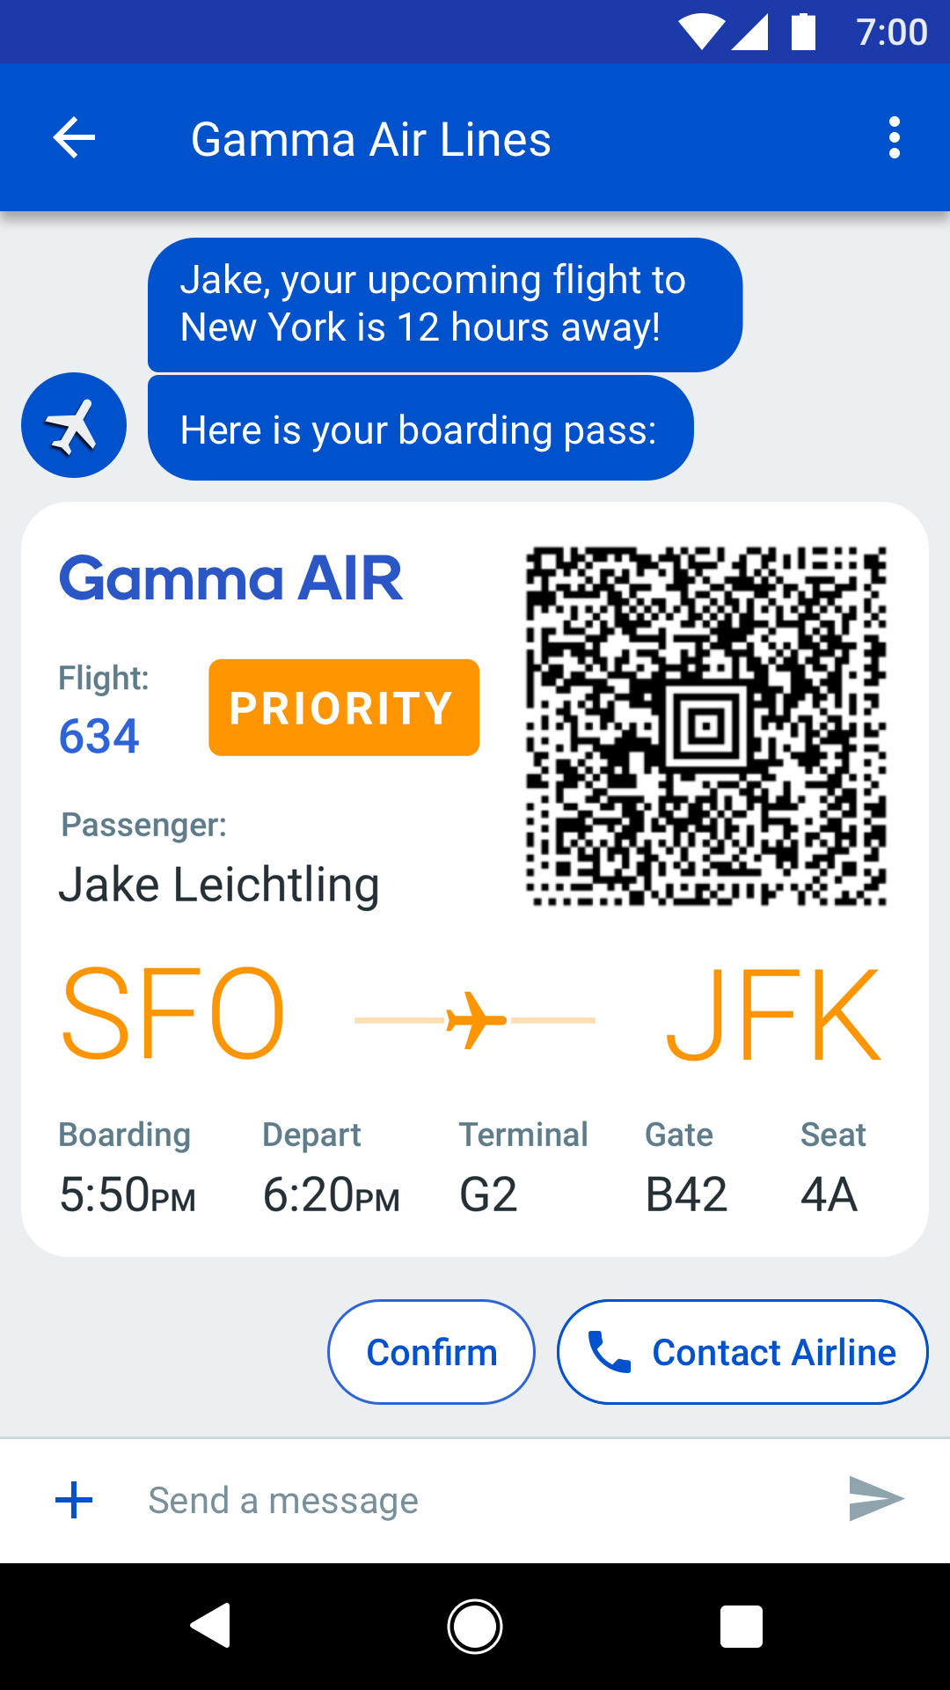
RCS Features
Verified Sender
Customers have peace of mind
Branding
Name, logo, color
QR Codes
For tickets, tracking, and redemptions
Rich Media
Images, videos, GIFs, any color
True Metrics
Client based DLRs
Read Receipts for Brands
Suggested Replies
Customized reply button's, preprogrammed by brand
Suggested Actions
URL, Map, Calendar, or Dialer

Slide 3
THE RCS NETWORK
_
RCS is currently in exploratory phases of development. Many carriers, OEMs, and other partners are developing the technology and user experience on Android Messages application. Android Messages supports the GSMA’s Universal Profile for interoperability across operator networks and devices. Currently in the US, this is limited to the Sprint carrier and Android devices.
The Framework is set up for brand to register an Agent that will act as the point of contact with the end user. These registered agents will run RCS programs that adhere to the GSMA’s RCS protocol.
RCS FRAMEWORK
GSMA PROFILE
Brand Agent
Brand Agent
Brand Agent
Carrier
Carrier
Carrier
Carrier
Carrier
Carrier
RCS Compliant Devices

Slide 4
THE RCS FEATURE SET
_
In partnership with Google, Vibes has been testing and exploring a number of features of Google’s RCS framework. Vibes is reviewing use-cases of customers to see how RCS features provide more value to the end-user.
ENHANCED UI
BUSINESS FEATURES
FUTURE ENHANCEMENTS
Suggested reply
Suggested actions
High resolution photos
Videos
Solve MMS incompatibility
Full brand name instead of random ID
Brand Customization
Web Viewer
Native Calendar Integration
Proven Delivery Receipt
Read receipts including open-time
Verified business checkmark
Block unwanted conversation / unwanted brands
Dynamic QR Codes
Location Services
AI Intent analysis
Live Video

